Slide 1
DIGITAL SAMPLE CASE
ATEX PRODUCTS
Strongex 2
Acquex
Kratex
Orex www.trilux.com

Slide 2
PLEASE START THE PRESENTATION MODE

Slide 3
CLICK ON THE PRODUCTS
TO PICK THEM UP

Slide 4


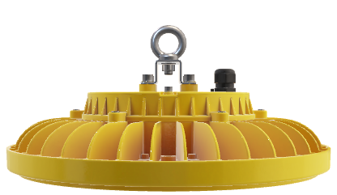
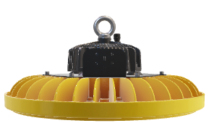
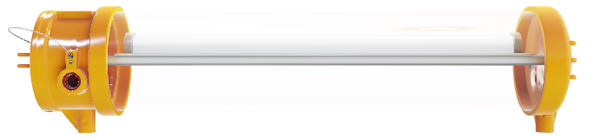
OREX LED
STRONGEX 2 LED
KRATEX LED
AQUEX LED

Slide 5
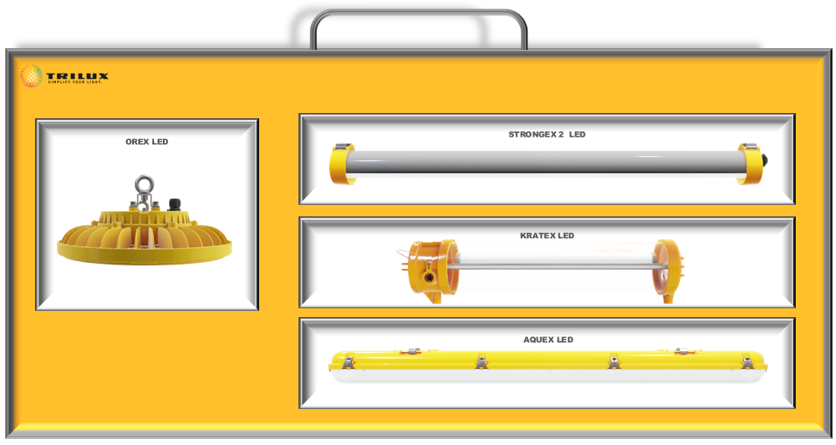
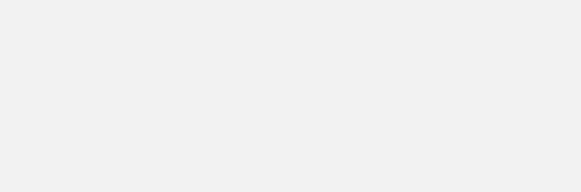
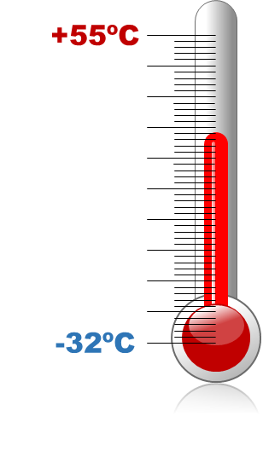

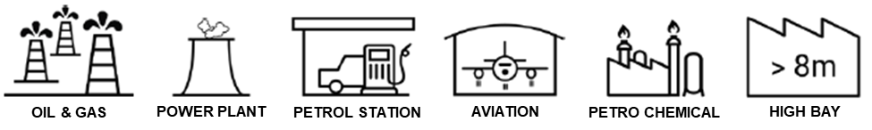
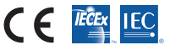
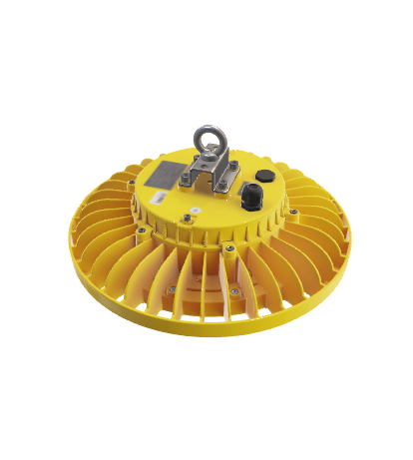
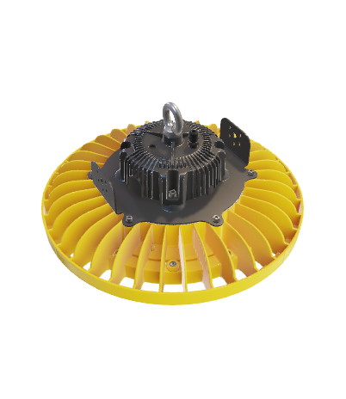
OREX 1 LED
Back to Sample Case
OREX LED
High bay solution for halls with explosion hazards
Suitable for outdoor
Extreme resistance to weather and tough industrial conditions thanks to its glass cover and aluminium housing
Wide voltage range driver suitable for industrial applications
DALI dimmable optional, and several mounting accesories and junction boxes
OREX 1 up to 20.000 lm
OREX 2 up to 40.000 lm
Zone 1, 21
II 2G Ex eb mb op is IIC T5 GB
II 2D Ex tc op is IIIC T105 Db
II 3G Ex ec op is IIC T5 Gb
II 3D Ex tc op is IIIC T105 Dc
OREX 2 LED
Zone 2, 21
Zone 2, 22
II 3D Ex tc op is IIIC TX Dc
II 3G Ex ec op is IIC TX Gc
II 2D Ex tb op is IIIC TX Db
IP 66/67
IK 10

Slide 6
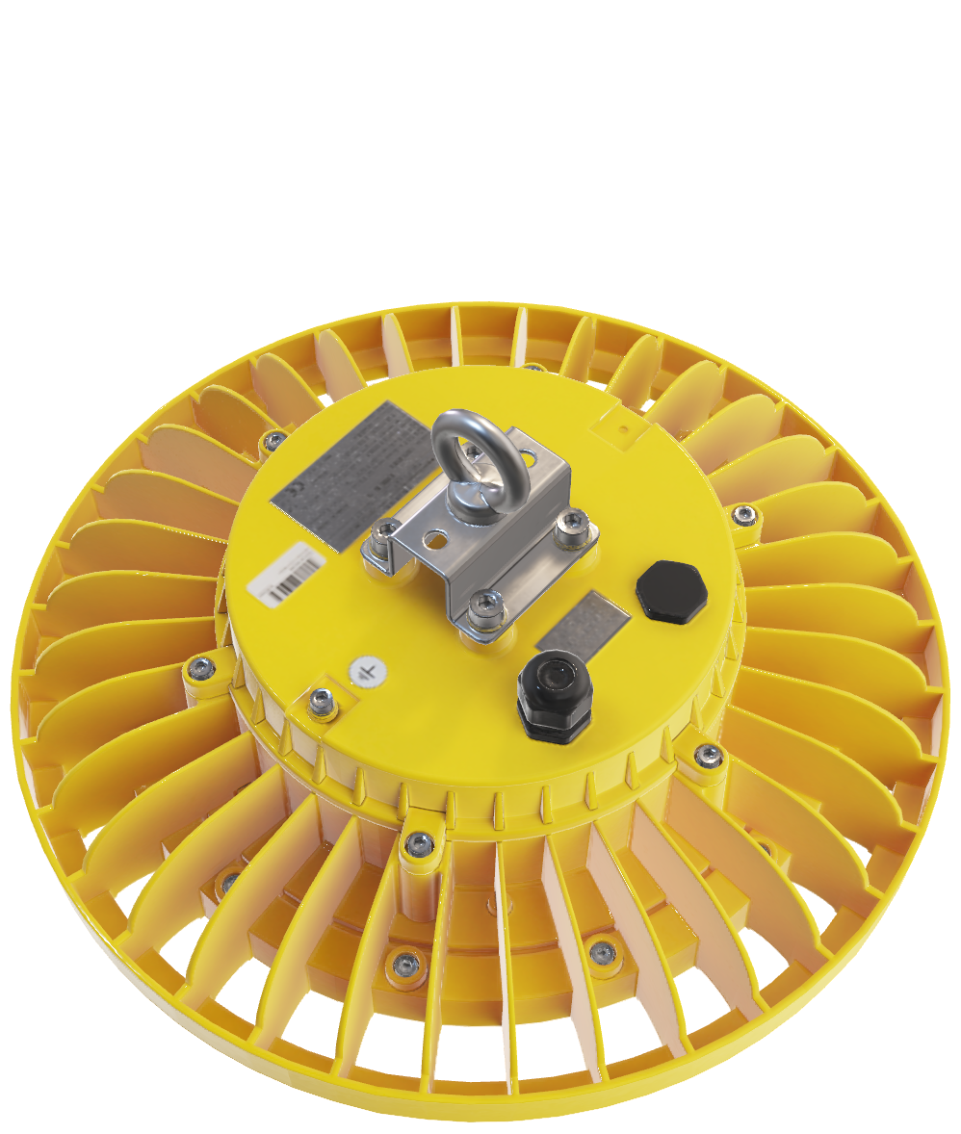
OREX 1 LED
Back to Sample Case
MOUNTING
Eyebolt made on SS 304
included and installed
ATEX directive 2014/34/EU
Zones 1 and 21
High resistance to industrial conditions
Eyebolt included and installed made of stainless steel 304 (optional 316)
IK08 impacts resistance
Surface protected against corrosive environments
IP66/67
High resistance materials, suitable for outdoor
HEAVY DUTY BRACKET
SS 304 to adapt all available Mounting Accessories
GASKET
IP67 Polyamide
(Also available of nickel brass and ready for armored cable)
CABLE GLAND
IP67 Polyamide
COOLING RIBS
Absorbs Heat up to 55° C
GROUND

Slide 7
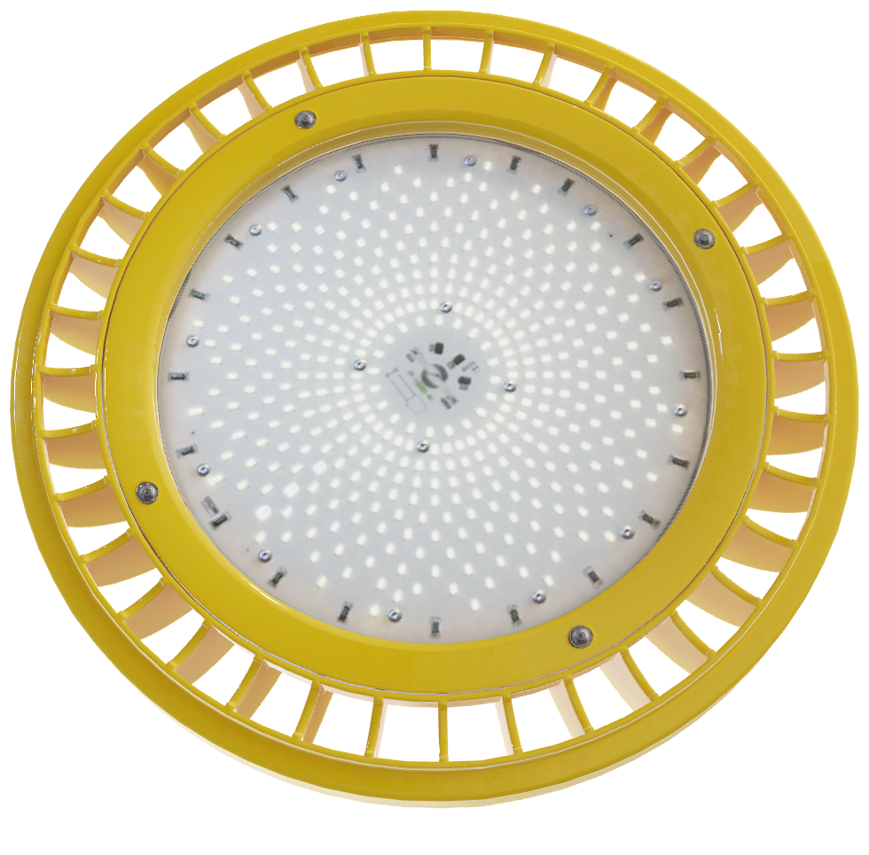
OREX 1 LED
Back to Sample Case
High performance
Luminous flux from 8.000 lm to 20.000 lm.
Up to 130 lm/W.
L80B10 70.000 h
Large selection of options
Light color: 4.500K, 5.000K and 6.500K.
CRI: CRI>80, CRI>90
Fast and easy installation via cable gland connection
DALI dimmable
External connections
Several accessories available
Wall mounting
Pole mounting
Tube mounting
Junction boxes
HEAVY DUTY HOUSING
Made of durable Aluminium
LED MODULE
Up to 20.000 lm
(with an efficiency up to 130 lm/W)
LED UNIT
With MB (encapsulation) ATEX Protection Mode.
COOLING RIBS
Absorbs Heat up to 55° C

Slide 8
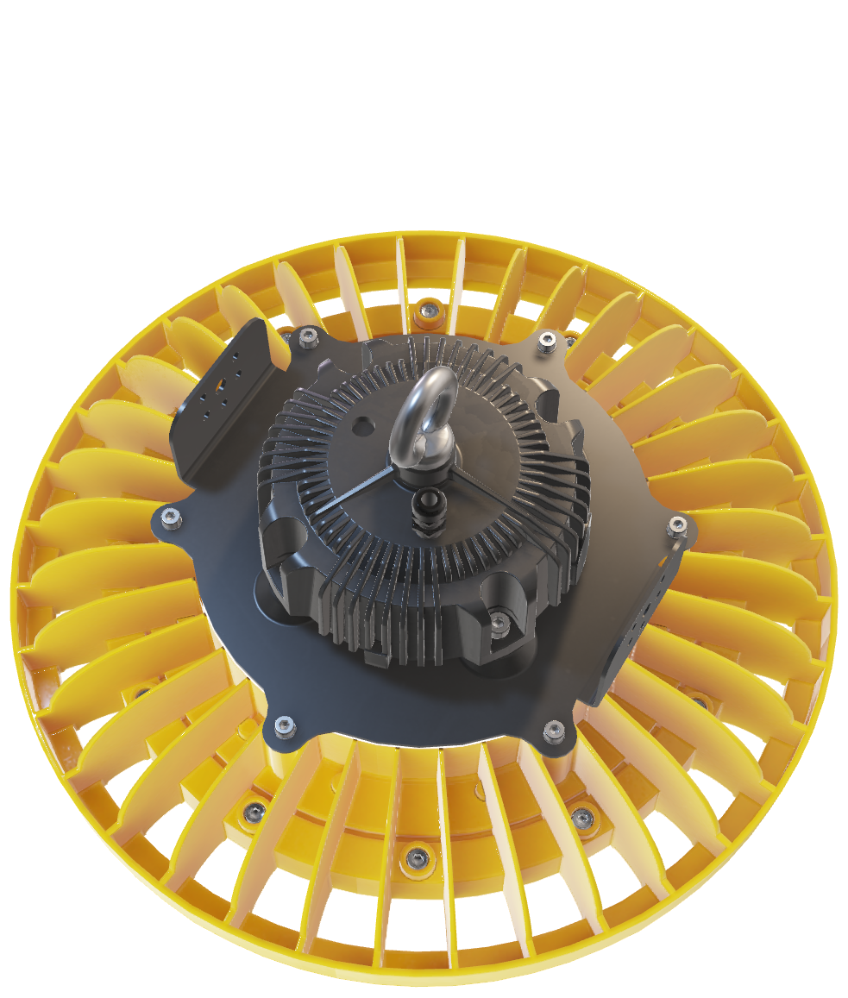
OREX 2 LED
Back to Sample Case
ATEX directive 2014/34/EU
Zones 2, 21 and 22.
High performance
Luminous flux from 8.000 lm to 39.500 lm.
Up to 145 lm/W.
L80B10 70.000 h
Large selection of options
Light color: 3.000K, 4.000K, 4.500K, 5.000K, 6.500K
CRI: CRI>80, CRI>90
Fast and easy installation via cable gland connection
DALI dimmable
External connections
Several accessories available
Wall mounting
Pole mounting
Tube mounting
Junction boxes
HEAVY DUTY BRACKET
SS 304 to adapt all available Mounting Accessories
HEAVY DUTY BRACKET
Eyebolt made on SS 304
CABLE GLAND
IP67 Polyamide
(Also available in nickel brass)
COOLING RIBS
Absorbs Heat up to 55° C
HEAVY DUTY HOUSING
Made of durable Aluminium

Slide 9

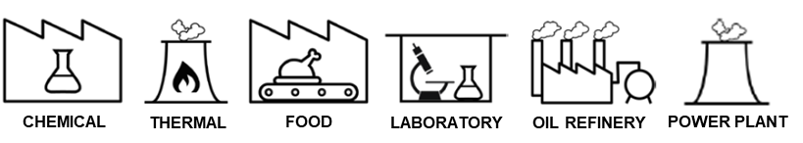
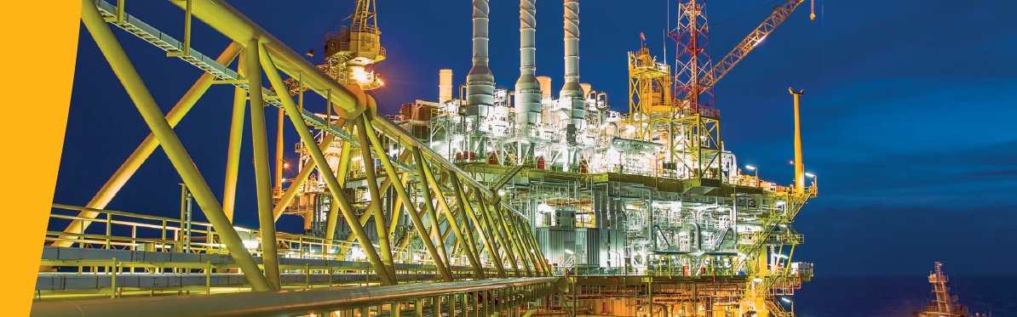
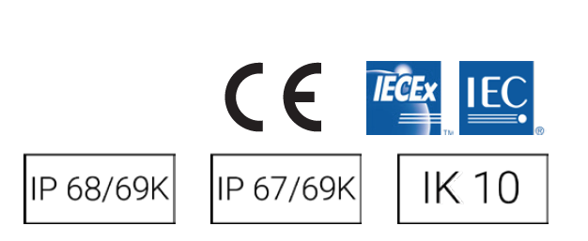
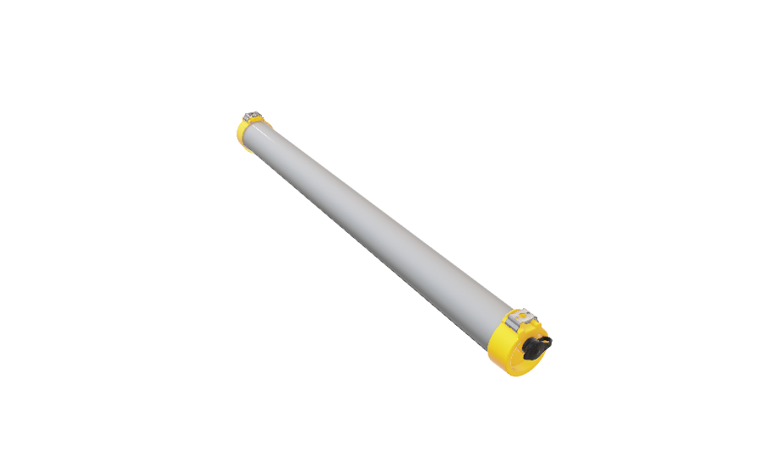
STRONGEX2 LED
Back to Sample Case
STRONGEX2 LED
Extreme robustness and resistance against impacts and chemical agents
High performance LED and driver, with extreme resistance to high temperatures up to 55ºC
Specific gas tigh potting to avoid the ingress and condensation of gases
Resistant to acids, sulphur vapours and salty environments
Suitable for outdoor without limitations
Surge protection of 4kV
Zone 2, 21 / 2, 22
II 3G Ex ec op is IIC T6 Gc
II 3D Ex tc op is IIIC T85 Dc
II 2D Ex tb op is IIIC T85 Db
IP 66/69k
IK 10

Slide 10
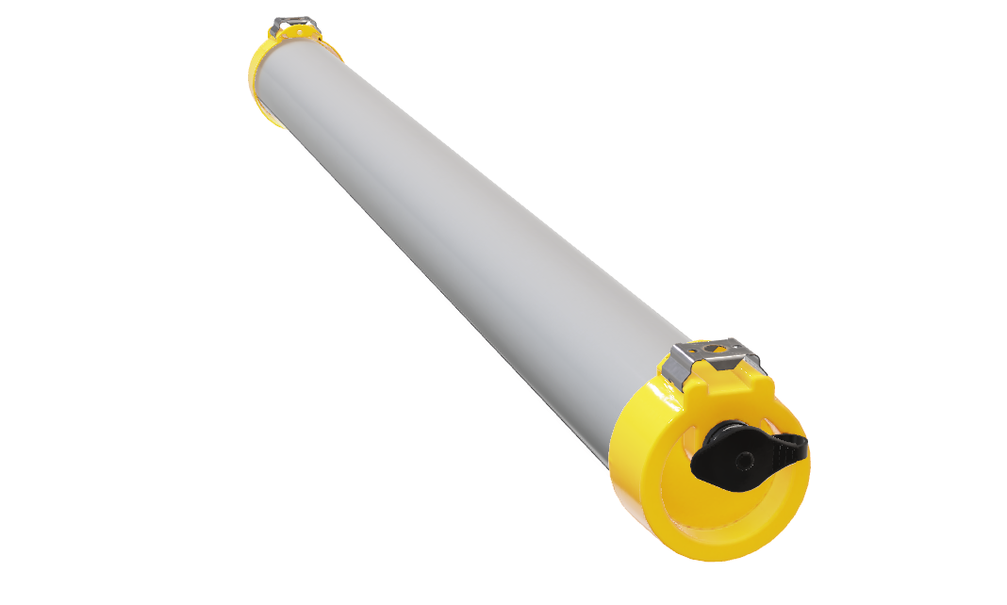
STRONGEX 2 LED
Back to Sample Case
ATEX directive 2014/34/EU
Zone 2, 21
Zone 2, 22
High resistance to almost all environments.
IK10 impacts resistance
PMMA body with high resistance to corrosive environments
IP66/69K
Endcaps made of PA66 and fiber glass, ready for outdoor
High versatility
Luminous flux from 1.200 lm to 6.500 lm
Up to 145 lm/W
L80B10 100.000h
3 different lengths 300, 600 and 1.200 mm
HIGH IMPACT TUBING
Special PMMA with IK10 Protection and complying with UL746C
ULTRA STRONG CLIPS
Mounting Clips made of SS301 & SS316
QUICK CONNECTOR
Made for ATEX Cable Requirements
OPTICS
Adaptable to Photometric Curve for different Requirements

Slide 11


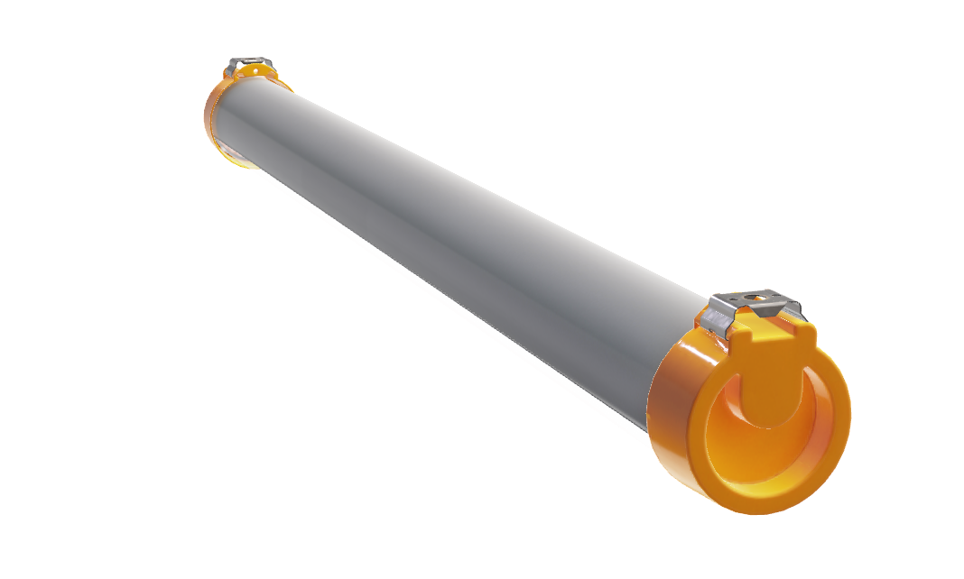
STRONGEX 2 LED
Back to Sample Case
Large selection of options
Light color: 3.000K, 4.000K, 5.000K, 6.500K
CRI: CRI>80, CRI>90
Fast and easy installation via cable gland connection or ATEX quick connector
DALI and BLE dimmable
Protection mode: GAS
Increased safety: “e” (Previously nA)
Ensures reliable prevention of unacceptably high temperatures and sparks or electrical arks
Protection mode: DUSTS
Restricted breathing: “t”
Sealed tight, that no combustible dust can enter
Minimum degree of protection in accordance with IEC/EN 60529 ≥ IP 6X
VARIOUS COLOURS
PMMA tube available in Grey & Transparent Color, and in Opal Color
ELECTRICAL CONNECTION
(Through an ATEX cable gland with high resistance cable included or through an ATEX quick connector to use the cable on requirements)
HEAVY DUTY END CAPS
Made of Polyamide with Fiber Glass to resist Impacts and very harsh Chemical Environments

Slide 12
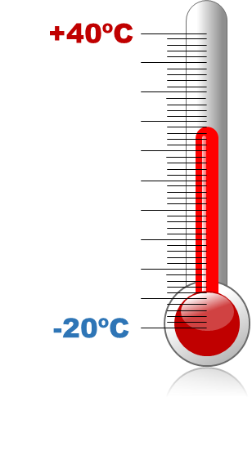

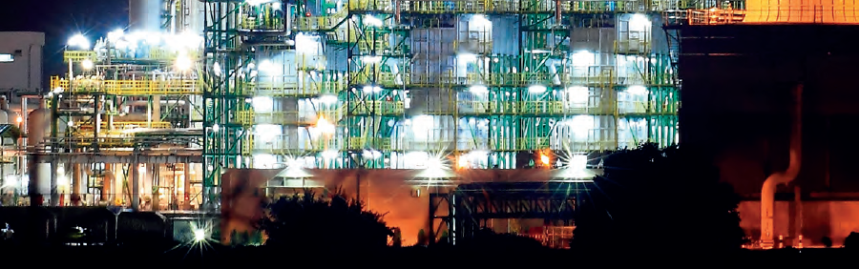
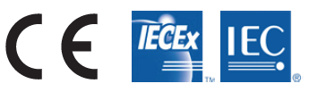
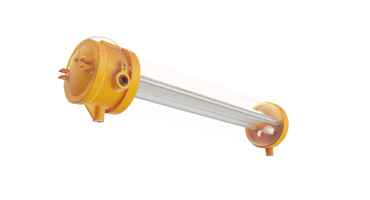
KRATEX LED
Back to Sample Case
KRATEX LED
Connected lighting with a wide range of options for ATEX projects
Suitable for the hottest environments up to 55ºC, even outdoors
Compliant with gas groups IIA, IIB, IIC, due to its reduced MESG, making it perfect for almost all ATEX environments
DALI dimmable to optimize the use of the light and save energy
Intelligent wireless control optional
Zone 1, 21
II G Ex db IIC T6 Gb
II 2D Ex tb IIIC T85 Db
IP 66
IK 10
IK 07 / IK 09

Slide 13
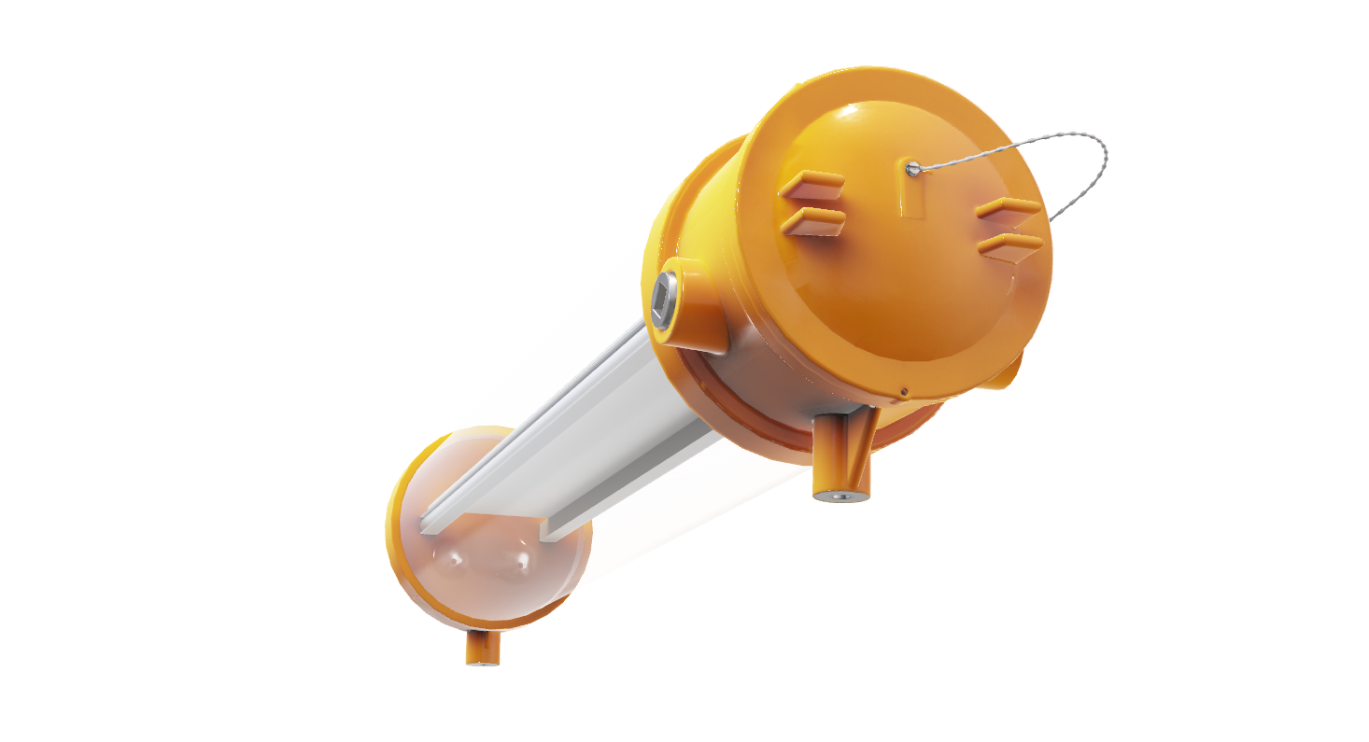
KRATEX LED
Back to Sample Case
GLASS HOUSING
UV-Resistant Polycarbonate IK10 or
Borosilicate Glass
ATEX directive 2014/34/EU
Zone 1
Zone 21
Highest resistance for ATEX environments.
Compliant with gas groups IIA, IIB, IIC, due to its reduced MESG
Protection mode “DB”, making it explosionproof and flameproof
Temperature class T6 / T85ºC
NK class approved
High performance and protection.
Suitable for the hottest environments up to 55ºC, even outdoors
Output flux up to 11.750 lm
IK10 housing for PC version and IK09 for the glass one
DALI and BLE dimmable
MOUNTING
Mounting Holes ready to install Hook or fixing Omegas
ATEX METALLIC STOPPER
Provides Protection and can be removed for Through-Wiring
CAPSULE
Aluminum Alloy End Caps with Polyurethane Surface in RAL 1003

Slide 14
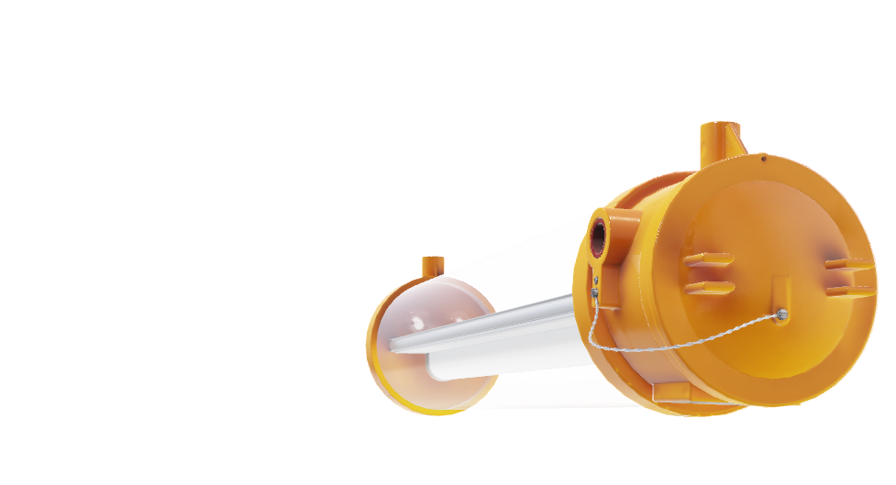
KRATEX LED
Back to Sample Case
DIFFUSER
Internal opalised Diffuser to avoid Glare
High versatility
Luminous flux from 2.500 lm to 11.750 lm including DALI versions
Emergency kit versions, for 1 and 3 hours
Through-Wiring
2 different lengths 700 and 1.300 mm
Protection mode: GAS
Flameproof enclosure: “d”
Parts which could ignite an explosive atmosphere are located inside an enclosure which can withstand the pressure of an explosion of the explosive mixture inside
Prevents the transmission of the explosion to the explosive atmosphere surrounding the enclosure
LED MODULE
With 50.000h Lifetime, an Efficiency of up to 150 lm/W and 11.750 lm.
CABLE ENTRY
3/4" NPT ready for double sealed EX Cable Glands

Slide 15
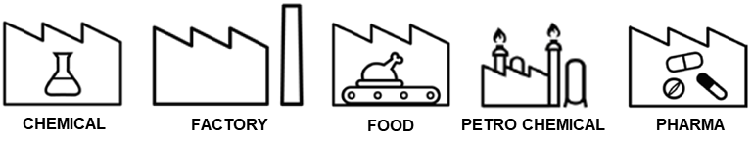
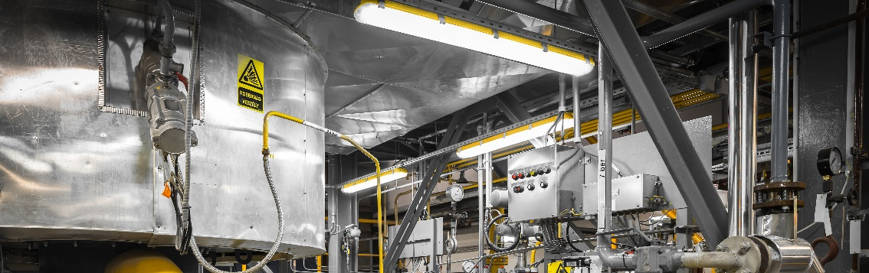
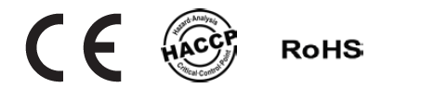
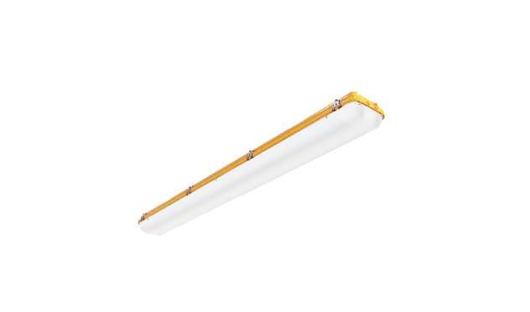
ACQUEX LED
Back to Sample Case
ACQUEX LED
Simply, safe and reliable for explosive atmospheres in Zone 2, 22
Safe installation thanks to its internal diffuser which avoids direct contact with the LED module
Outstanding impact resistance IK10
Emergency kit optional
Quick, easy and safe mounting on ceiling on wall
Zone 2, 22
II 3G Ex nA IIC T6 Gc
II 3D Ex tc IIIC T85 Dc IP66
IP 66
IK 10

Slide 16
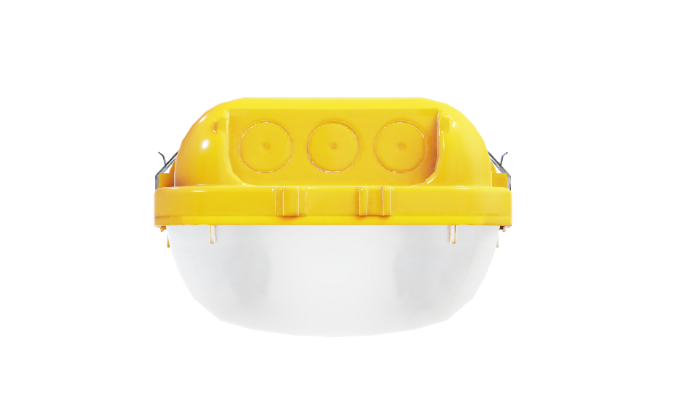
ACQUEX LED
Back to Sample Case
PRE-DRILLED HOLES
IP66 and M20/M25 for Power Connection
ATEX directive 2014/34/EU
Zone 2
Zone 22
High Quality Materials
Diffuser: reinforced PC diffuser (IK10) with prismatic design for an optimum light distribution
Housing: high impact compressed fiber glass reinforced polyester
Gasket: polyurethane, poured in one piece
Features substantially improved
Up to 150 lm/W
Up to 8.000 lm
Temperature range: (-20ºC to 40ºC)
DALI2 regulation
Emergency battery, 1 or 3 hours
LOCKING CLIPS
Made of durable Stainless Steel
DIFFUSER
Sturdy IK10 reinforced PC
LED MODULE
LED Modules with 100.000h Lifetime and an Efficiency of up to 155 lm/W.

Slide 17
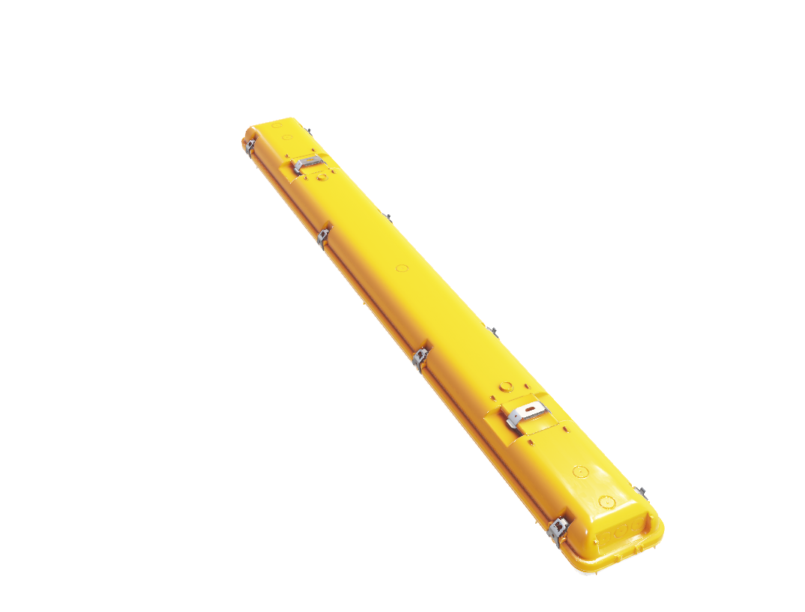
ACQUEX LED
Back to Sample Case
ULTRA STRONG CLIPS
Mounting Clips made of durable Stainless Steel
Quick, easy and safe mounting
Ready to be installed in ceiling or wall mounting
Stainless steel fixing brackets included
Fast and easy installation via cable gland connection
3 lengths: 600 mm, 1.200 mm, 1.500 mm
Protection mode: DUSTS
Restricted breathing: “t”
sealed tight, that no combustible dust can enter
Minimum degree of protection in accordance with IEC/EN 60529 ≥ IP 6X
PRE-DRILLED HOLES
IP66 and M20/M25 for Power Installation on the Top of the Housing
STURDY HOUSING
Pressed Fiber Glass reinforced Polyester in RAL 1003
ULTRA STRONG BRACKETS
Stainless Steel Brackets made of SS 301 (V2A) or SS316 (V4A).

Slide 18
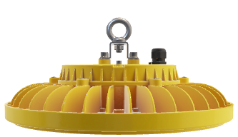
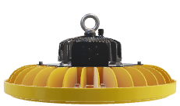

OREX LED
STRONGEX 2 LED
KRATEX LED
AQUEX LED

Slide 19
THANK YOU www.trilux.com

