Slide 1
WELCOME AT TRILUX www.trilux.com

Slide 2
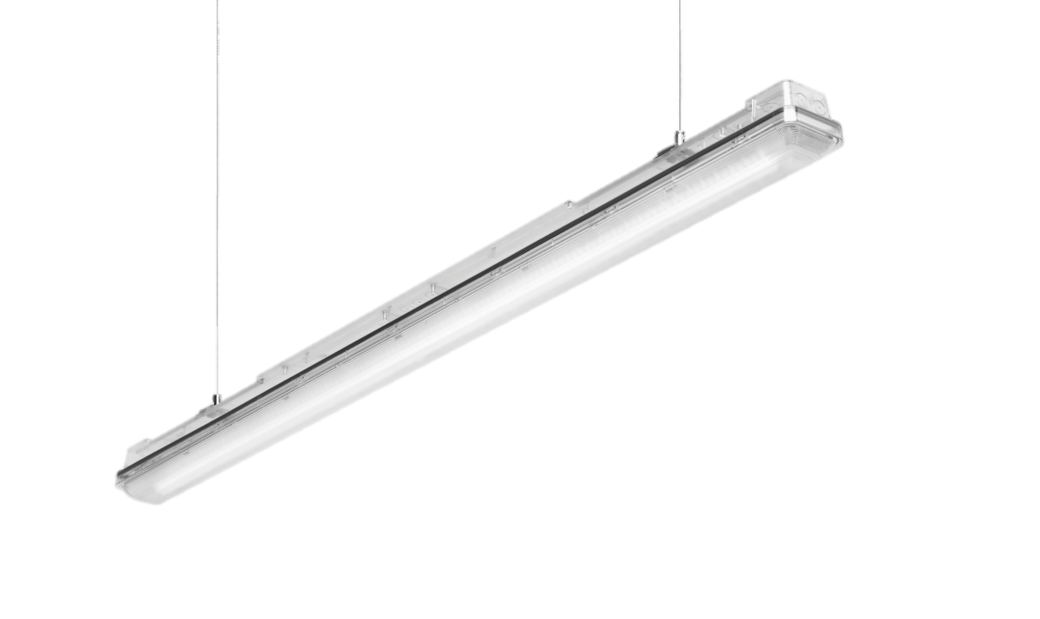
Aragon fit LED
pro-level efficiency, quality and intelligence

Slide 3
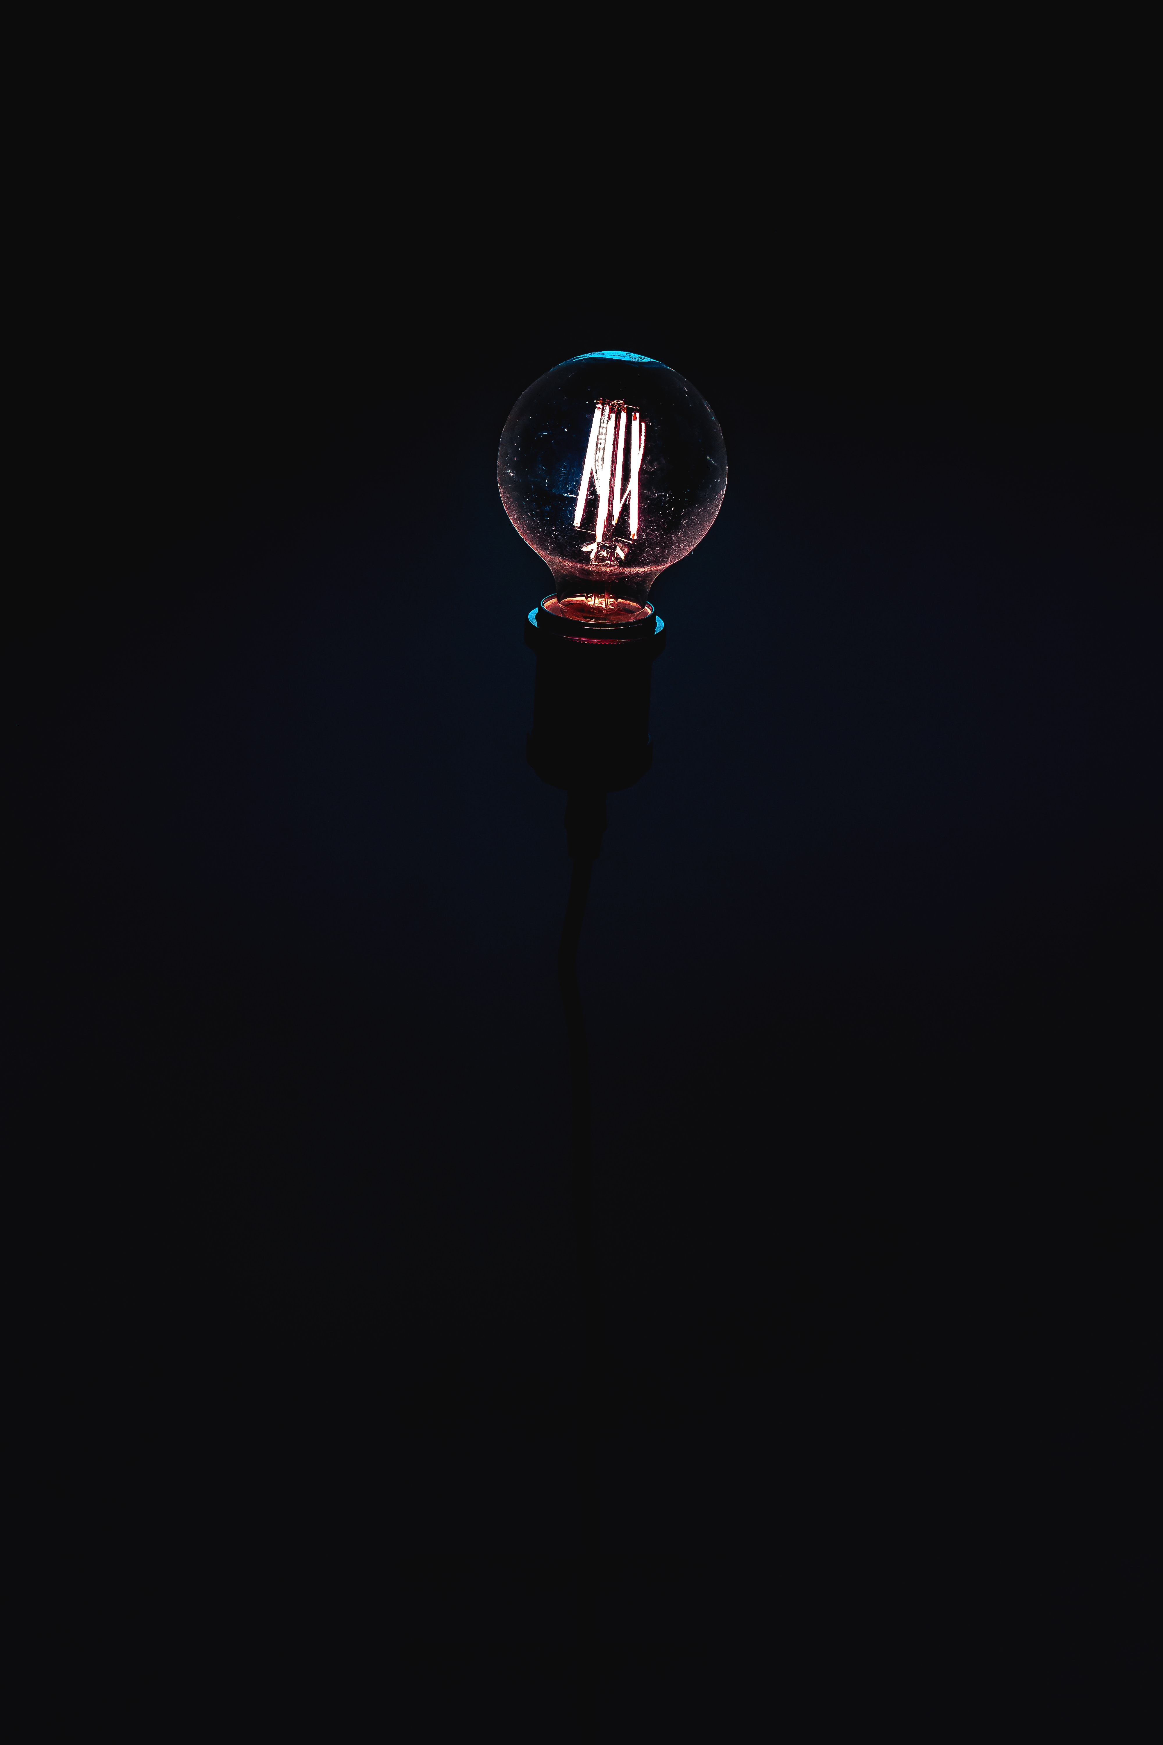
The challenge
Weather-proof luminaires still primarily need to comply with economic criteria. At the same time, the demands made on quality of light, functionality, design and connectivity have grown considerably – for example in car parks or in the food industry.

Slide 4
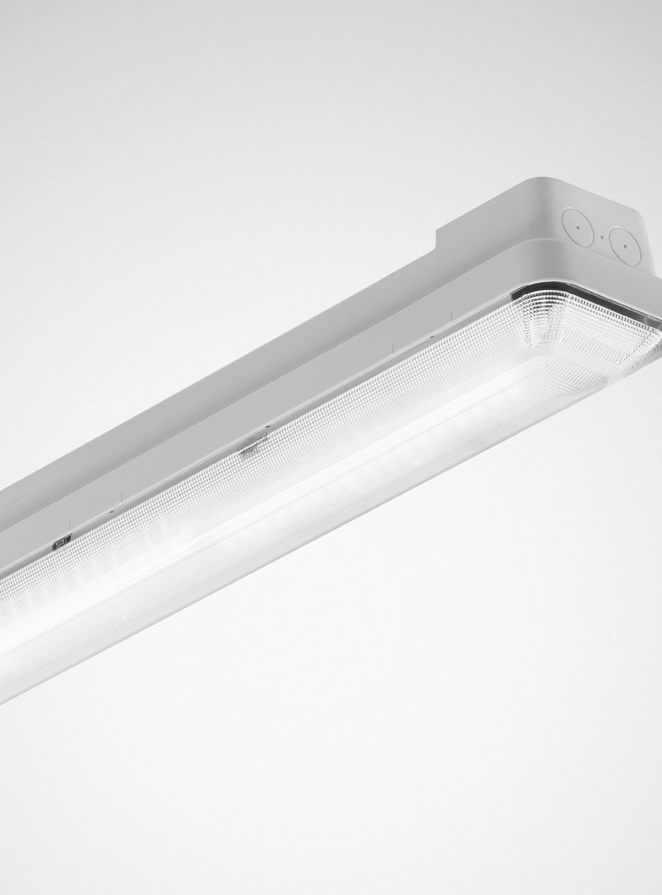
THE SOLUTION
Aragon Fit LED raises the standard of weather-proof luminaires to a new level. As well as significant improvements in quality of light and efficiency, the system has been considerably modularised: a wide range of optics, precisely configurable luminous flux packages and a large number of variants make it possible to offer tailor-made solutions for any application. Furthermore: Aragon Fit LED can be controlled via sensors and networked with the LiveLink light management system. Thanks to the well thought-out mounting and packaging concept, refurbishment projects are completed in a flash.

Slide 5
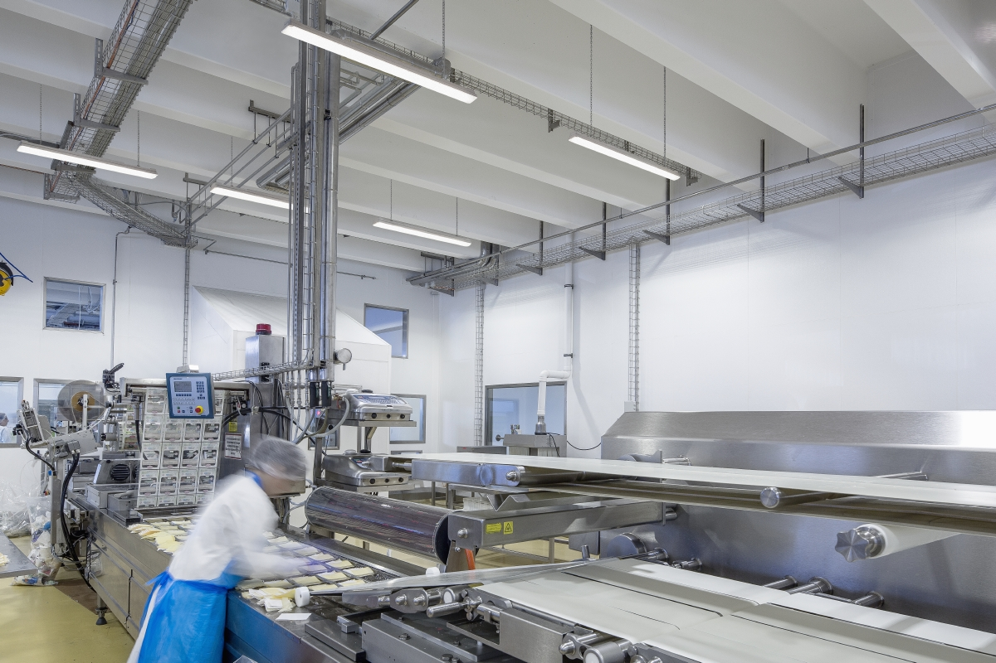
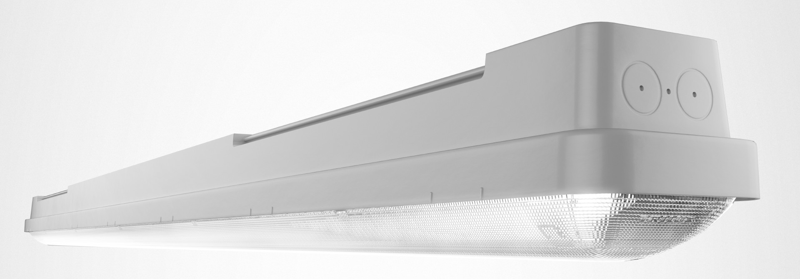
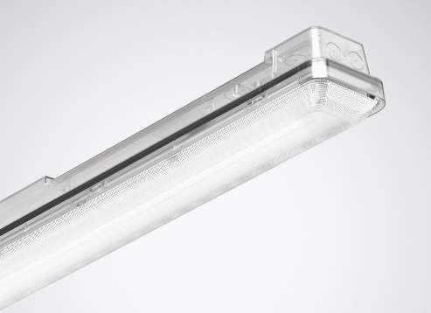
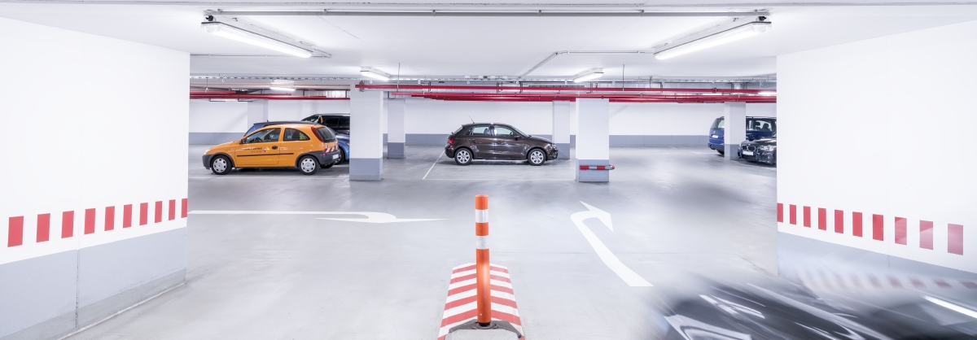
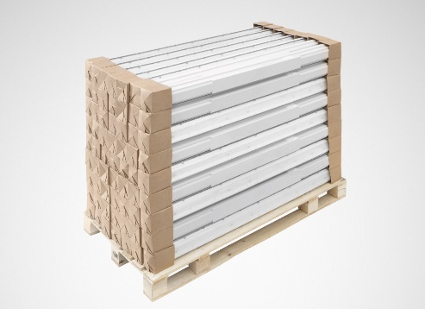

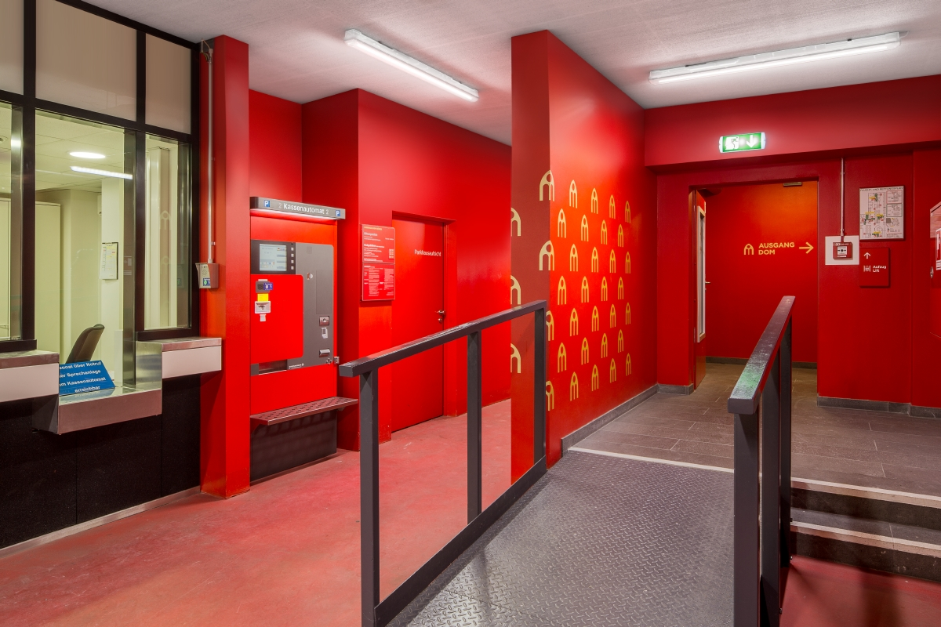
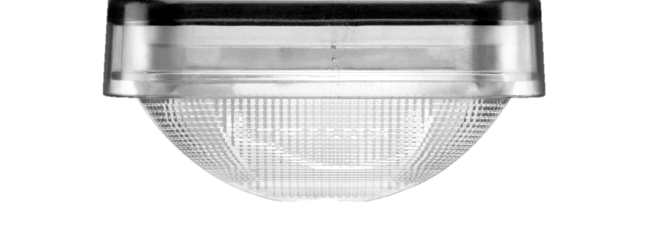

Slide 6
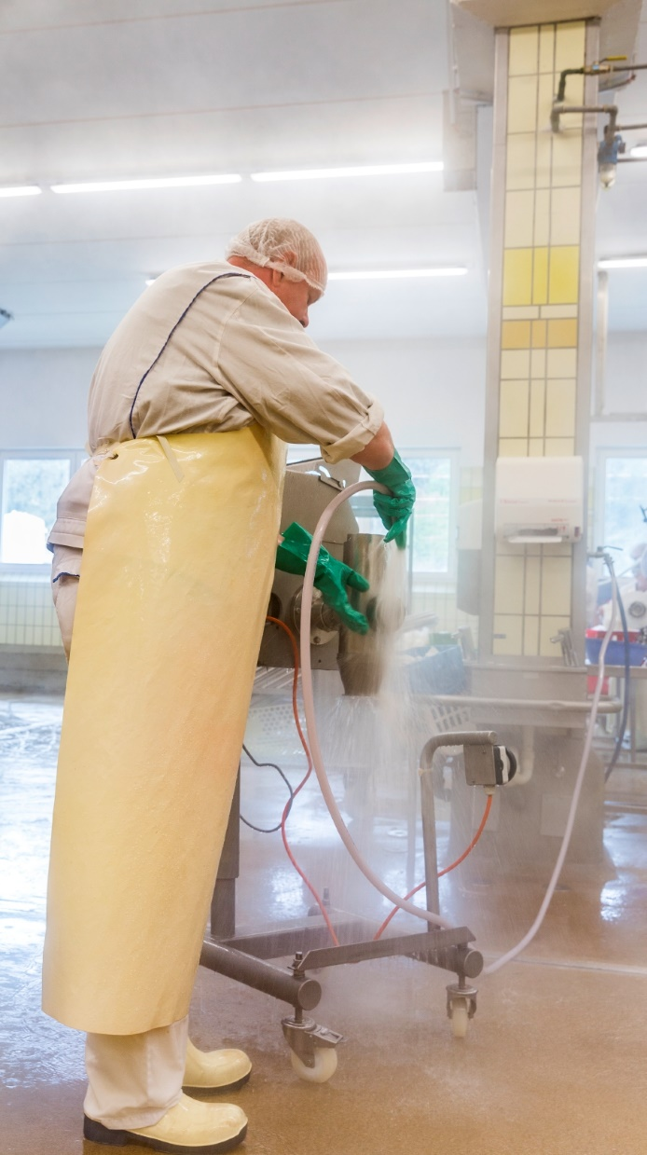
Advantages in lighting design
Allow me: Your specialist for challenging environments
Aragon Fit LED was designed specifically for use in challenging surroundings. The luminaire is ideal e.g. for illuminating car parks, damp rooms in the food industry, canopied outdoor areas and areas with an adverse atmosphere.

Slide 7
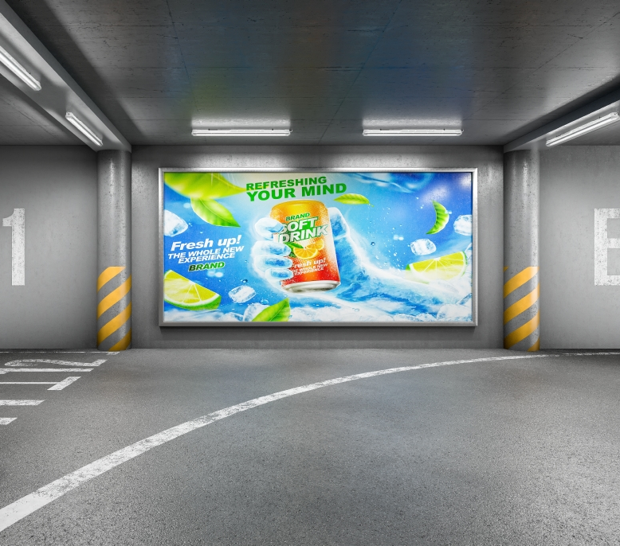
Advantages in lighting design
Wide modular range of optics – always the right light distribution
Thanks to a wide selection of special optics and lumen packages, various applications can now be illuminated even better. Five optics are available, ranging from narrow to extremely wide distribution. There is also an asymmetric optic – perfect e.g. for payment areas or illuminating signs and posters in multi-storey car parks. An intuitively used comparison calculator minimises the effort involved in selecting and calculating the optimum number of luminaires.

Slide 8

Advantages in lighting design
A new luminaire for new standards
The new DIN 67528 standard for "Lighting in public car-parks and on public off-street parking spaces" has tightened the lighting requirements, e.g. regarding uniformity and glare control. This is no problem for Aragon Fit LED when fitted with the special car park optic.

Slide 9

Advantages in lighting design
Interchangeable components – less effort, more flexibility and sustainability
Thanks to the modular design, individual components of the luminaires can be quickly and easily exchanged. This enables particularly simple, low-cost maintenance and makes Aragon Fit LED extremely flexible: if the lighting requirements change – e. g. due to a change in use of the room – only the corresponding components need to be exchanged. The result: lower costs and greater sustainability.

Slide 10
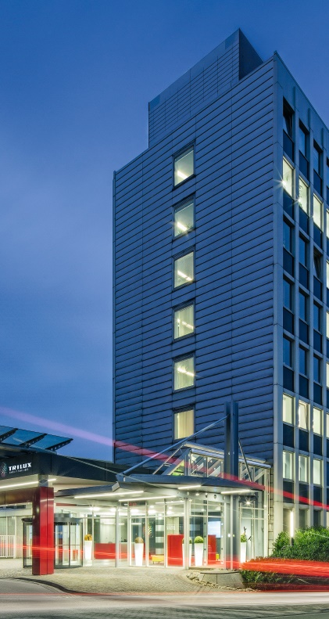
Advantages in lighting design
SOF – special solutions in sight
Higher efficiency or longer service life? Special emergency light modules? Or intelligent IoT applications such as beacons or Wi-Fi repeaters? No problem at all: due to the high vertical range of manufacture, TRILUX can also manufacture weather-proof luminaires according to individual specifications if required. Quick, simple and safe.

Slide 11


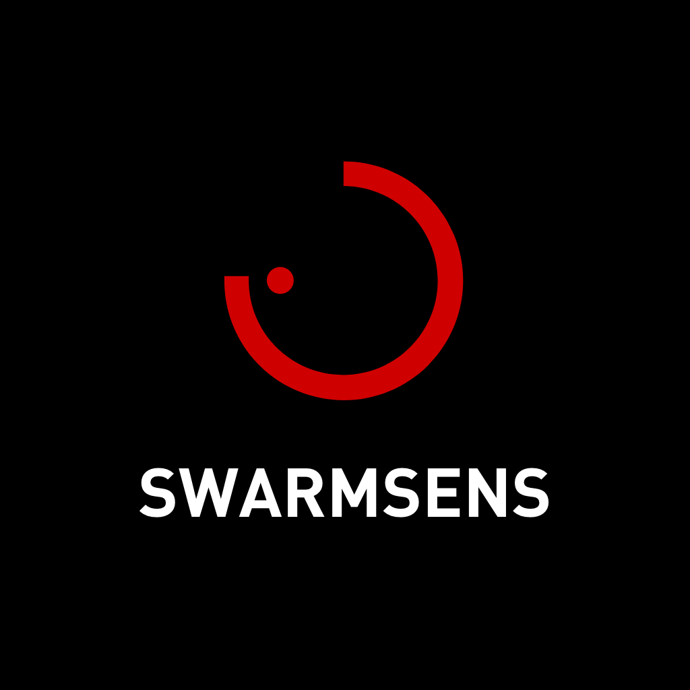
BENEFITS DURING INSTALLATION
If there are no control lines – dimming by radio refurbishment
Dimmable DALI luminaires require five-core control cables. If only three-core cables are routed in damp rooms, radio refurbishment via LiveLink is the alternative. This allows Aragon Fit LED to receive the control signals simply via radio even without complex rebuilding measures.

Slide 12
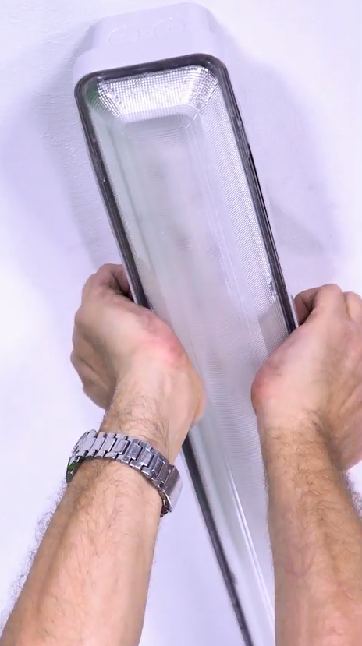
BENEFITS DURING INSTALLATION
Clipless mounting – fast and easy
Time is money. For this reason, the luminaire is supplied completely pre-assembled and can be mounted to the ceiling by the installer in a single step. Intelligent: clip-free mounting accelerates the installation process by up to 33 percent. This is also a visual gain, because the appearance is not affected by clips.

Slide 13
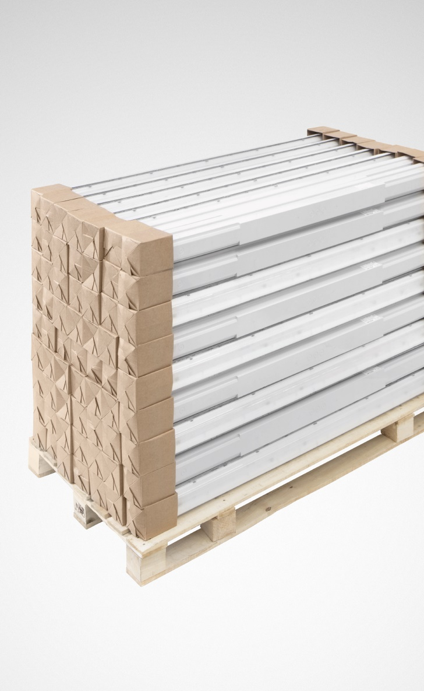
BENEFITS DURING INSTALLATION
Packaging optimised – more time and less waste
On request, Aragon Fit LED can be delivered to the construction site in packaging-optimised containers. You can choose between a box of 15 or a pallet of 63, which are packed completely free of styrofoam. This accelerates mounting by up to 50 percent and reduces the amount of rubbish generated by up to 68 percent.

Slide 14
BENEFITS DURING INSTALLATION
Multi-lumen – luminous flux adjusted on site
The Aragon Fit LED lumen packages can be flexibly adjusted on the control gear unit. This offers maximum flexibility for on-site installation. It also simplifies ordering and warehousing because only one variant needs to be stocked.

Slide 15

ADVANTAGES IN OPERATION
Market-leading efficiency for low operating costs
With energy efficiency of up to 170 lm/W, Aragon Fit LED once again raises the bar even higher for weather-proof luminaires. Together with a long service life, it is particularly attractive from an economic point of view

Slide 16
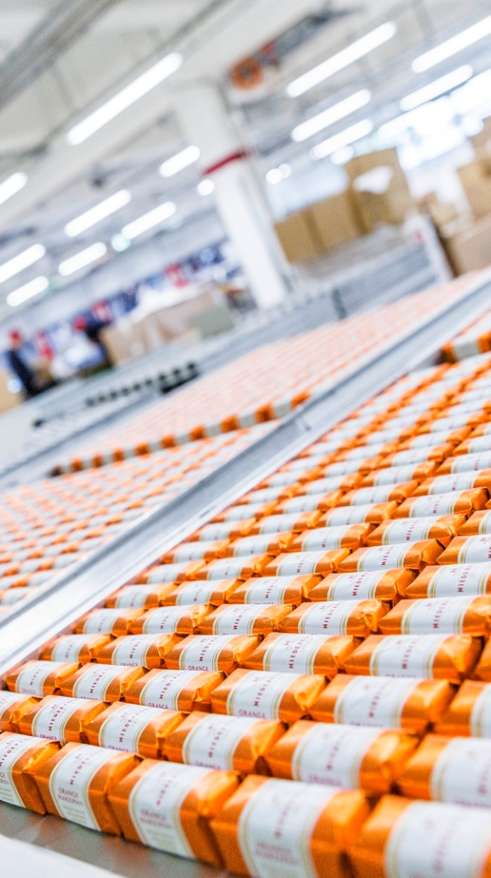
ADVANTAGES IN OPERATION
Outstanding quality of light
Aragon Fit LED scores points with its excellent quality of light. The light is pleasantly free of glare and with CRI90 ensures natural colour rendering – important, e.g., when used in the food industry.

Slide 17
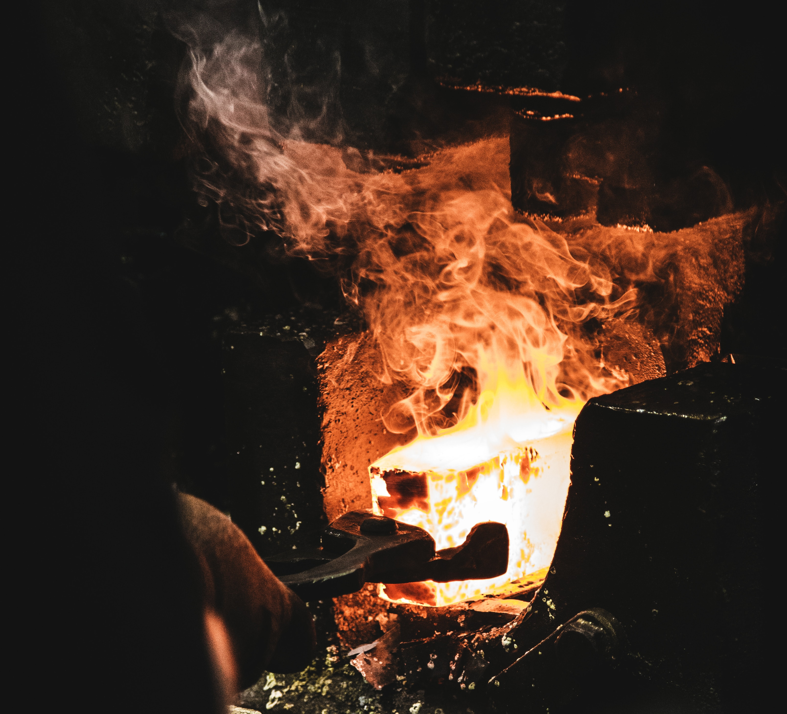

ADVANTAGES IN OPERATION
A temperature specialist – created for extremes
For use in extreme temperatures, Aragon Fit LED is optionally available as an LT (low temperature) version for cold stores and as an HT (high temperature) version for particularly hot environments, e.g. in production halls or under hall roofs.

Slide 18
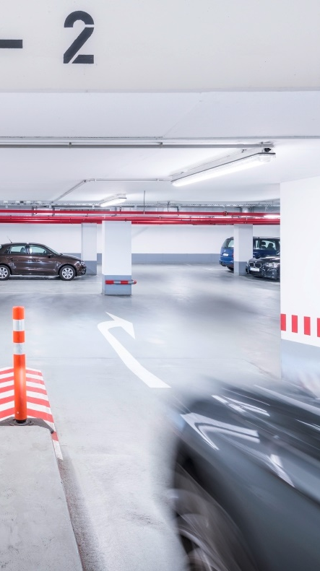
ADVANTAGES IN OPERATION
Dimmability – required, delivered
With dimmable sensor-controlled luminaires, energy consumption can be minimised – an option that was previously unused in many damp rooms due to the lack of control cables. This is a gap covered by Aragon Fit LED thanks to the radio refurbishment.

Slide 19
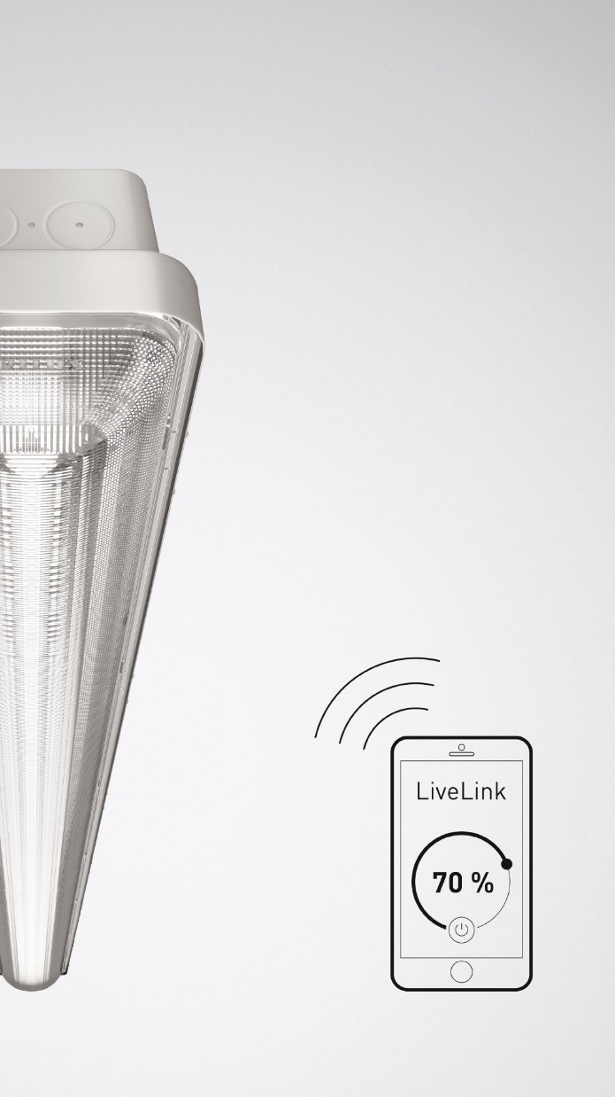
ADVANTAGES IN OPERATION
Network-capable – predictive maintenance
On request, the luminaires can be networked via LiveLink and integrated into the cloud. This enables particularly convenient control and monitoring of the lighting system, as well as services such as predictive maintenance.

Slide 20

ADVANTAGES IN OPERATION
Swarm intelligence – perfect coordination
The luminaires can be networked via the LiveLink light management system and combined into functional groups. In this way, applications such as running light in multi-storey car parks can be installed.

Slide 21
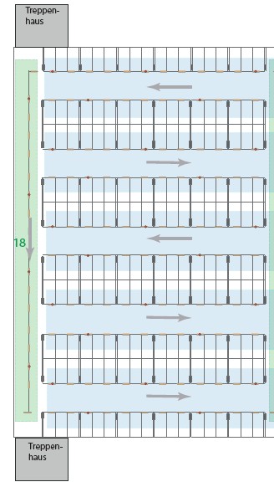
ADVANTAGES IN OPERATION
6
1
Saving energy with control of small groups
Small groups, big advantage: with LiveLink, the luminaires can be combined into small groups. This enables very precise and energy-saving control via sensors: if a presence sensor detects a person then only the connected DALI group is activated, but not all luminaires in the room.
2
3
4
5

Slide 22

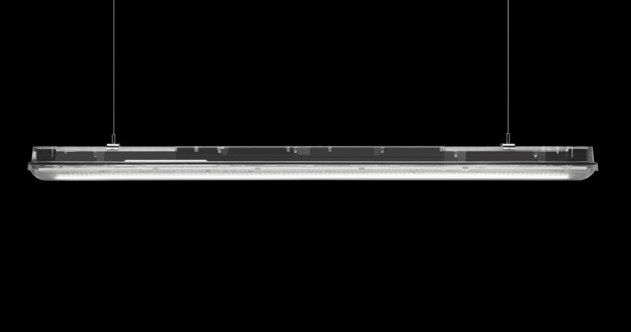
ADVANTAGES IN OPERATION
More safety and comfort – indirect light, direct benefits
The Aragon Fit LED variant with a translucent housing has an indirect light component of 15 percent. This not only increases safety and comfort. The brightening of the ceiling also brings more style into the rooms.

Slide 23
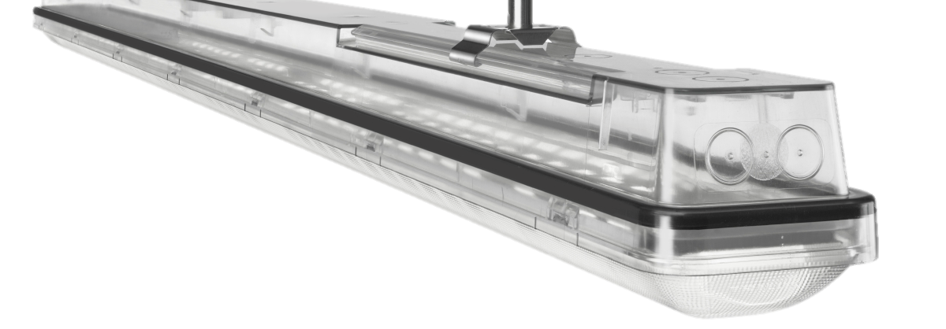
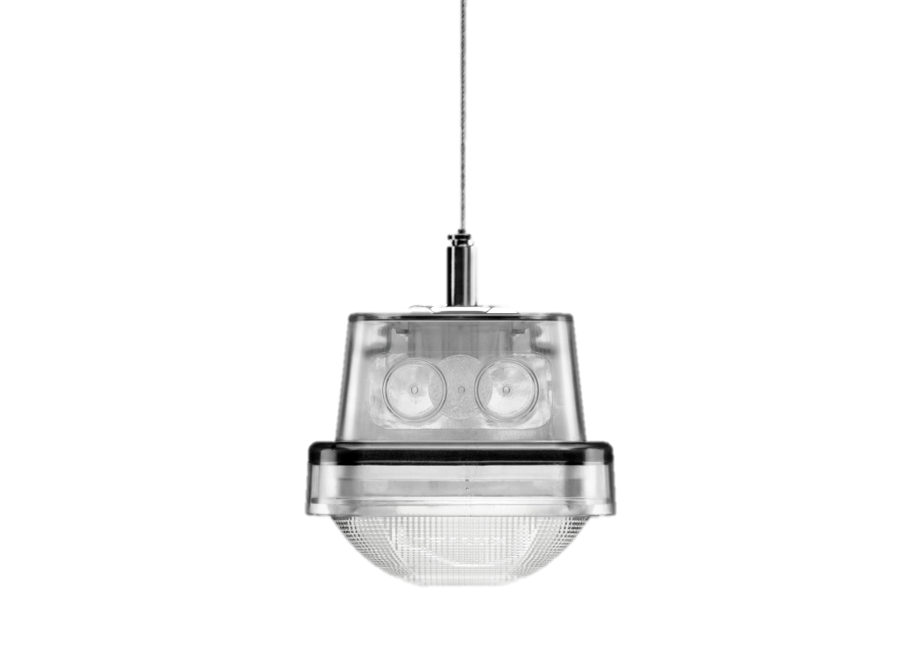
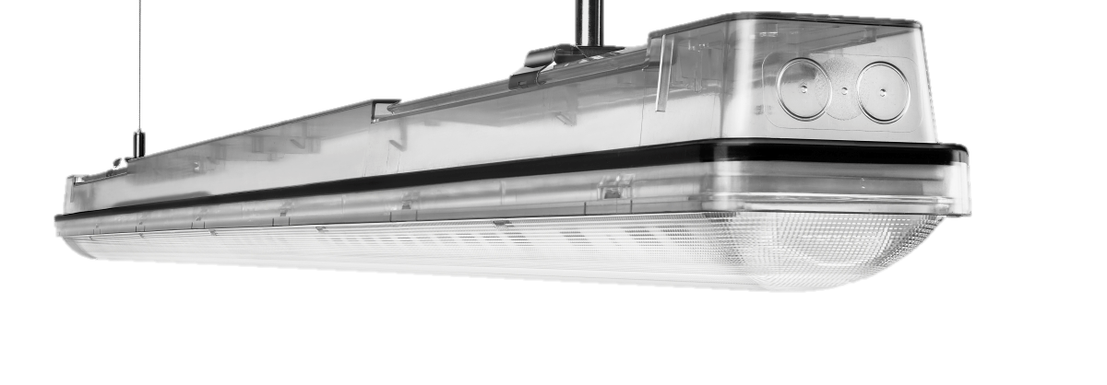
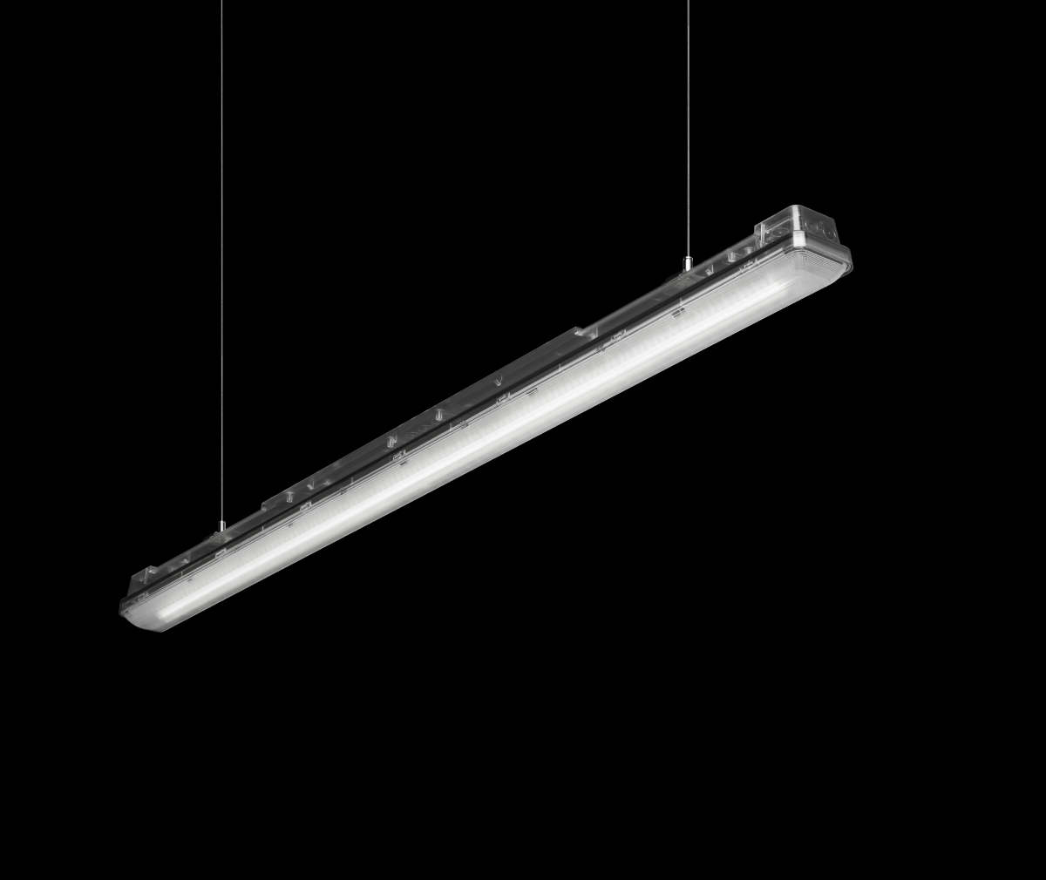
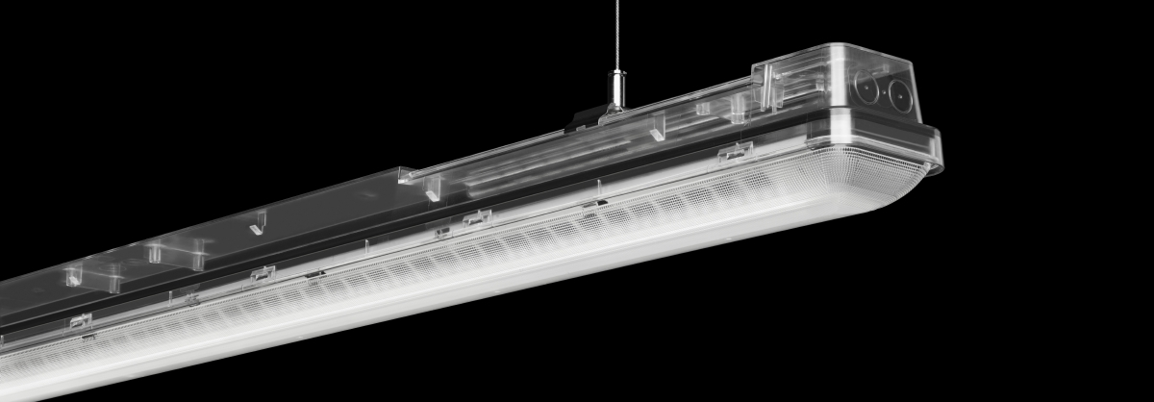
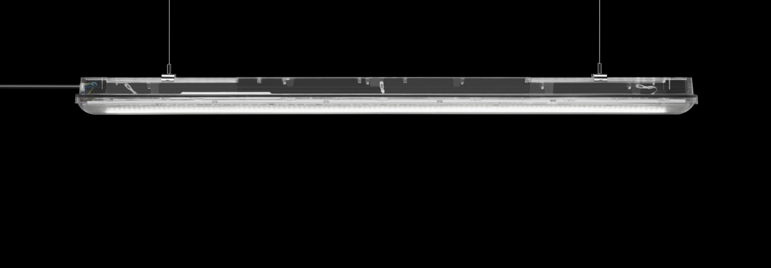

Slide 24
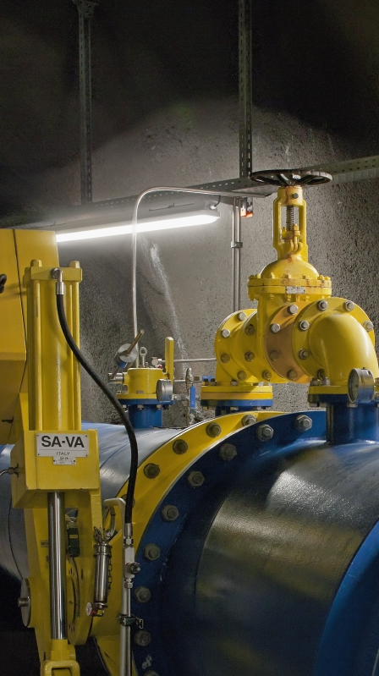
ADVANTAGES IN OPERATION
Flexibility – everything modified and exchanged in a flash
Optic, control gear unit, gear tray, sensors – thanks to the modular design, all components can be replaced quickly and flexibly even after the mounting process. This makes maintenance easier, offers maximum flexibility e.g. when the room is used differently, and is particularly sustainable.

Slide 25

ADVANTAGES IN OPERATION
Nice and clean – the housing is optimised for cleaning
Hygiene is a must, especially in the food industry. The housing of Aragon Fit LED can be cleaned quickly and reliably and is permanently resistant to a variety of cleaning agents.

Slide 26

ADVANTAGES IN OPERATION
From consulting to maintenance – all from a single source
As a full-service provider, TRILUX is the central contact for lighting. With the broadly diversified and modular service portfolio, customers can place their entire process into the hands of TRILUX – and continue to concentrate on their core areas of expertise. Tailor-made special solutions are also available.

Slide 27

LIGHTING DESIGNERS
Aragon Fit LED is a real all-rounder that can be flexibly adapted to the wide range of applications thanks to its many variants and large kit of optics. The weather-proof luminaire also features excellent quality of light and maximum efficiency. An intelligent comparison calculator helps with luminaire selection and minimises the complexity of the lighting design.

Slide 28
ELECTRICAL CONTRACTORS
Clipless mounting in a single work step, flexible adjustment of luminous flux on site, optional radio refurbishment and packaging-optimised containers: Aragon Fit LED is particularly quick and easy to install thanks to a holistic, well thought-out mounting concept and many clever features.

Slide 29
END CUSTOMERS / OPERATORS
Excellent light, minimum costs and maximum possibilities: Aragon Fit LED scores points thanks to its wide range of variants and perfectly illuminated rooms – and achieves minimal operating costs thanks to maximum efficiency and a long service life. The networking via LiveLink opens up new options for convenient control and monitoring of the lighting installation.

Slide 30
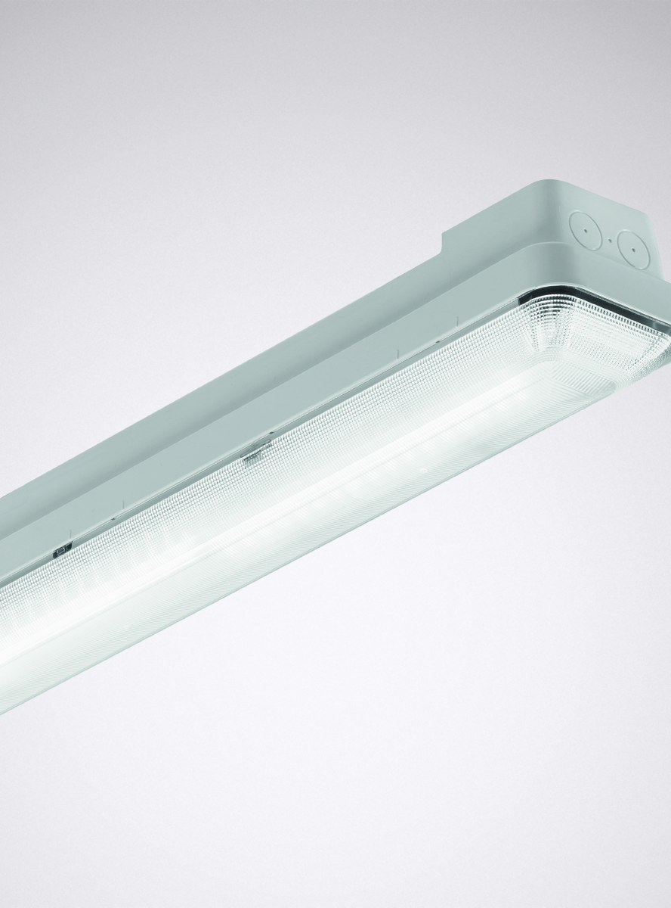
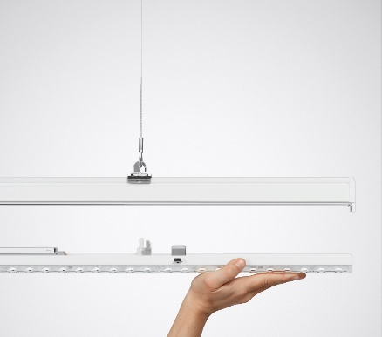
Technical features
Energy efficiency: | up to 170 lm/W
Lumen packages: | 2,000 lm – 10,000 lm
Service life: | L80 50,000 h tq 35 ºC L80 70,000 h tq 25°C Special LT/HT variants: -40° C to +50° C
Colour rendering / colour temperatures: | 4,000 K 6,500 K HCL: optional
Light distribution: | P-W (wide distribution), P-N (narrow distribution), P-VW (very wide distribution), P-XW (extremely wide distribution), P-AW (asymmetric distribution)
Electrical version: | ET, ETDD, Mulitlumen, CLO optional
Protection rating | safety class: | IP66 PMMA: IK03 PC: IK08
Sensor technology | HFS, HFSB / HFSX
Control | Swarm intelligence LiveLink: control, monitoring + Special LiveLink Wi-Fi radio refurbishment solution
Luminaire colour: | Light grey, similar to RAL 7035 / translucent

Slide 31
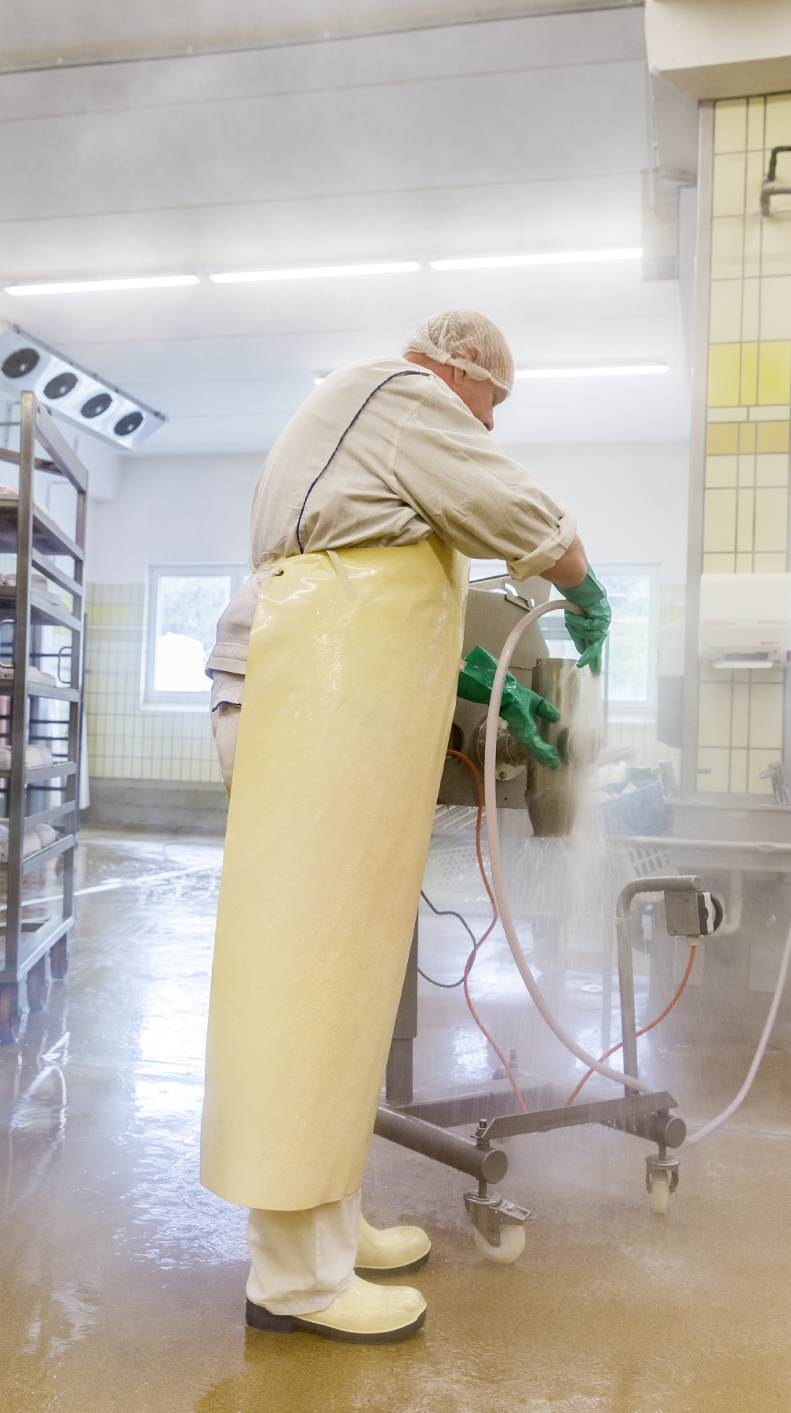
Application INDUStry
The new level for weather-proof luminaires: Aragon Fit LED combines the highest quality of light and efficiency, and can be perfectly adapted to on-site requirements thanks to its modular design. To achieve minimum energy consumption and maximum convenience the luminaires can be quickly and easily networked, either via DALI or radio.

Slide 32
Bullet points
High efficiency, long service life
With energy efficiency of up to 170 lm/W and a long service life (L80 50,000 h tq 35 ºC; L80 70,000 h tq 25°C), Aragon Fit LED is highly attractive from an economic point of view.
Wide kit of optics
Aragon Fit LED provides tailor-made light in damp rooms thanks to its wide modular kit of five application-specific optical systems.
Flexible adjustment of luminous flux
The luminous flux can be flexibly modified on the luminaire's control gear unit. This simplifies and accelerates ordering and warehousing.
Quick and easy mounting
Intelligent details such as closing the luminaire without clips and optimised packaging ensure fast, uncomplicated mounting.
Refurbishment possibility – wireless networking
If there are no DALI control luminaires, Aragon Fit LED can also be easily networked by radio and controlled via sensors and the LiveLink light management system. This enables rapid refurbishment without interfering with the building structure.
Easy exchange of components
Thanks to the modular design, all components, including the optics, can be exchanged with minimum effort. This makes maintenance work easier, and increases flexibility if the room use changes for example.

Slide 33

FOR MORE INFORMATION VISIT US AT:
WWW.TRILUX.COM/X-RANGE

Slide 34
Thank you for your attention! www.trilux.com

