Slide 1
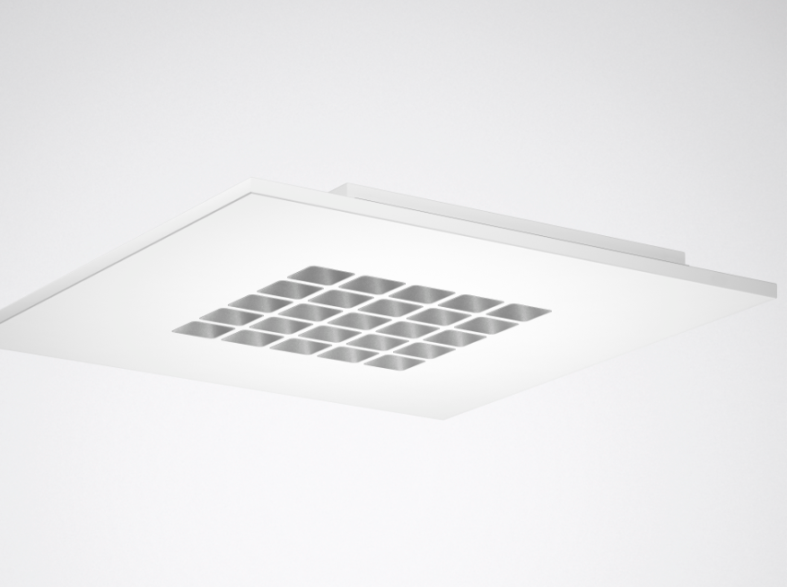
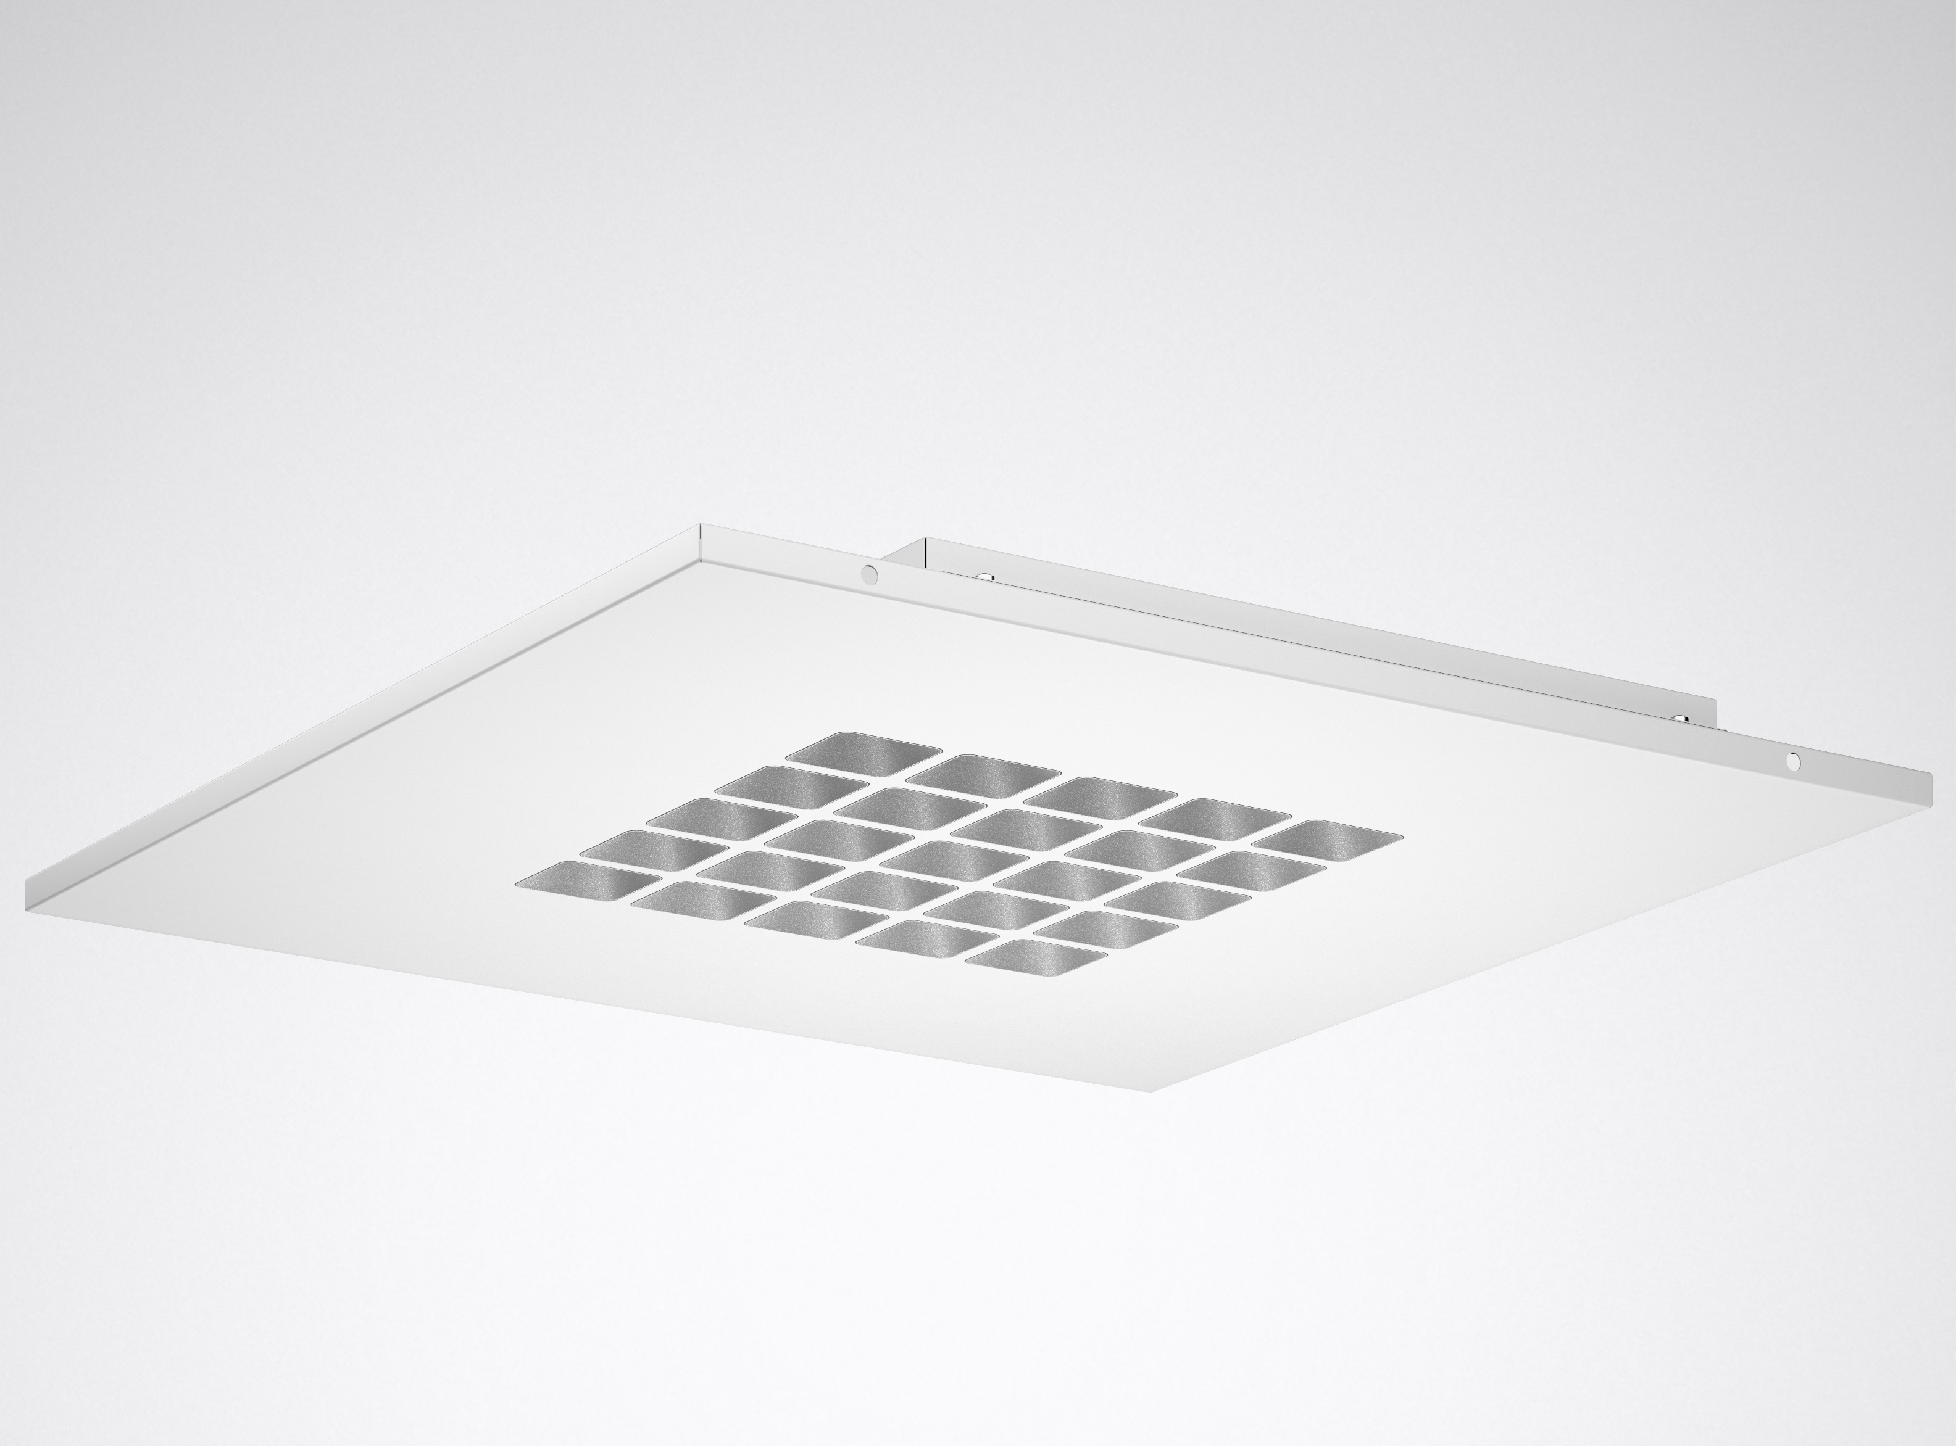


  CREAVO LED
  the future-oriented light

Slide 2
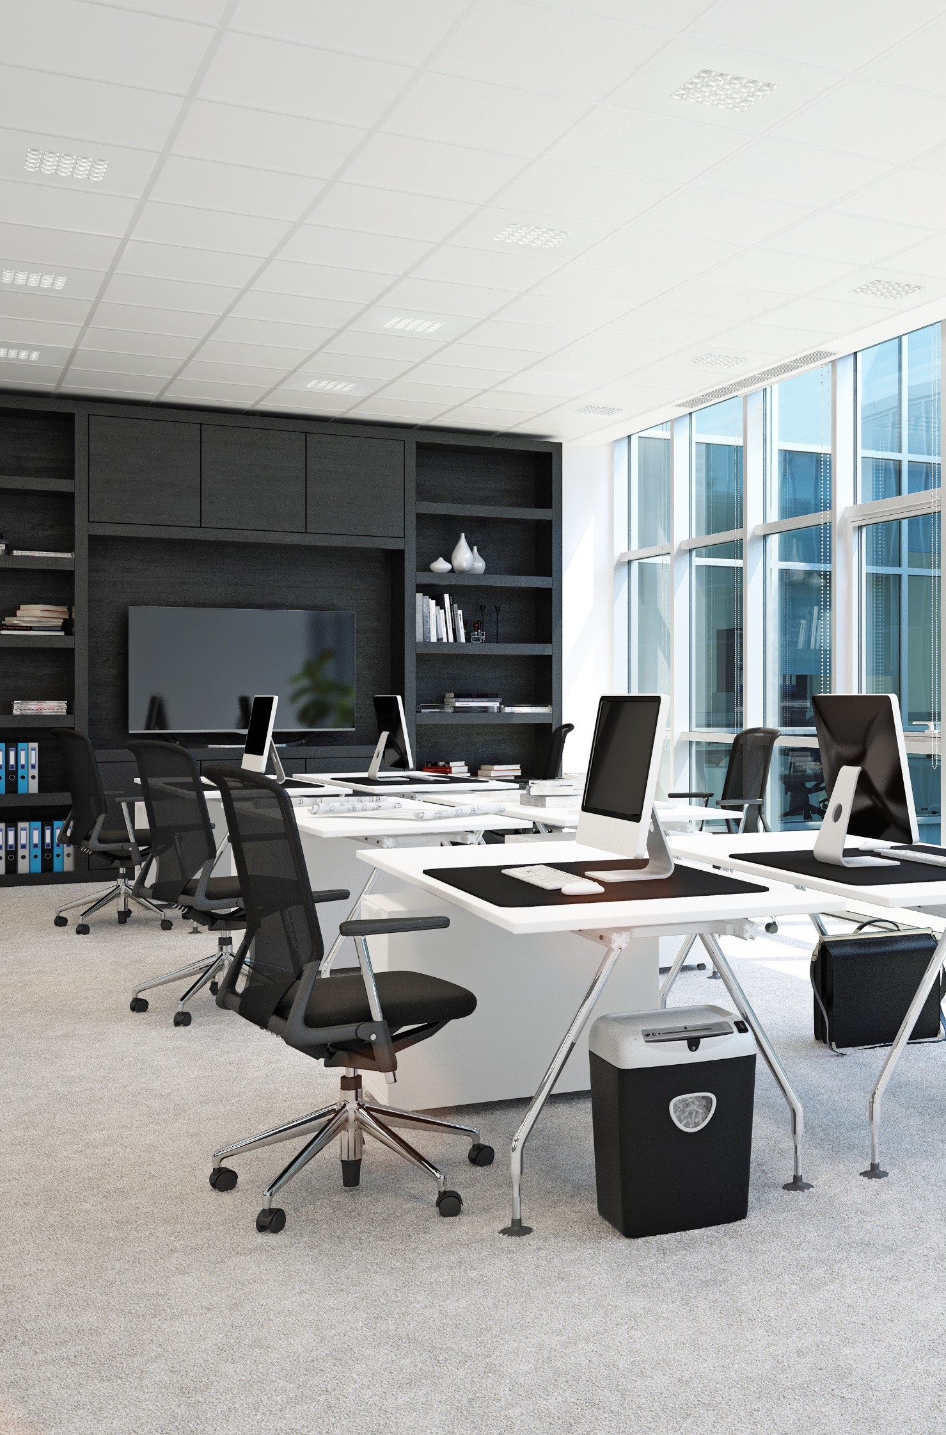
Modern architectural concepts demand lighting solutions that can be used parallel to the building axis in order to optimally emphasise the individual room and building appearance. At the same time the lighting must also guarantee perfect work conditions in the office.

Slide 3
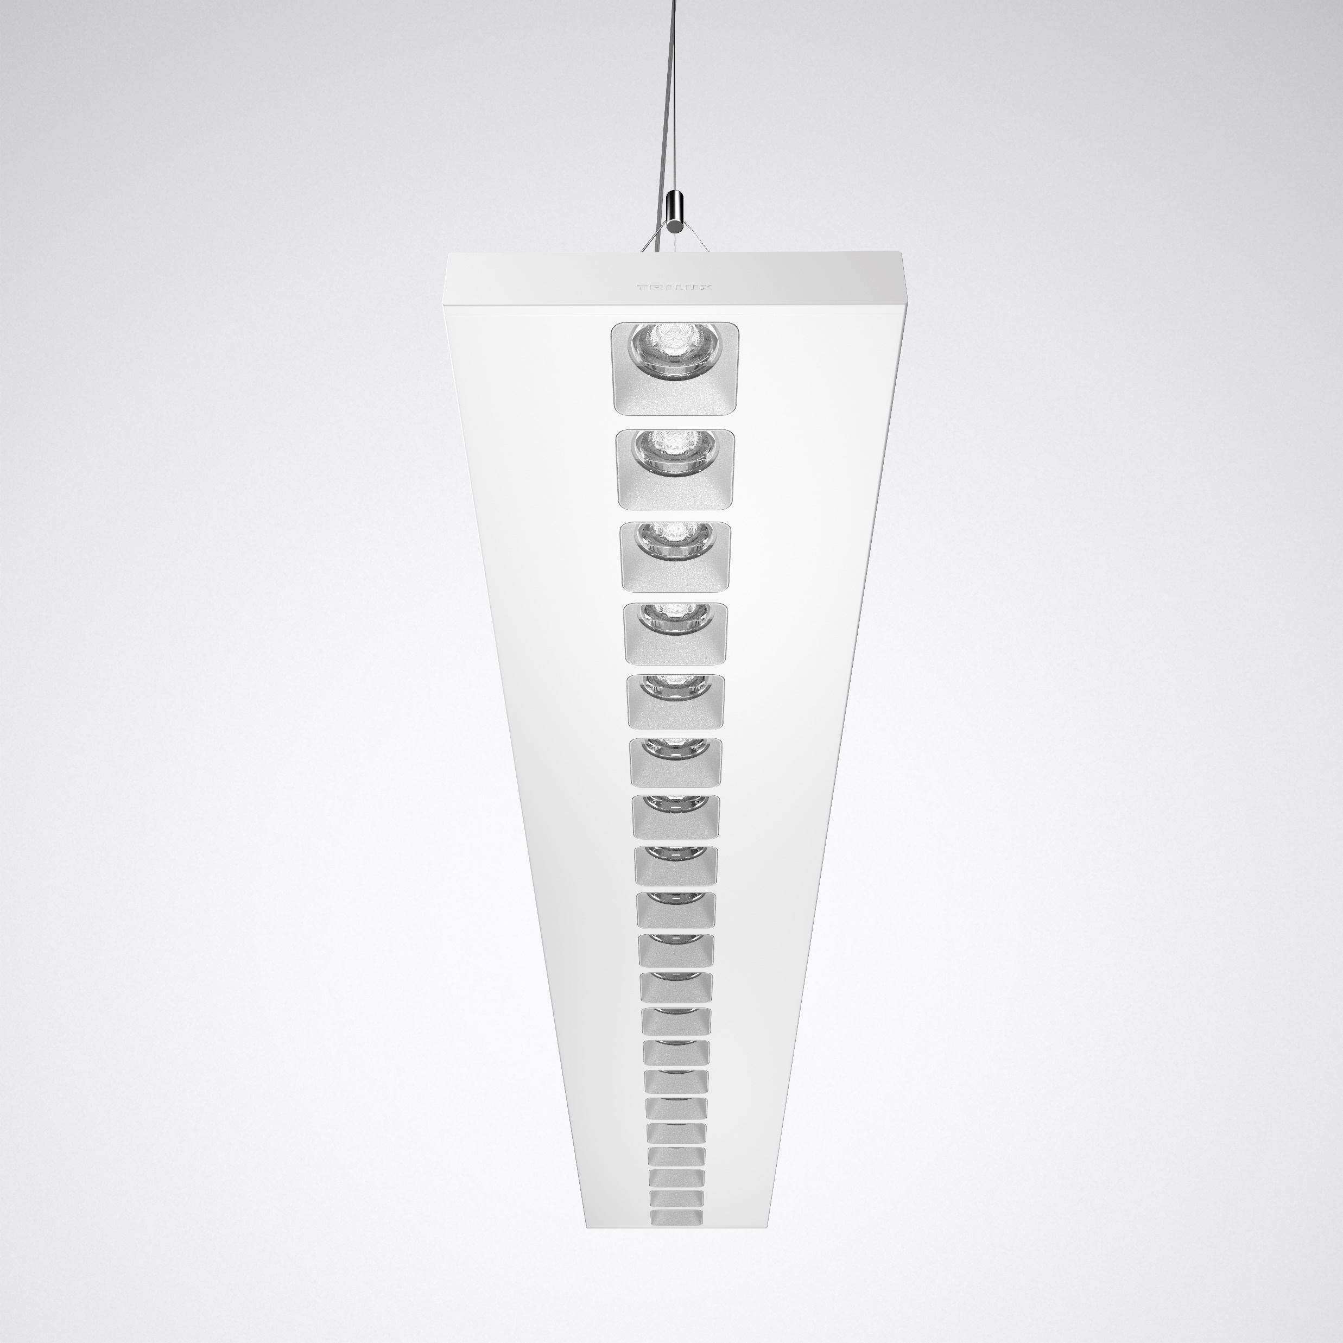
You've never seen directional light like this before: the innovative two-part optic with ConVision® technology ensures the highest perceptible quality of light and efficiency. Thanks to its high quality, attractive design and its wide range of sizes and mounting methods, Creavo is the all-purpose solution for directional lighting in offices and education. Light management and digital services can also be implemented via an IoT harbour. This makes Creavo fit for the future today.

Slide 4
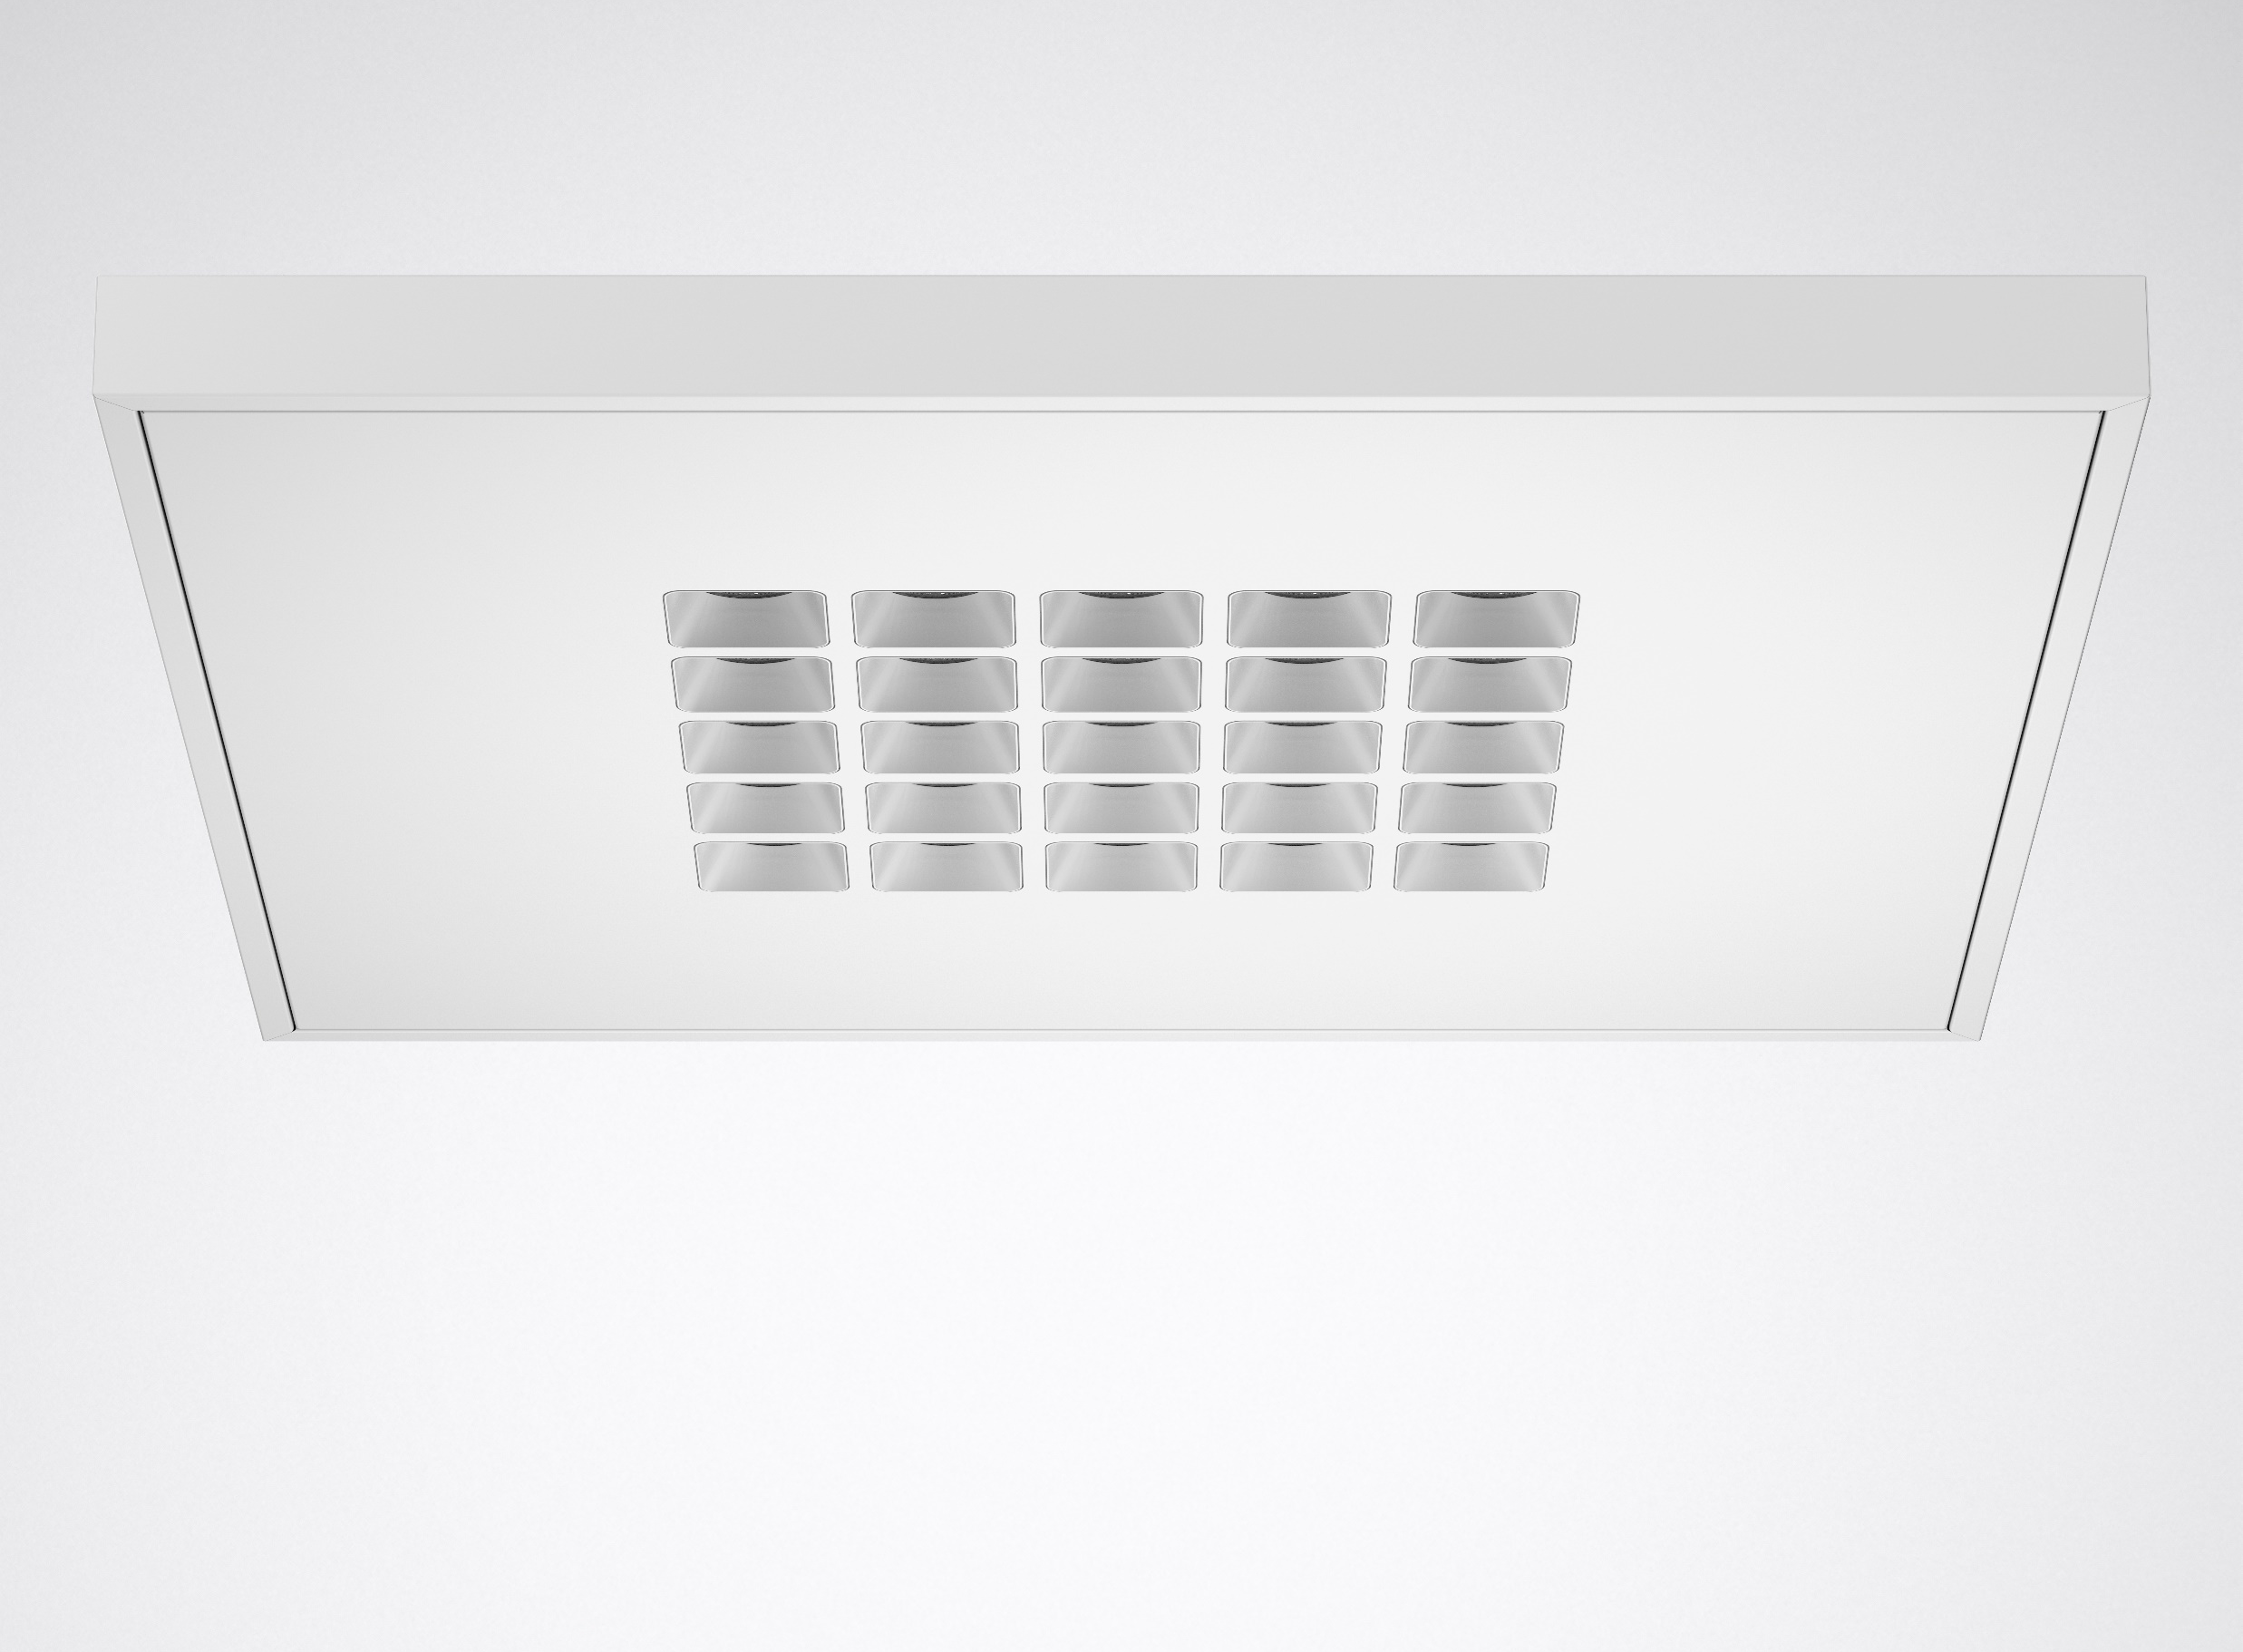
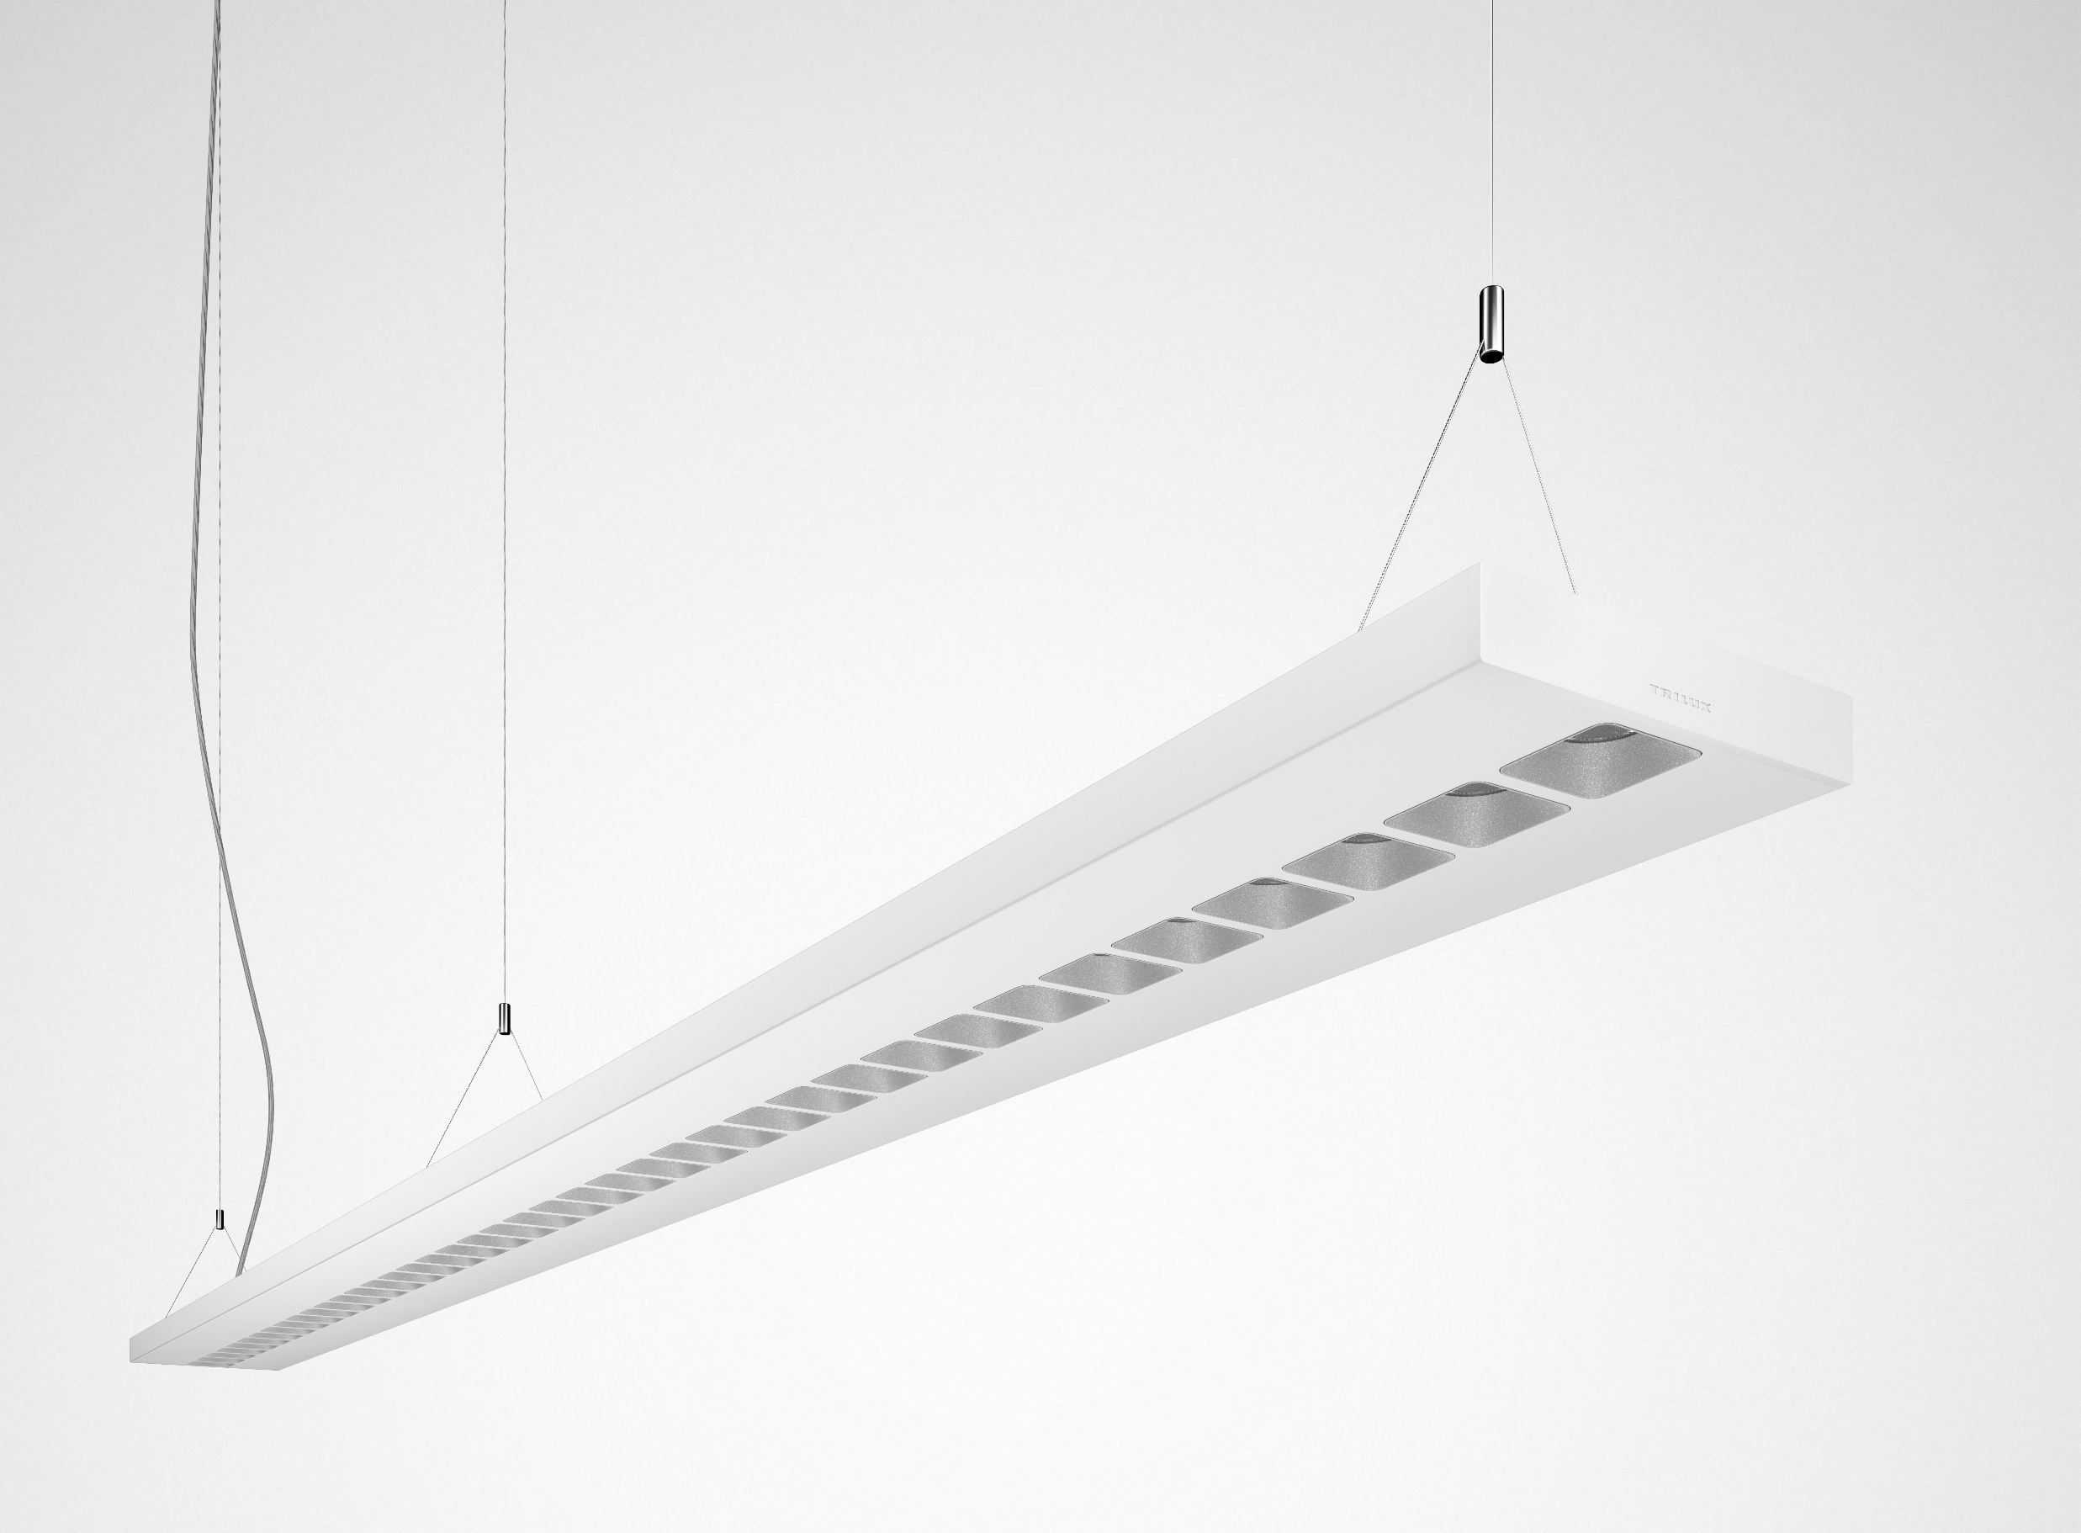
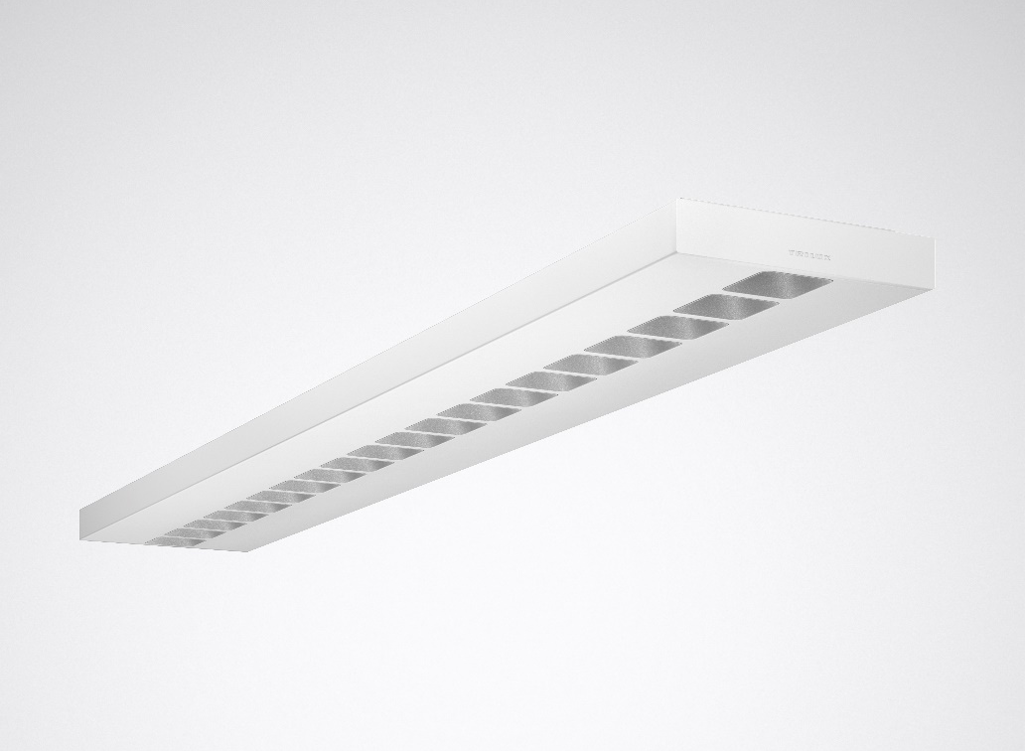

Slide 5
One system – further developed for offices and education
Creavo offers unique flexibility with directional light. The portfolio consists of recessed, surface-mounted and suspended luminaires as well as a wide selection of photometric options and module sizes. This makes Creavo the ideal tool for lighting designers and architects with all lighting tasks in the office and education sectors.
Perfect combination – holistic solutions
Holistic lighting concepts not only implement recessed, surface-mounted and suspended luminaires. With the Sonnos range of downlights and the Linus light channel, TRILUX also has precisely the right compatible systems for directional light in its portfolio. All three systems are equipped with ConVision® technology. With use of the same colour scheme the systems can be simply and harmoniously combined while retaining a uniform appearance.

Slide 6
Extremely pleasant – directional light
Due to intelligent two-part ConVision® (Convenience Vision) technology with lens and light chamber, the lighting effect is particularly pleasant – with noticeably reduced glare and less disturbing multiple shadows. Users can select between two light distribution curves: a wide beam optic for optimum uniformity with UGR < 19 and L65 < 3000 cd/m² according to DIN 12464:2011, or an accenting light distribution curve with UGR < 16 and L65 < 1500 cd/m². Variants with an asymmetric LDC as wall-washers for panel lighting in the same design and axis-parallel suspended luminaires for the ideal illumination of new room concepts round off the portfolio. Many variants can also be realised with a colour rendering index of Ra90 for especially natural colour rendering. The result is perfectly illuminated work surfaces with very good glare control.

Slide 7
Creativity and self-fulfilment – maximum design flexibility for individual solutions
The light chambers are available as standard in three different colours – in white, silver or matt black. While white appears structured and restrained, silver provides a timeless elegance to the room. The matt black light chambers are reminiscent of the typical dark-light effect of earlier louvre luminaires, achieving a discreet lighting effect. The design can also be personalised: the light chambers as well as the sheet steel can be individually designed upon request, e.g. using corporate colours.

Slide 8
Adapted lumen packages – for easy refurbishment projects
The draft (prEN 12464-1:2019) to the new EN 12464-1 recommends higher illuminances of up to 1,000 lx for office workplaces – for better quality of light, especially when the sensitivity of eyes decreases with age. In order to achieve these illuminances the Creavo portfolio includes higher lumen packages tailored to such requirements. Glare is also noticeably minimised thanks to ConVision®. For particularly fast and simple 1:1 refurbishments Creavo is also available with lumen packages analogous to the standard T5/T8 solutions.

Slide 9
Diversity of variants and accessories – anything’s possible
Ranging from the small square recessed solution to the linear suspended luminaire: with a total of thirteen sizes, Creavo offers the right format for almost all common ceiling systems. Especially useful is that thanks to its construction design, the lay-in luminaire can also be used for concealed grids. Individual custom products are also possible upon request.

Slide 10
Commissioning – plug & play with Linect®
Incredibly quick: with the universal Linect® connection system, many variants of Creavo can be connected quickly and easily via plug & play. For maximum flexibility the luminaires can be installed either conventionally or via a plug-in connection. Connected luminaire concepts are implemented as continuous lines with a single power feed. The result: significant time savings when connecting.
Quality – premium material and excellent workmanship
When the going gets tough: high quality materials such as a robust sheet steel body facilitate handling. Thanks to precise workmanship, the luminaire can be mounted quickly and easily without pressing, squeezing or squeaking.

Slide 11
Networking – quickly done with LiveLink
With the TRILUX LiveLink light management system, luminaires can be quickly and easily networked and combined with sensors. In building areas without system ceilings, surface-mounted and suspended luminaires can be networked quickly thanks to LiveLink Wireless without laying DALI control lines – this saves time and money during installation.

Slide 12
Winning features – high efficiency and low operating overheads
With an efficiency of up to 150 lm/W and a service life of L90 50,000 h, Creavo ensures permanently low operating costs – with savings of up to 50 percent compared to conventional systems. Additional reductions in operating costs are also possible by combining with the LiveLink light management system.
Human Centric Lighting – for greater well-being in the workplace
All luminaires are available as Active versions for Human Centric Lighting, thus bringing "natural daylight" into the office. This can increase the well-being of employees and strengthen the biological rhythm when working in closed rooms without sunlight.

Slide 13
IoT harbour – space for the future
Fit for the future: the IoT harbour offers space for a sensor, beacon or emergency-control LED as standard. The sensor for daylight and presence control in combination with the LiveLink light management system enables the operating costs to be minimised. The beacon for Location Based Services can be used e.g. for navigation in the building or for room booking. The emergency light variants provide light in emergencies. Upon request, the IoT Harbour, thanks to its interface-based design, offers users the option of easily integrating additional sensors. This creates maximum future security.

Slide 14
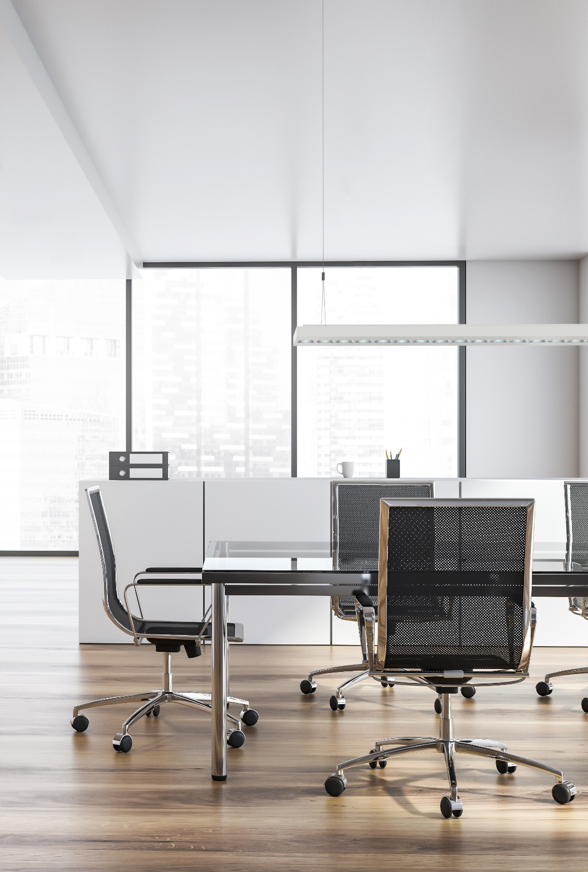
Creavo offers high quality, individual lighting solutions for various office areas as a recessed, surface-mounted or suspended version in square or linear design. This makes Creavo the all-purpose solution for directional light in offices.

Slide 15
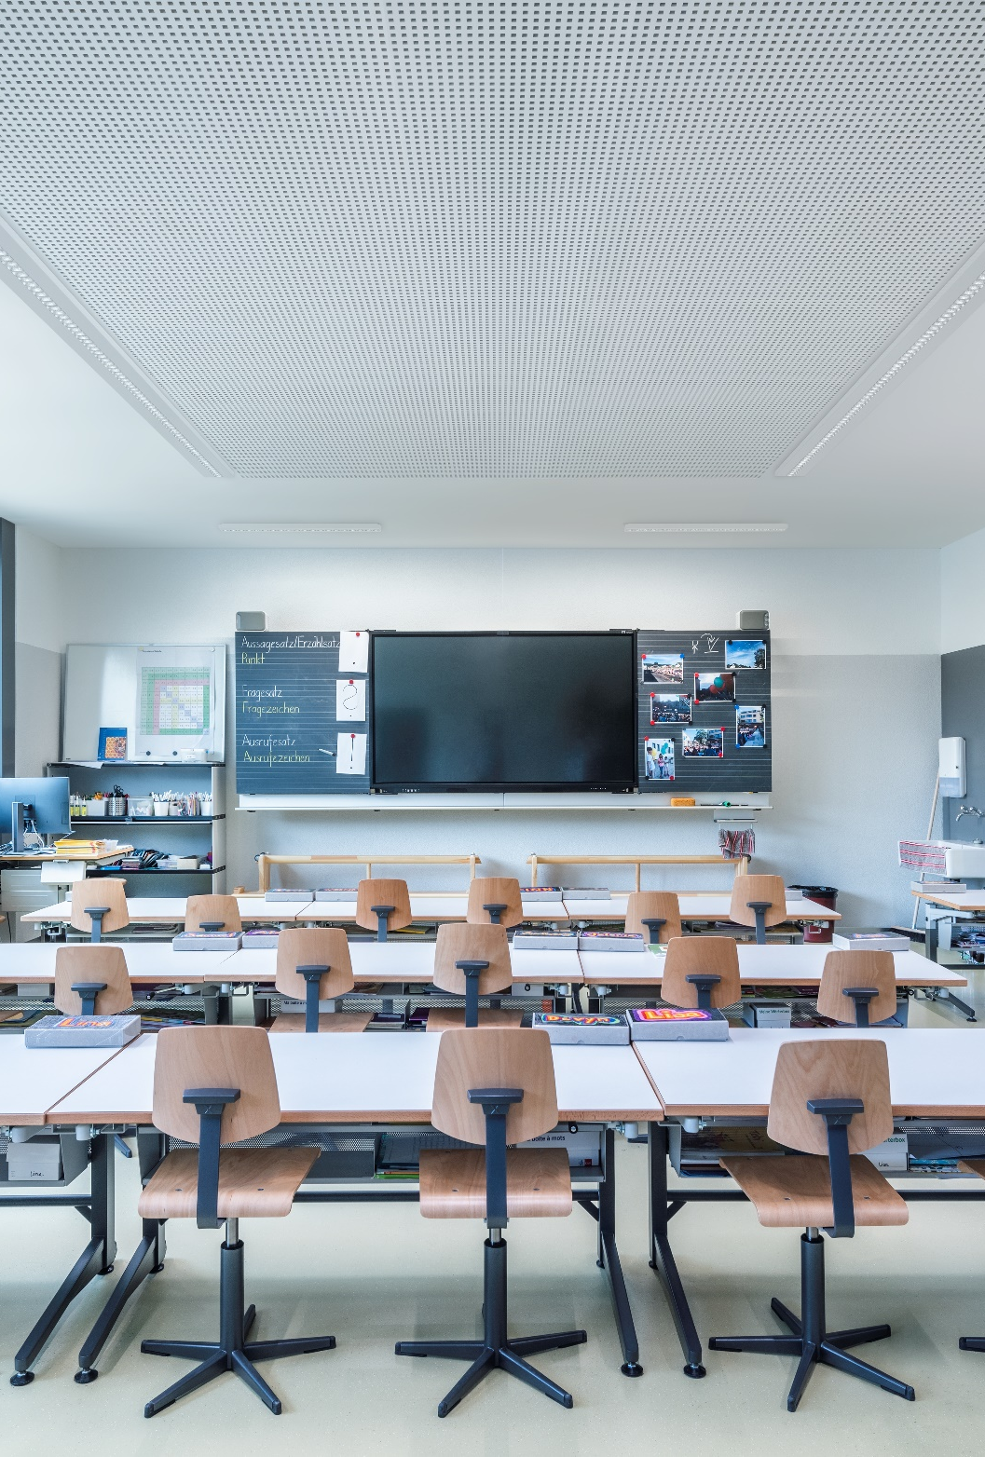
Creavo is in its element wherever maximum quality of light and freedom from glare are required in the educational sector. A particular highlight: the wall-washer for lighting blackboards is in the same luminaire design, for uniform implementation of general and panel (blackboard) lighting. Connected luminaire concepts can also be implemented as continuous lines with a single power feed.

Slide 16

In combination with the interior design and materials used, Creavo creates a unique spatial experience for maximum well-being. The uniform appearance results from the size ratio of the light chambers to the ridge width and the grid group to the surrounding frame area.

Slide 17
Creavo provides glare-free directional light everywhere due to its broad variety of sizes, optics and mounting methods. Users can select between three light distribution curves and light chamber colours. For simple 1:1 refurbishments Creavo is available with lumen packages and sizes analogous to the standard T5/T8 solutions.

Slide 18
Thanks to excellent workmanship and clever features such as the rapid connection system, Creavo is installed in no time at all. Connected luminaire concepts can be realised with a single power feed in the form of a time-saving continuous line. Luminaires can be quickly and simply networked with LiveLink (either via DALI or radio).

Slide 19
Creavo is energy-efficient and features highest visual comfort thanks to ConVision® technology. A sensor for daylight and presence control or a beacon for location-based services can be integrated via the IoT harbour.

Slide 20
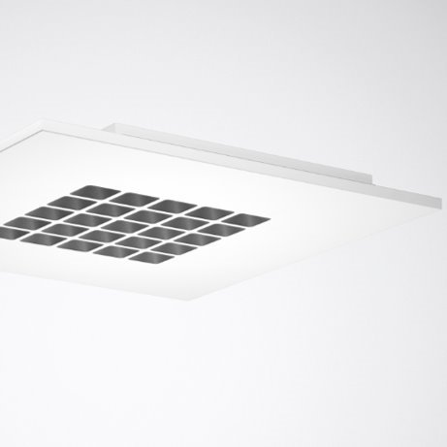
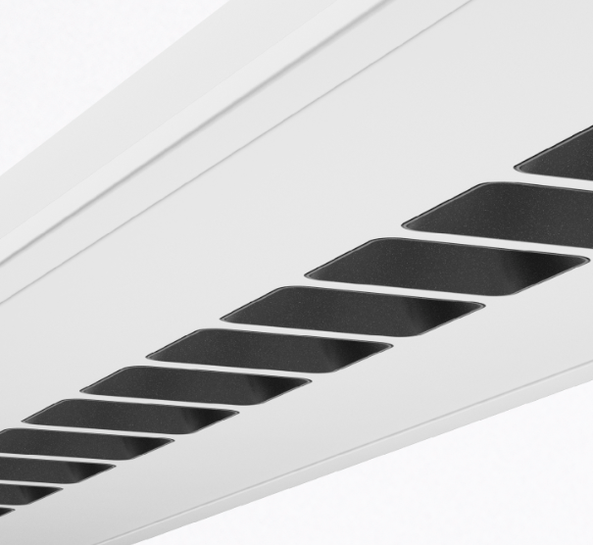
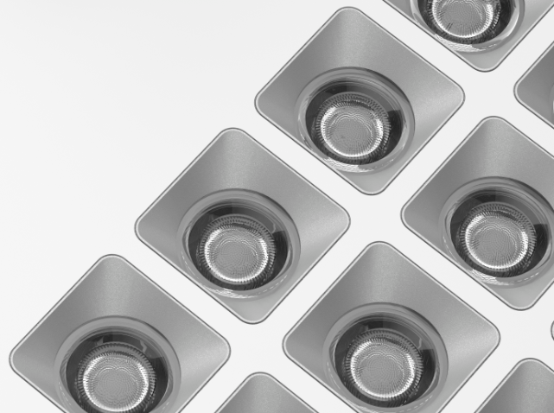
CREAVO LED
Directed recessed, surface mounted and suspended luminaires with ConVision® technology
Continuous line ability for surface and suspended
Long service life of 50,000 h (L90 at 25 °C)
High energy efficiency up to 150 lm/W
Optionally with 3000 K or 4000 K colour temperature or as Active version (2700 K to 6500 K)
Glare evaluation (EN 12464-1) according to UGR
< 19. or <16. VDU workstation-compliant in accordance with 12464-1.
With lighting management LiveLink
IoT-harbour with sensor, emergency light, or beacon for location based services

Slide 21
