Slide 1
WELCOME TO TRILUX! www.trilux.com

Slide 2
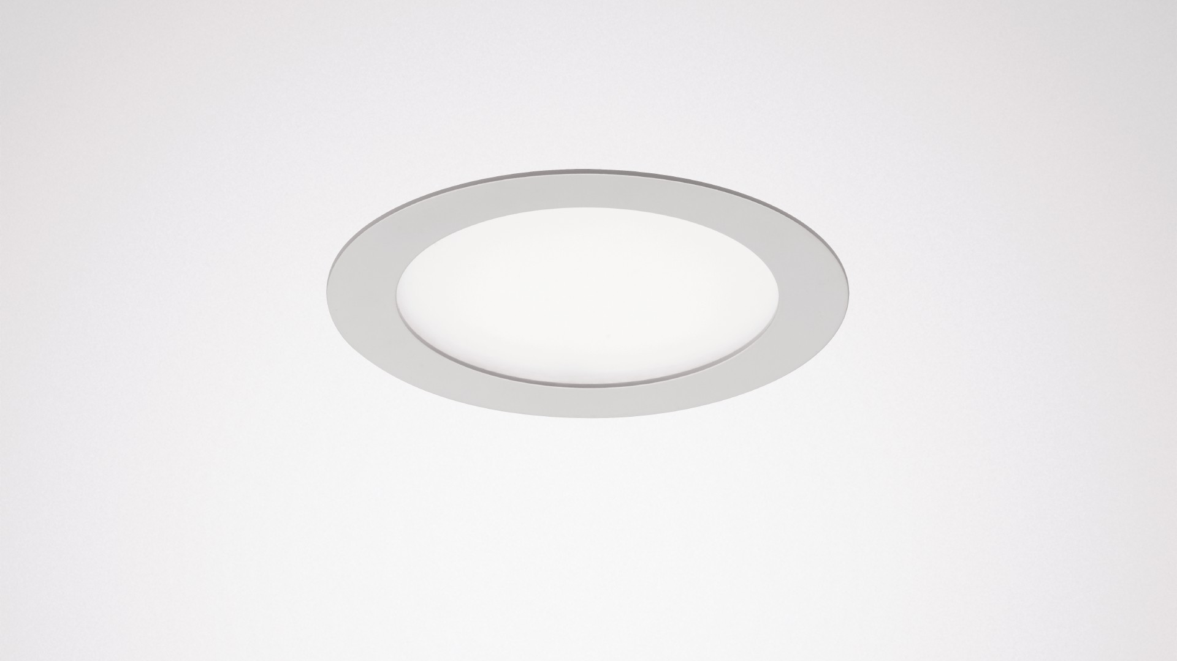
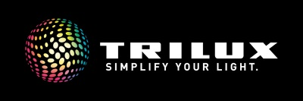
aviella LED
A slender start with planar light

Slide 3
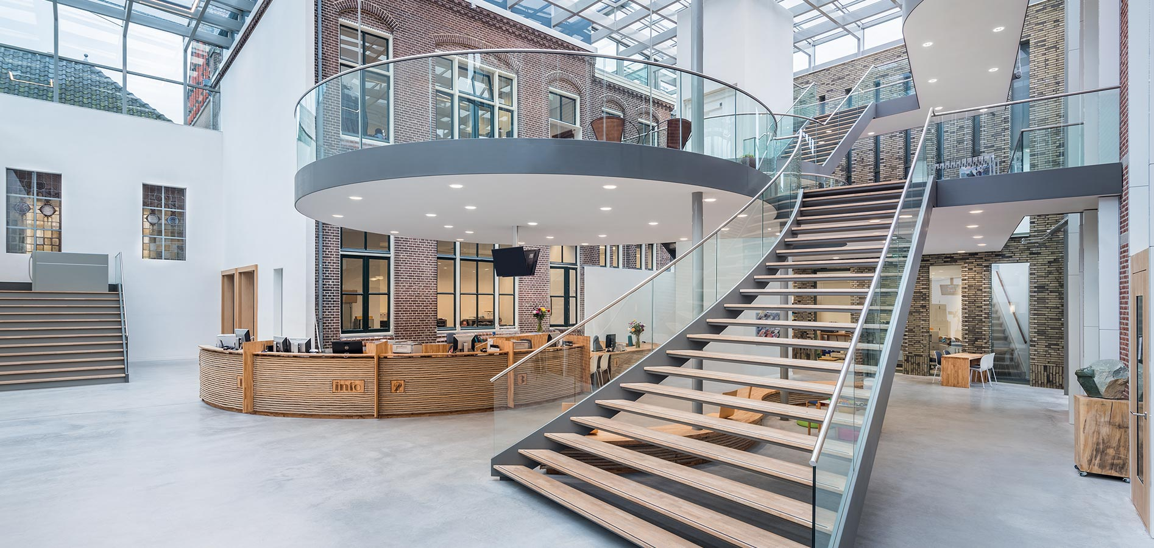
the challenge
If corridors, stairwells or entrance areas are to be fitted or refurbished with LEDs in a price-conscious manner, there is a wide choice of functional, cost-effective downlights. It becomes much more difficult when the light is also required to create atmosphere. This can be achieved, for example, with planar light that creates a pleasant atmosphere because the light is visible on the ceiling, is distributed evenly throughout the room and only minimal shadows are created. So what is needed are solutions that not only offer a fair price but also the feel-good factor of planar lighting.

Slide 4
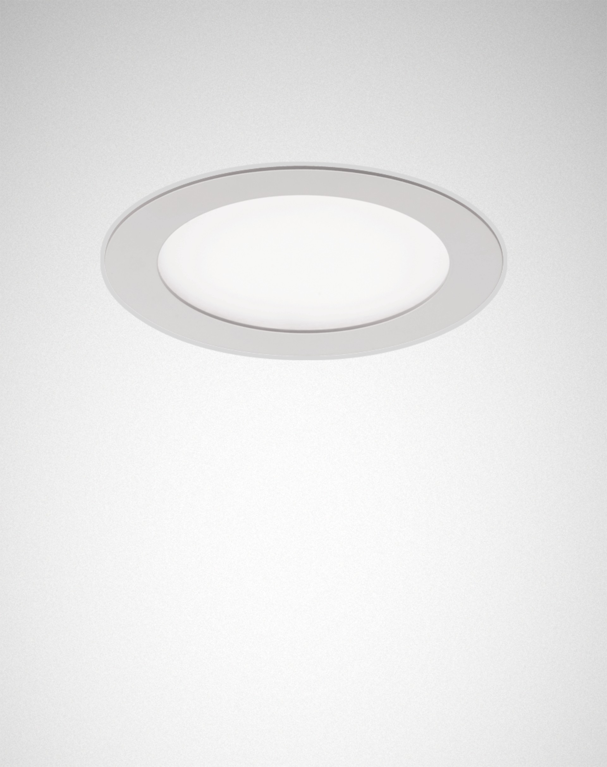
the solution
As an economical downlight solution, the Aviella LED from TRILUX brings many advantages of planar light to functional areas of buildings: Its visible light emitting surface distributes the light evenly throughout the room. Even the upper wall areas are illuminated. This makes the luminaire an attractive alternative to reflector downlights, for example in canteens or stairwells.
In addition, the round luminaire with the white recessed ring scores with its wide range of variants. The Aviella LED is available with four different lumen packages and a choice of warm white or neutral white light. Thanks to a minimum mounting depth of 47 mm, it can even be installed in suspended ceilings with little space between them and even in walls.
Planar light at a low price - the Aviella LED from TRILUX simply resolves the contradiction between low cost and a feel-good atmosphere. With the combination of pleasant light, low purchase costs and full LED efficiency, the Aviella LED scores points with price-conscious operators even in large quantities.

Slide 5
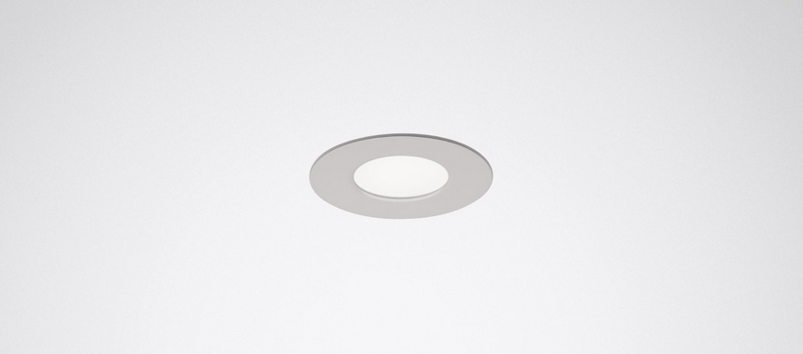
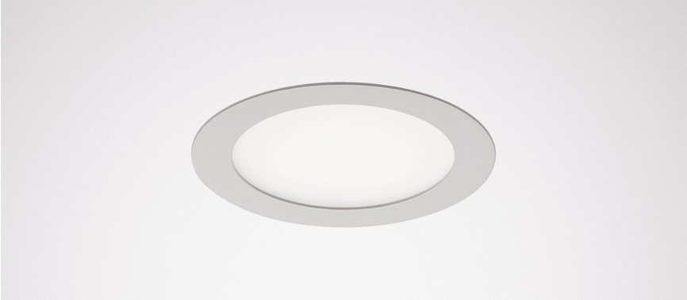
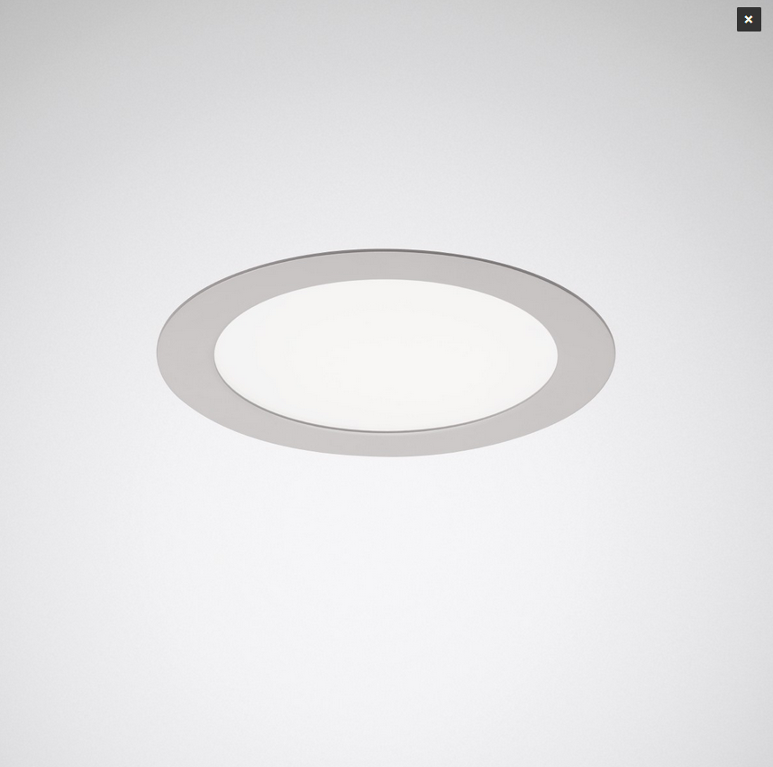
advantages with lighting desing
Slim appearance, well thought-out functionality
Its particularly flat design makes the Aviella LED the ideal solution even for suspended ceilings with little space in between. It can even be installed in the wall. Various equipment options provide planners and installers with additional flexibility: four lumen packages between 400 and 2,700 lm in four sizes are available. The downlight is also available with warm white or neutral white light colour.
Timeless design
Its circular light emitting surface and a characteristic white cover frame determine the timeless, unobtrusive design of the Aviella LED. The luminaire thus blends harmoniously into functional areas such as corridors, stairwells, entrance areas or canteens.

Slide 6
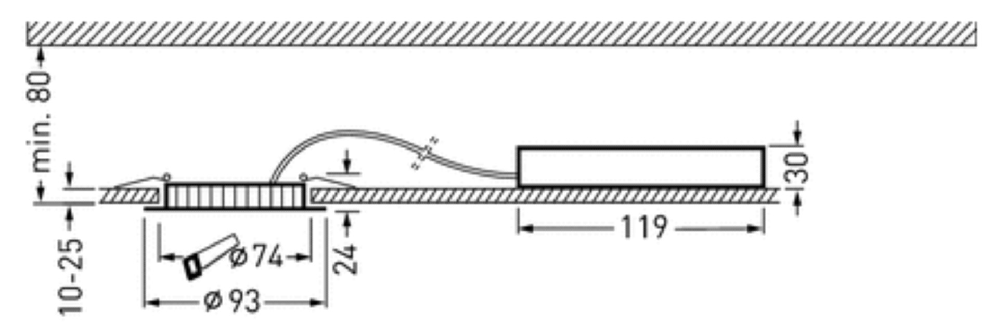
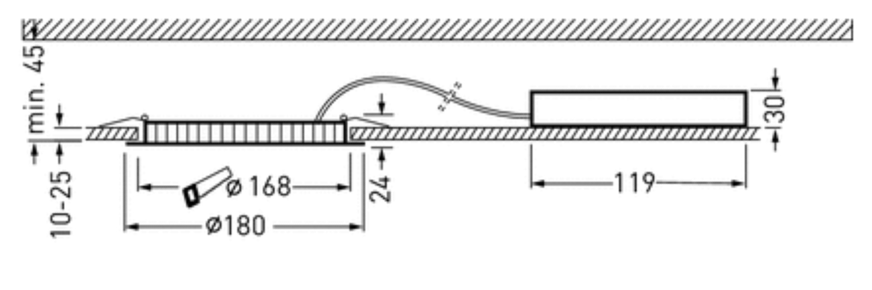
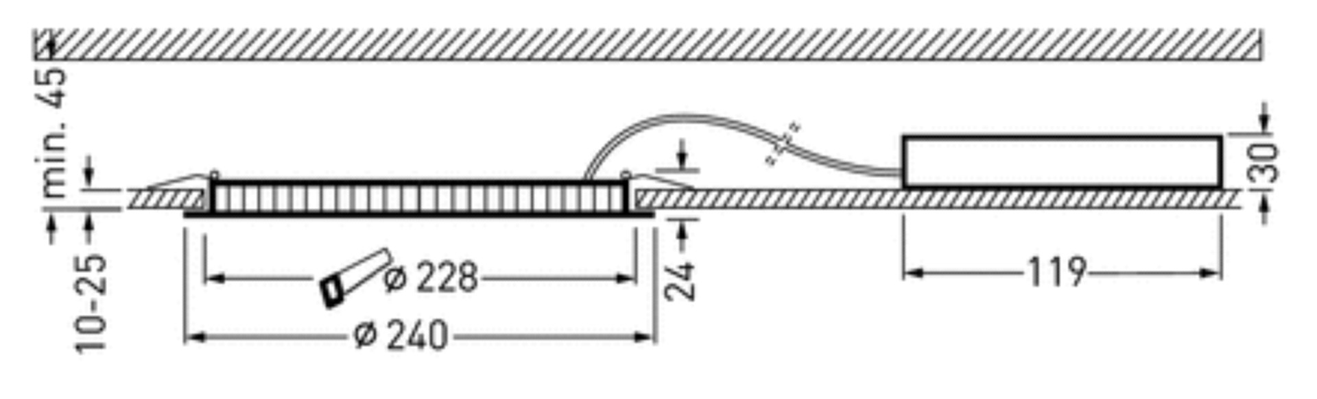
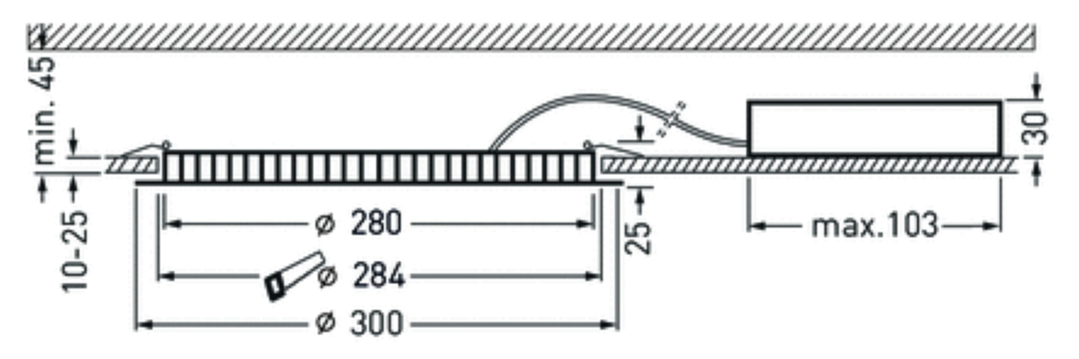
advantages during installation
Lean refurbishment solution
Thanks to its flat shape with an installation depth of only 47 mm, it is the optimal renovation solution for suspended ceilings with little space between them. The luminaire can also be installed in walls.

Slide 7
advantages in operation
Atmosphere building planar light
The downlight manages without a reflector, its visible light emitting surface distributes the light evenly throughout the room. This creates a pleasant, homogeneous lighting effect with little shadowing and also provides brightness even to the upper wall area. In this way, even functional building sections benefit from wide-area lighting.
Full cost efficiency
As a contemporary LED solution with a service life of 25,000 hours (L80, tq 25°C) and low acquisition costs, the circular downlight also convinces particularly price-conscious operators. This makes the Aviella LED the optimal refurbishment solution for functional indoor areas. A further cost advantage: its shallow depth ensures minimal storage volume.

Slide 8
Technical features
Energy efficiency | Up to 90 lm/W
Lumen packages | 400 lm, 1.200 lm, 2.000 lm and 2.700 lm
Colour temperature/ Colour rendering | 3.000 and 4.000 K, CRI >80
Service life | L70 (25 °C) = 35.000 h L80 (25 °C) = 25.000 h
Light distribution | Wide
Switching type | ET, ETDD (switchable and DALI dimmable)
Protection rate | IP 44 room-side
Ceiling cutout | 74, 168, 228 and 284 mm
Control | LiveLink: Control, Light management NEW: LiveLink WiFi radio refurbishment
Luminaire colour | white
Accessories/ variants | Junction box accessory

Slide 9
THANK YOU FOR
YOUR ATTENTION! www.trilux.com

