Slide 1
welcome to TRILUX www.trilux.com

Slide 2
company presentation
2
TRILUX SIMPLIFY YOUR LIGHT

Slide 3
Light - Since 111 years our 'thing
111 years
7 holdings
In 1912, TRILUX was founded in Menden (Germany). Since then, TRILUX has played a decisive role in shaping the lighting market through innovations.
Seitec, ICT, Crosscan, Led Luks, watt24, wtec, monolight
50 countries
30 subsidiaries
As an international company, TRILUX is present in 50 countries around the world.
The TRILUX Group has 30 subsidiaries.
5,000 team players
60,000,000 €
TRILUX employs around 5,000 people worldwide.
Investments (since 2016)
6 production sites
740,000,000 €
TRILUX produces in Germany and several other European countries, divided over 6 plants.
In 2022, TRILUX generated 740 million euros in sales worldwide.
3
TRILUX SIMPLIFY YOUR LIGHT

Slide 4
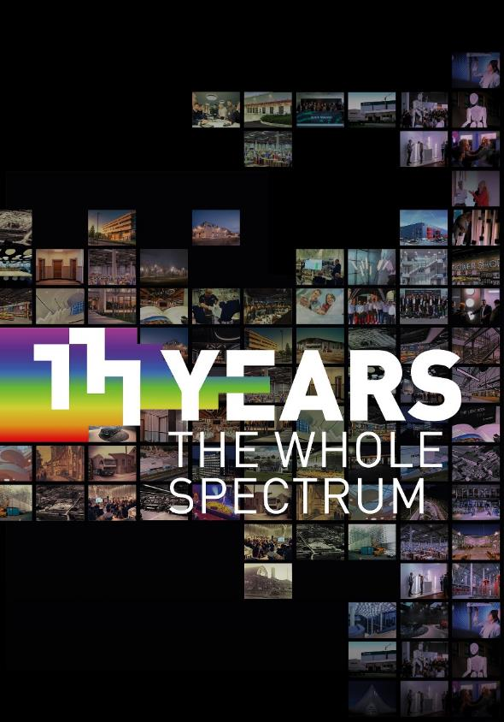
111 years of excellent Lighting
For more than 111 years, TRILUX has been shaping the present and the future of light, with the aim of creating artificial light that is as efficient, versatile and sustainable as the sun. Under the motto "111 Years - The Whole Spectrum", we celebrate our anniversary with exciting images and emotional videos, highlight the company's history and honor the #TeamTRILUX.
Learn more about 111 years of TRILUX
4
TRILUX SIMPLIFY YOUR LIGHT
Notes:
It helps us that we can map the bundled competence within the TRILUX Group. Everything from a single source, from planning, the product, lighting control and other services, we ensure with our partners that the customer receives the best solution.

Slide 5
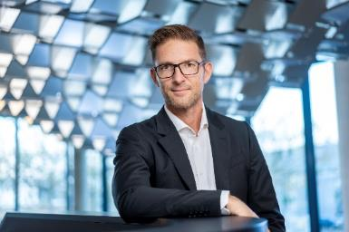
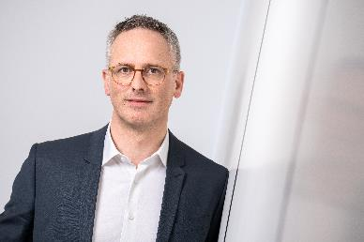
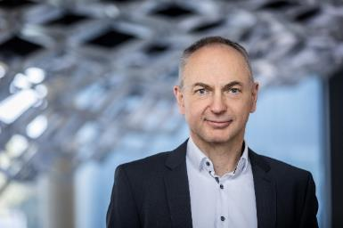
Values - What drives us
Customer focus
Innovative strength
Competence and culture
"We combine our unique market and application-specific knowledge with profound technology know-how, while always keeping an eye on the individual wishes and needs of our customers."
Joachim Geiger, CSO & CMO
"For over 100 years, innovations have been the engine of our success. With intelligent innovation management and structures such as the innovation centre, we have created the perfect framework for this."
Hubertus Volmert, CEO
"Light is 'people business'. As a family business, social responsibility is part of our self-image. It is always our goal to create added value for everyone – partners, customers and employees."
Johannes Huxol, CFO
5
TRILUX SIMPLIFY YOUR LIGHT

Slide 6
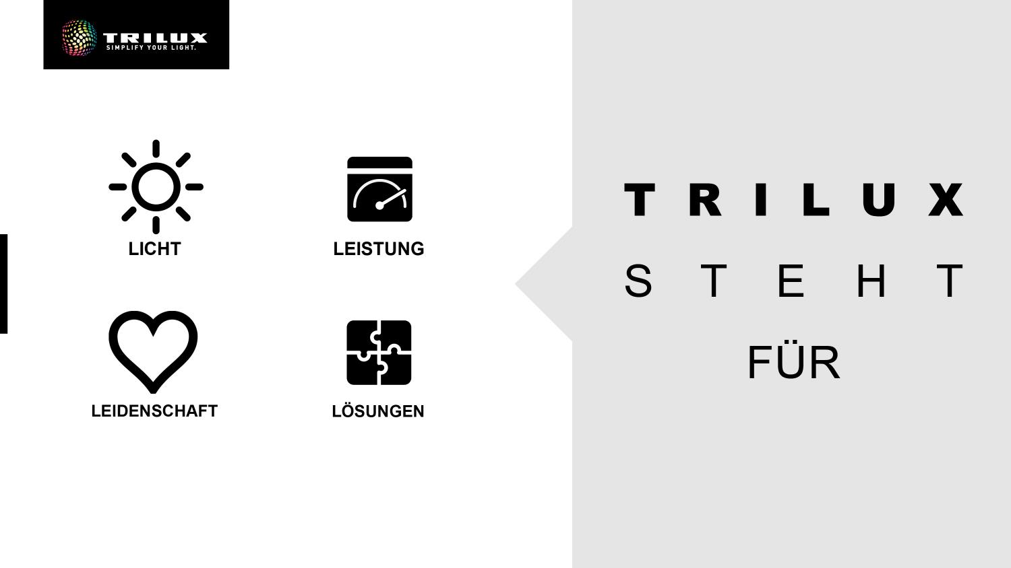

S T A N D S
LIGHT
PERFORMANCE
S T A N D S
LIGHT
PERFORMANCE
FOR
FOR
PASSION
SOLUTIONS
PASSION
SOLUTIONS
Notes:
(TRANSLATED CONTENTS OF THE SLIDE)
LIGHT-PERFORMANCE-PASSION-SOLUTIONS
TRILUX STANDS FOR

Slide 7
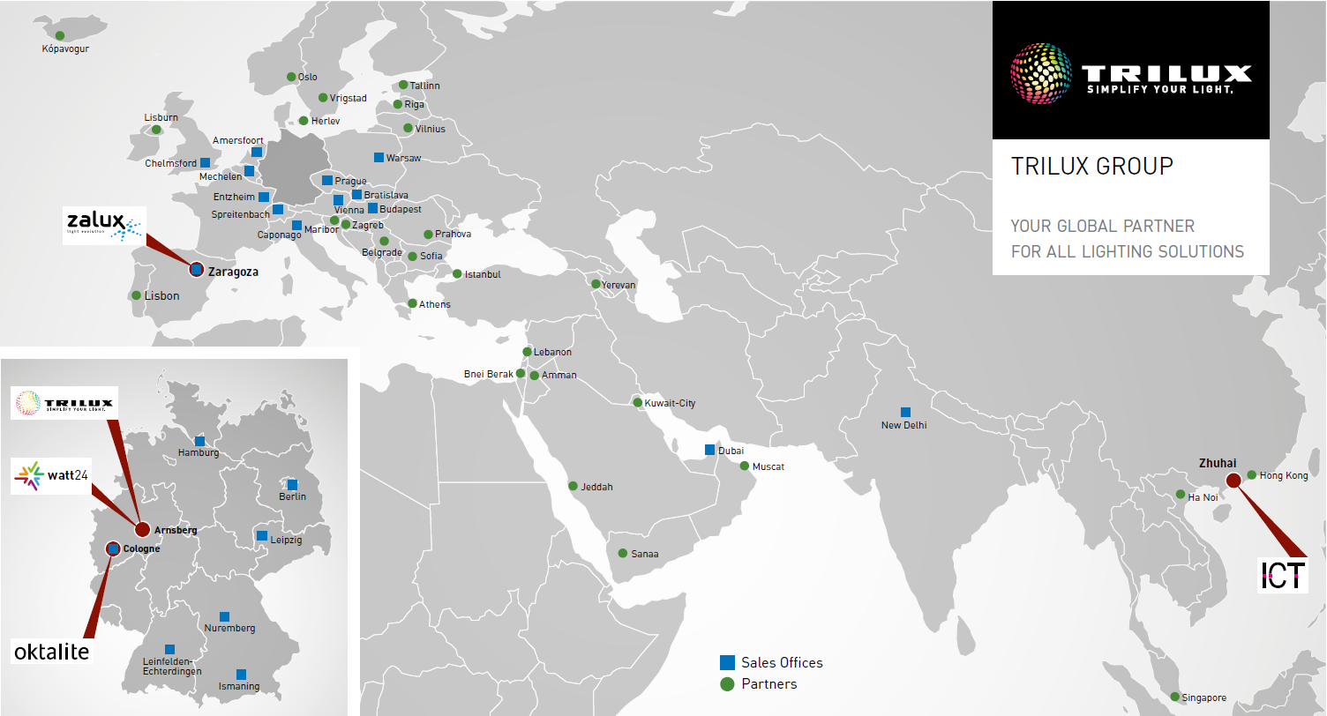
6
TRILUX SIMPLIFY YOUR LIGHT

Slide 8
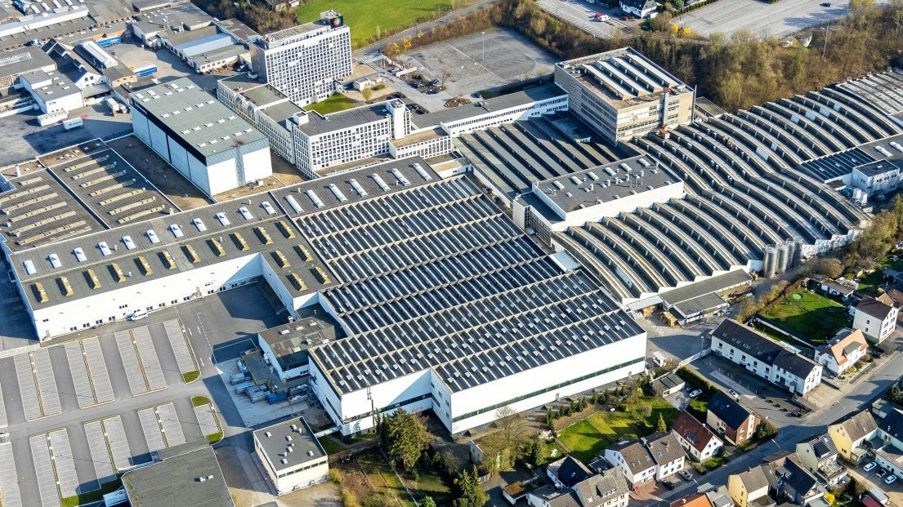
7
TRILUX SIMPLIFY YOUR LIGHT

Slide 9
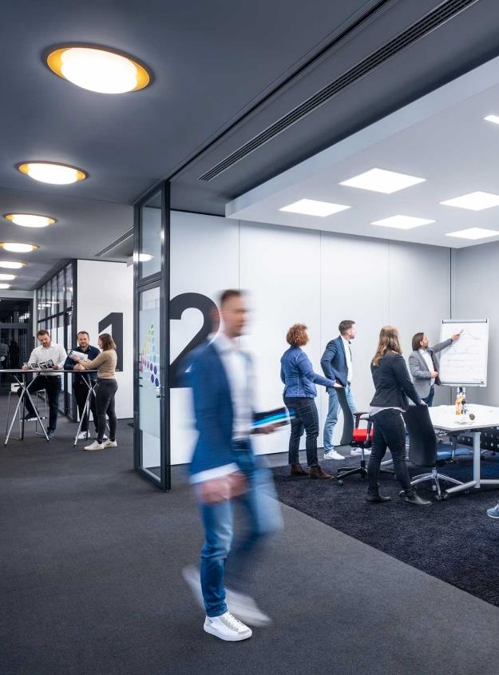
TRILUX AKADEMIE
FIRST-HAND KNOW-HOW
At a total of twelve TRILUX academies in ten countries, we impart cutting-edge lighting technology expertise, ranging from the fundamentals of lighting technology and electrotechnology to new technologies and country-specific features, such as normative lighting design or subsidy programs.
Our portfolio is aimed in particular at lighting designers, electrical planners, architects, installers and anyone who deals professionally with light.
The TRILUX Akademie is actively committed to high quality in further education in lighting technology and to objective proof of qualification in the lighting industry. The seminars of the TRILUX Akademie have above all the goal to offer you the optimal professional support for every challenge.
9
TRILUX SIMPLIFY YOUR LIGHT

Slide 10



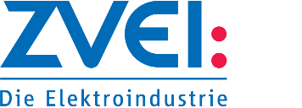

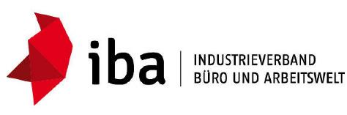






trilux partners and cooperations
10
TRILUX SIMPLIFY YOUR LIGHT
Notes:
The TRILUX Group is excellently networked. With industry associations, institutions in science and research as well as in cooperation with other manufacturers, technical developments are advanced worldwide, standards are developed and political framework conditions are discussed and evaluated. Here for example:

Slide 11
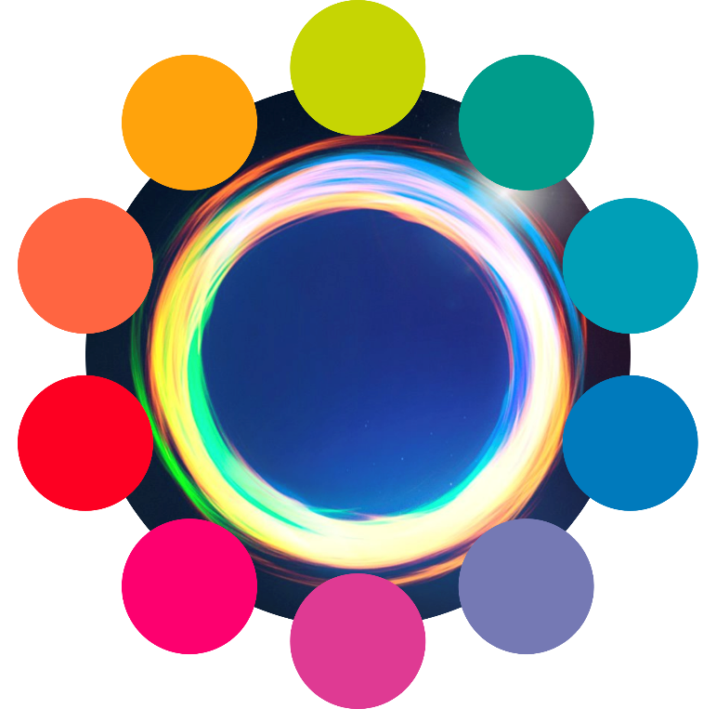
Services for you and your project
111 years of lighting expertise
TRILUX Light Academy
After Sales
Light Monitoring •
Positioning + Navigation •
Predictive Maintenance •
Workplace and room booking •
Digital services
First class advice
• Needs assessment
• Requirements
• Lighting concepts
• Solutions
TRILUX
Services
Leasing •
Installment plan •
Rent •
Contracting •
Financing options
Helpful
Tools
• Efficiency check
• Configurators
• TRILUX ONE
• Lighting concepts
Disassembly & disposal •
Installation & commissioning •
Project management •
Technical services
Network lighting designers and technicians
Operational excellence
11
TRILUX SIMPLIFY YOUR LIGHT

Slide 12
entry and trend topics application office
12
TRILUX SIMPLIFY YOUR LIGHT

Slide 13
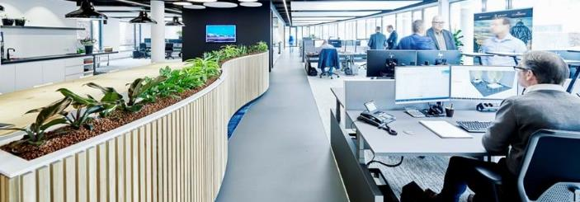

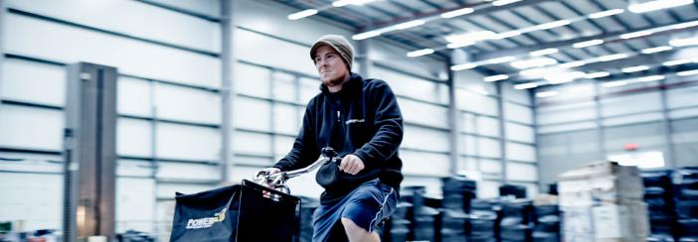
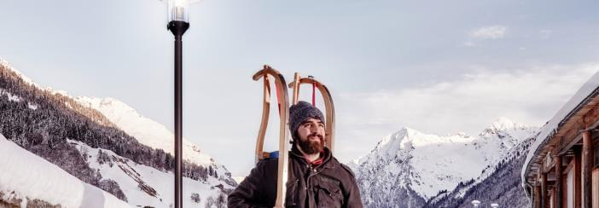
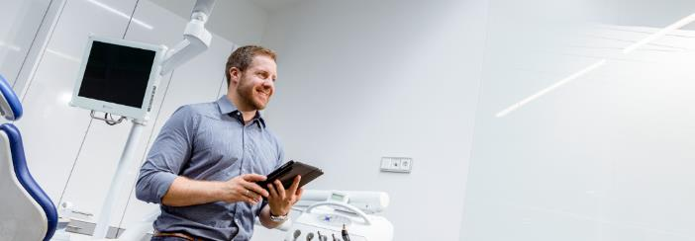
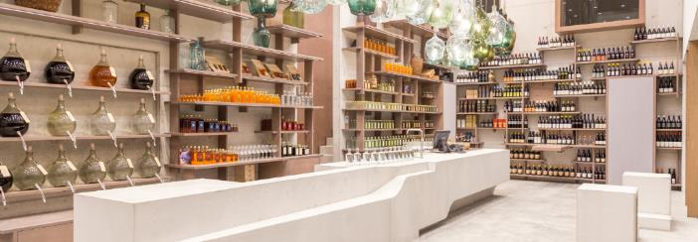
OFFICE
EDUCATION
INDUSTRY
OUTDOOR
HEALTH & CARE
RETAIL
14
TRILUX SIMPLIFY YOUR LIGHT

Slide 14
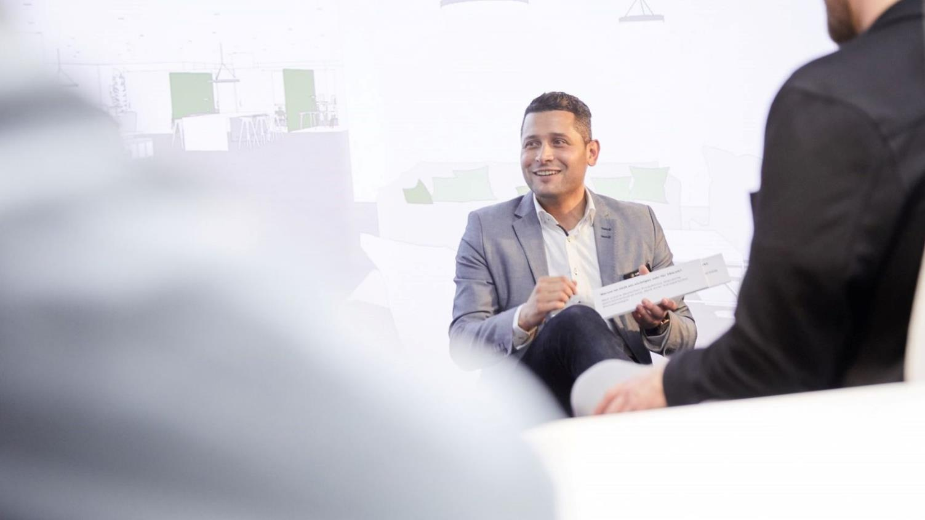
TRILUX mission office
We believe that good light makes the difference. And that light has the power to inspire, motivate and activate people.
With this conviction, we develop modern and sustainable lighting solutions for our customers that respond to the needs of employees, increase well-being and bring corporate values to life.
14
TRILUX SIMPLIFY YOUR LIGHT

Slide 15
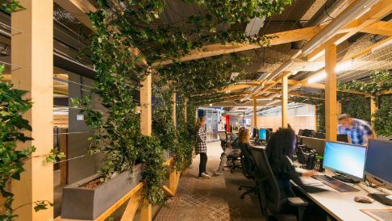

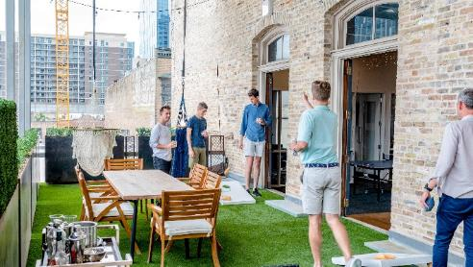
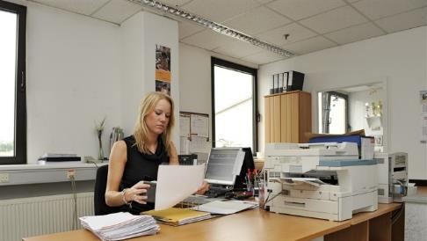
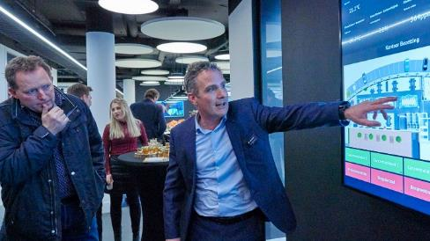
trEND TOPICS IN THE APPLICATION OFFICE
new work
Sustainability
The employee in focus
Refurbishment
Digital working environments
15
TRILUX SIMPLIFY YOUR LIGHT
Notes:
1. due to the corona pandemic, office organisations and the "place where we work" will change completely. We will see a new mix between corporate office, home office and third places.
2. When designing work environments, the focus will be more than ever on people and employees. Only if we know the needs and requirements of the users, we can develop the right concept for a satisfying working environment.
3. We assume that more than 50% of the existing office buildings need a refurbishment concept. Replacing or updating the technical building equipment can increase employee satisfaction and significantly reduce energy consumption.
4. New and future work environments must be able to offer employees and employers a variety of digital services, such as space booking systems, usability measurement, CO2 content, etc.
5. As a key issue, sustainability plays a very important role in the office sector. Here, for example, the focus is on reducing energy consumption, reducing space, and increasing the value of reuse and repurposing.

Slide 16
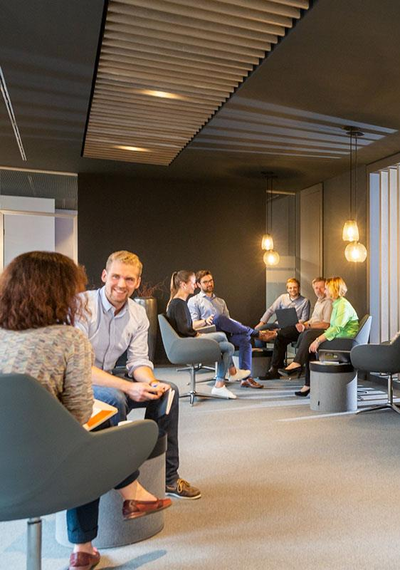
New Work
The changing world of work
Digitization, demographic change, individuality and work-life balance are changing modern work structures as well as office design. Project work, networking and informal communication are increasingly shaping everyday office life and require new work and room concepts.
Accordingly, the working world is becoming significantly more open, creative, individual and digital.
TRILUX has been dealing with the change in the working world for many years and today offers exactly the right lighting solutions for it – whether classic offices or New Work concepts.
16
TRILUX SIMPLIFY YOUR LIGHT

Slide 17
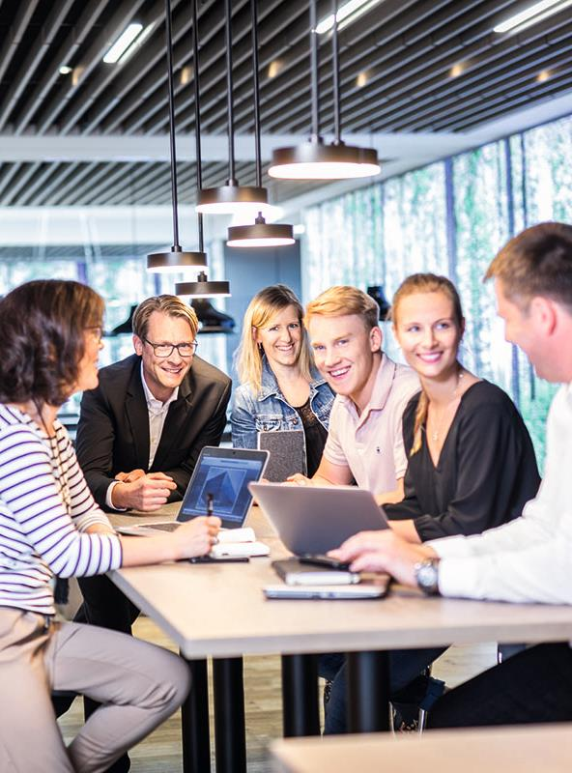
Employees in focus
Within the scope of planning and realization of office concepts with a holistic view, the focus is on the people who spend their time in this place.
The employee, the most important factor in a modern working world, chooses the appropriate location flexibly from a company office, home office or coworking space, depending on the activity and general conditions.
In the development and realization of modern working environments as well as innovative and sustainable lighting solutions, TRLUX focuses on the user.
17
TRILUX SIMPLIFY YOUR LIGHT

Slide 18

Sustainability
At TRILUX, environmental protection and resource conservation are firmly anchored in the DNA. As a corporate matter of course. We align the actions of our organisation to this in all core areas. The German production sites will be climate-neutral as early as 2025.
Modern lighting solutions and controls consume little energy and reduce the burden on the environment. They convince with good ecological balances, save costs and provide more quality of life.
TRILUX lighting solutions in combination with Livelink, a smart light management system, significantly reduce your energy consumption, increase the well-being of your employees and make a significant contribution to achieving your climate protection goals.
18
TRILUX SIMPLIFY YOUR LIGHT

Slide 19

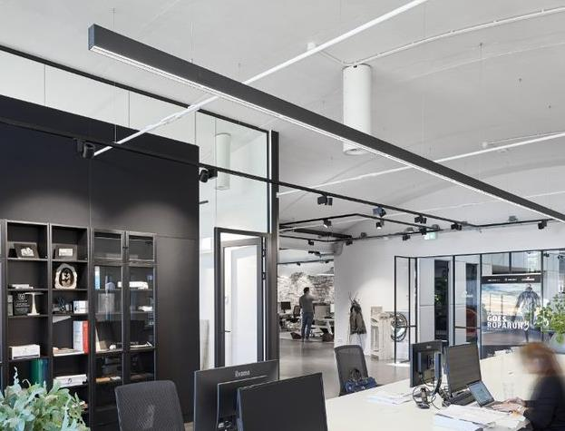
Refurbisment | modernization
Entrepreneurs, office real estate developers and operators are faced with the challenge of rethinking and reevaluating their existing structures. Anyone who wants to develop their companies in a future-proof manner must also create future-proof working environments for this purpose.
Adding urgency to lighting refurbishment is the phased ban on the sale of halogen lamps, fluorescent lamps and compact fluorescent lamps starting in February 2023.
TRILUX offers customer-oriented solutions, from 1:1 replacement with luminaires featuring modern LED technology to a completely rethought and digitized lighting concept, with full service options and financing offers.
19
TRILUX SIMPLIFY YOUR LIGHT

Slide 20
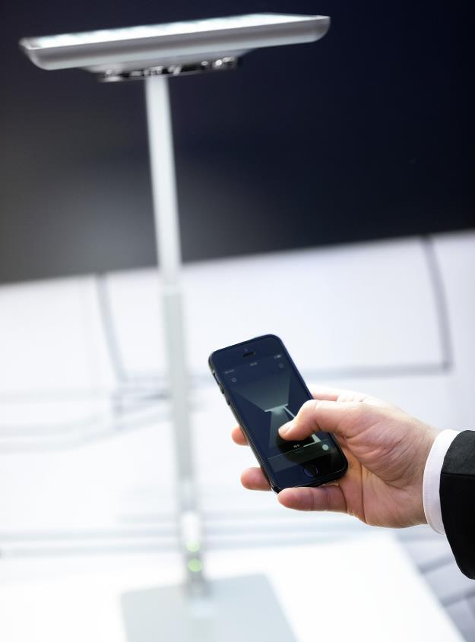
Digital working environments
The working world of today and tomorrow is and will remain hybrid. It is often characterised by smart solutions that enable flexible working, safe and healthy coexistence, and efficient use of space.
For companies or office operators, "smart" must at the same time be as simple as possible to keep costs and complexity under control.
Whether light and service quality, flexibility or smart lighting solutions – TRILUX has relevant expertise and thus supports you in the realization of customized and smart lighting concepts.
20
TRILUX SIMPLIFY YOUR LIGHT

Slide 21
light quality
21
TRILUX SIMPLIFY YOUR LIGHT

Slide 22
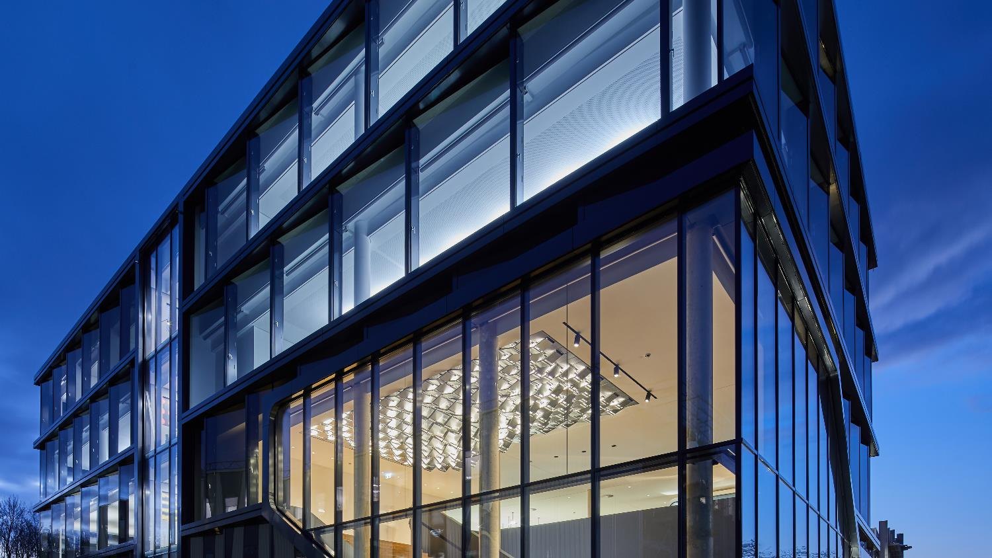
TRILUX LIGHT CAMPUS COLOGNE
Modern working environments in the metropolitan region

Slide 23
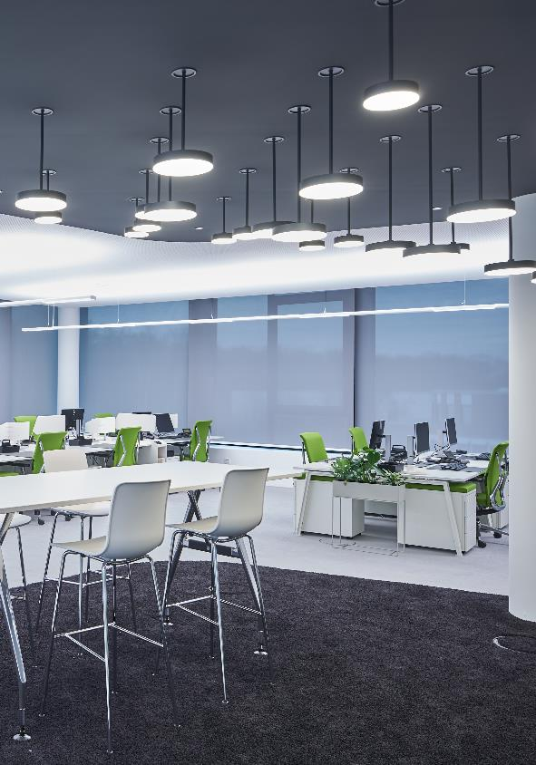
a unique interplay of functionality and design
The four-story building, which covers a total of 2,700 square metres, was designed in collaboration with GRAFT Architekten (Berlin), among others.
The result is a unique interplay of functionality and design, of light and architecture. The focus is on attractive and bright rooms as well as open areas that can be used flexibly and thus offer optimal conditions for New Work and cooperative working.
An important component of the new building concept – and a home game for TRILUX – is networked, intelligent lighting. It combines everything the future has to offer, from sensors and light management to Human Centric Lighting and Predictive Maintenance.

Slide 24
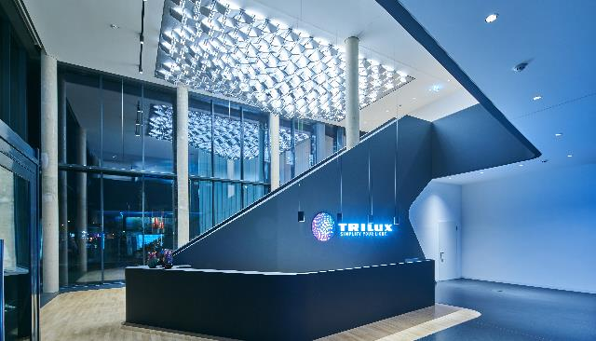
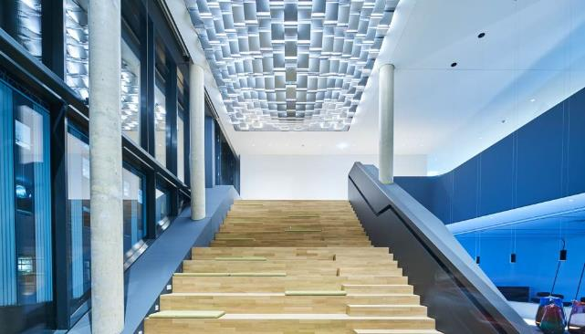
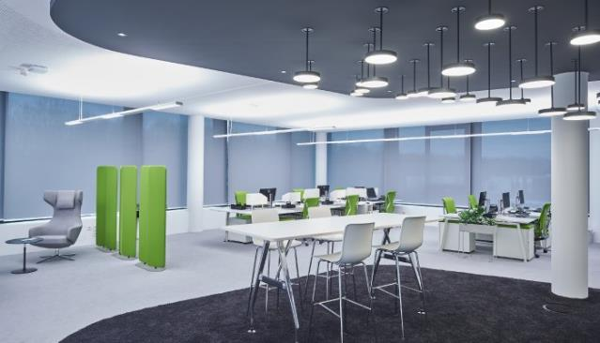
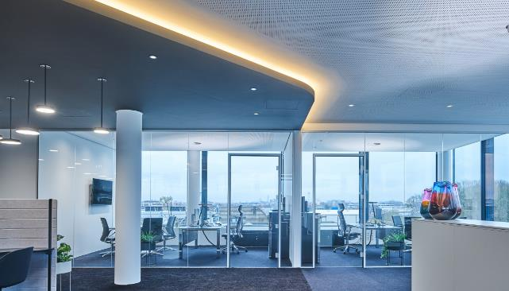

Slide 25
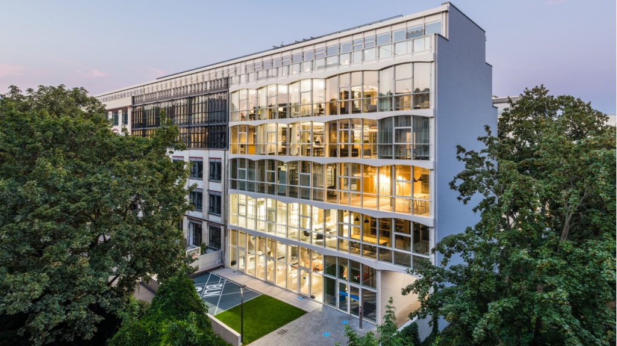
Nike One Central HQ, Berlin
Addition to a listed industrial building

Slide 26
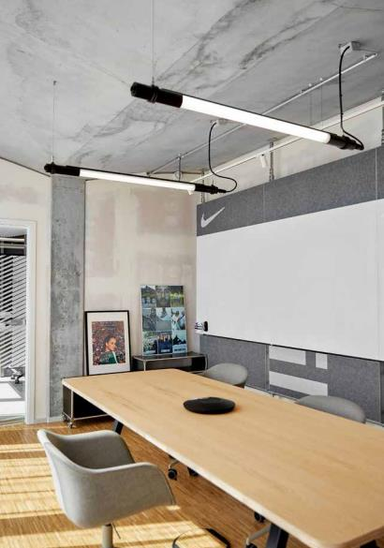
A prime example of light quality and user comfort
The new Nike One Central HQ is located in the middle of Berlin-Friedrichshain, embedded in the local neighbourhood structure. The result is a diverse office campus for up to 300 employees. This includes flexible workspaces, rooms for influencers and top athletes, showrooms and numerous sports facilities.
The versatility of the So-Tube is also reflected in its use as a single pendant luminaire in white/white. The circadian lighting provides a natural and motivating working atmosphere in the conference rooms. The length of the luminaires was combined and matched with table and media systems on site.

Slide 27
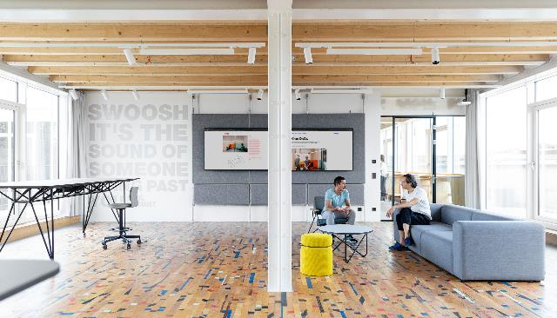
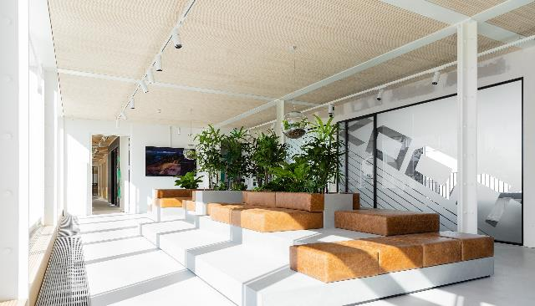
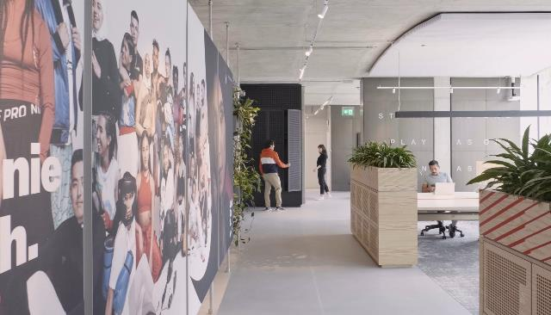
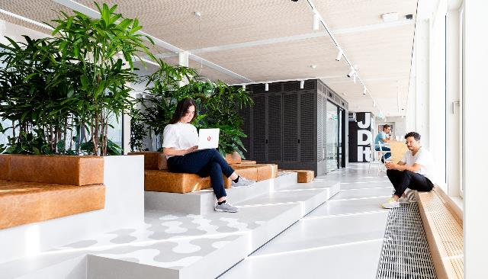

Slide 28
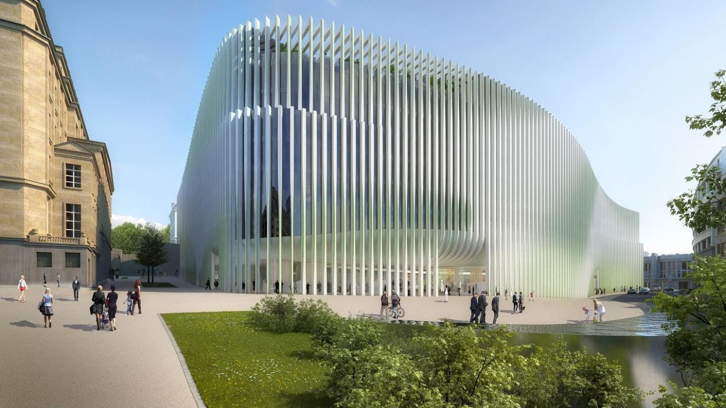
BNP PARIBAS IN BRUSSELS
The largest HCL project in Europe

Slide 29
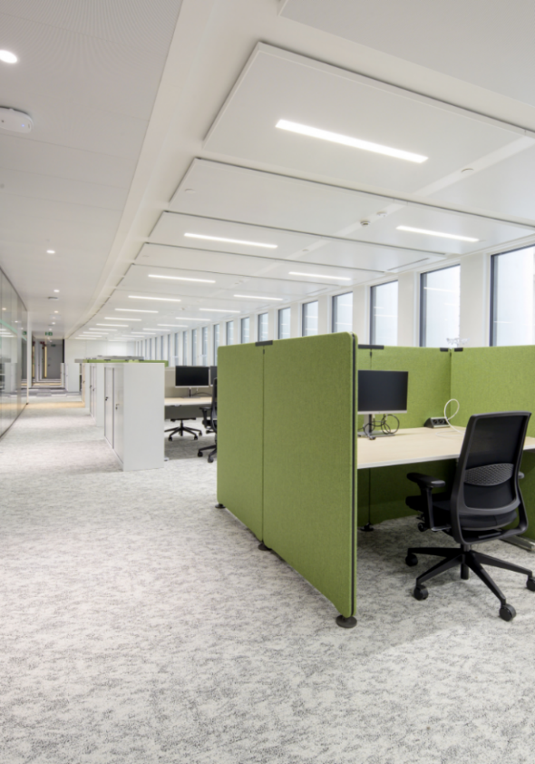
LIGHTING SOLUTIONS BASED ON HUMAN CENTRIC LIGHTING
The new BNP Paribas headquarters in Brussels has a total of more than 100,000 m­² of space on 12 floors, five of which are underground. This means that the dedicated office building has a capacity of 4,500 workplaces for BNP Paribas employees.
The building is equipped with high-quality materials and the latest technologies, which not only increase the comfort of employees but also enable optimization of environmental performance. As a result, BNP Paribas received BREEAM "Excellent" and "Passive House" sustainability certificates.
This modern office world was adapted to the new, hybrid way of working. As a lighting supplier, TRILUX was closely involved from the start of the project and supplied a total of 8,000 luminaires that were fully controlled via Human Centric Lighting (HCL).

Slide 30
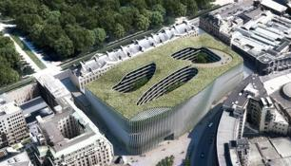
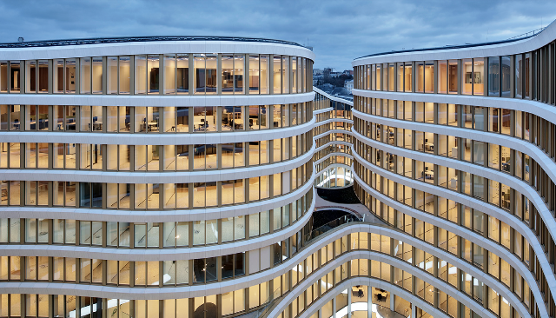
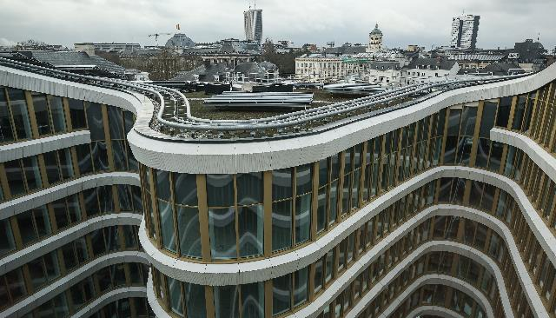
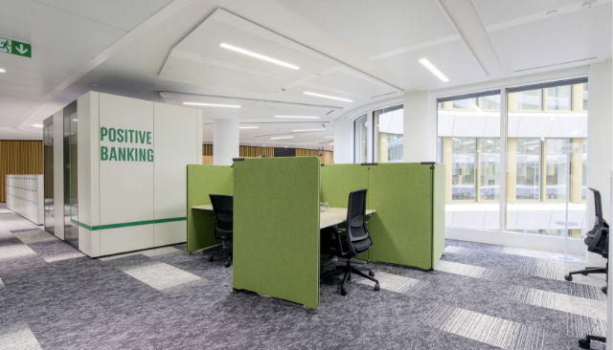

Slide 31
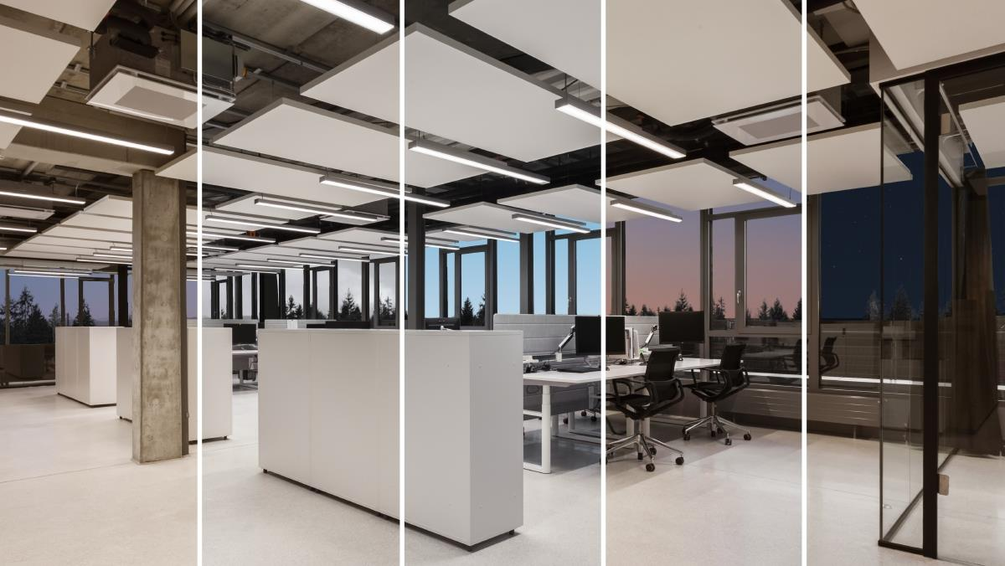
human centric lighting
Experience natural light

Slide 32
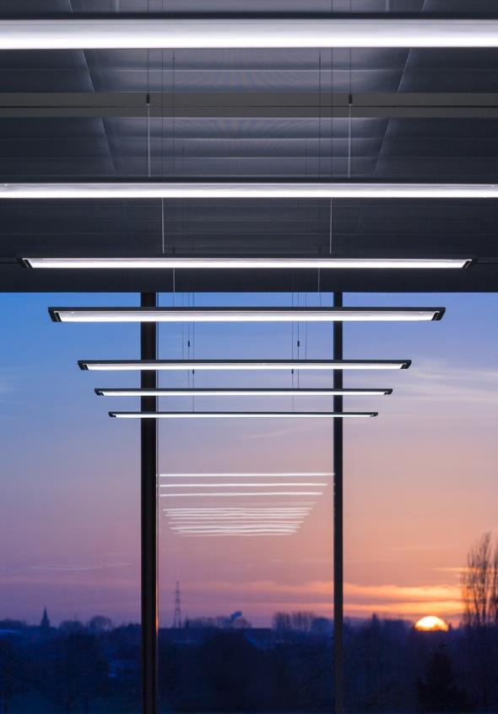


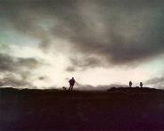
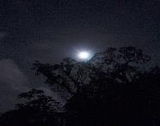
HUMAN CENTRIC LIGHTING
Light is a decisive factor for productive work and motivated employees – both for classic office environments and for the flexible New Work concepts.
TRILUX HCL solutions support the human biorhythm and can provide more well-being and motivation. This is how TRILUX brings sunlight into the room.
100,000 lx 10,000 lx 3,000 lx 0.1 lx

Slide 33
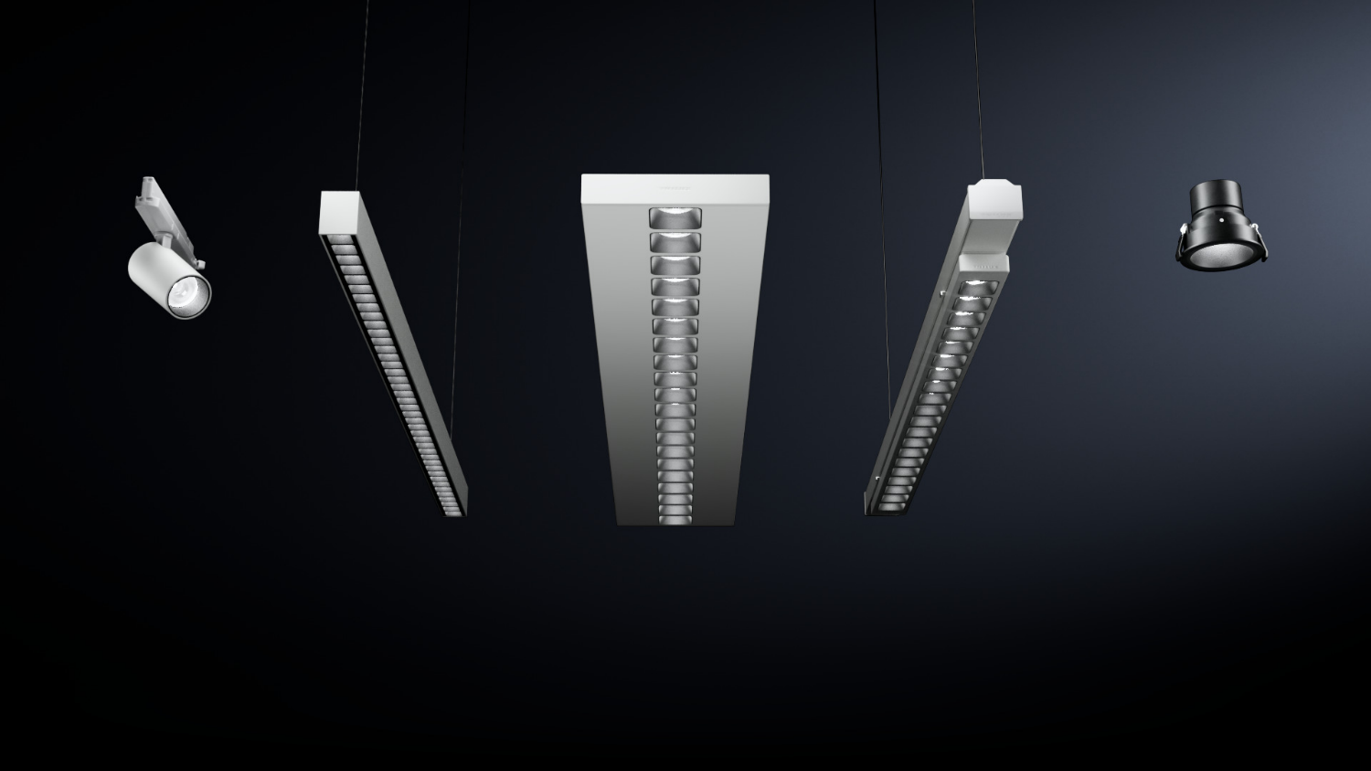
CONVISION® TECHNOLOGY
From TRILUX for pleasant light

Slide 34
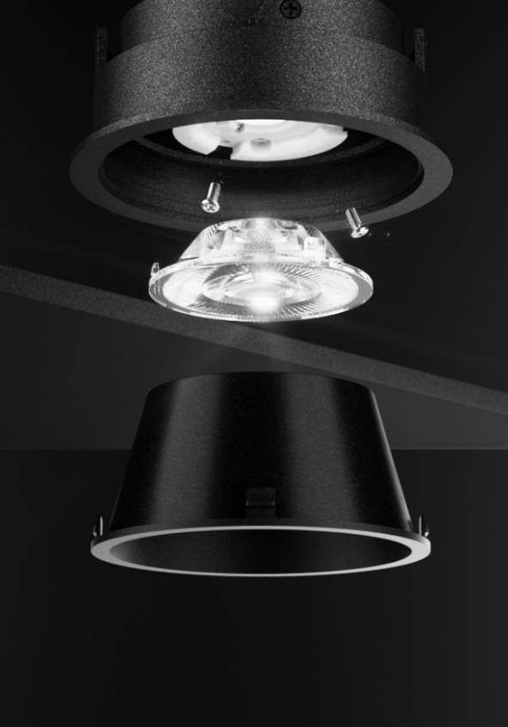
A prime example of light quality and user comfort
Luminaires with ConVision® technology – for example the Creavo luminaire system, the Sonnos downlight series and the Finea light channel – produce this particularly pleasant light: it is directed, and space and objects are perceived in a particularly vivid way.
The luminaires have a calm and unobtrusive effect. It enables differentiated lighting concepts through various light distributions in a uniform design. A principle that works just as well with linear luminaires as with downlights or spotlights.
Of course, ConVision® lighting technology is also suitable for Tunable White LEDs for use in HCL lighting concepts. TRILUX meets the particularly high demands for mixing the light colour components by precisely adjusting the lens material.

Slide 35
employees in focus
35
TRILUX SIMPLIFY YOUR LIGHT

Slide 36
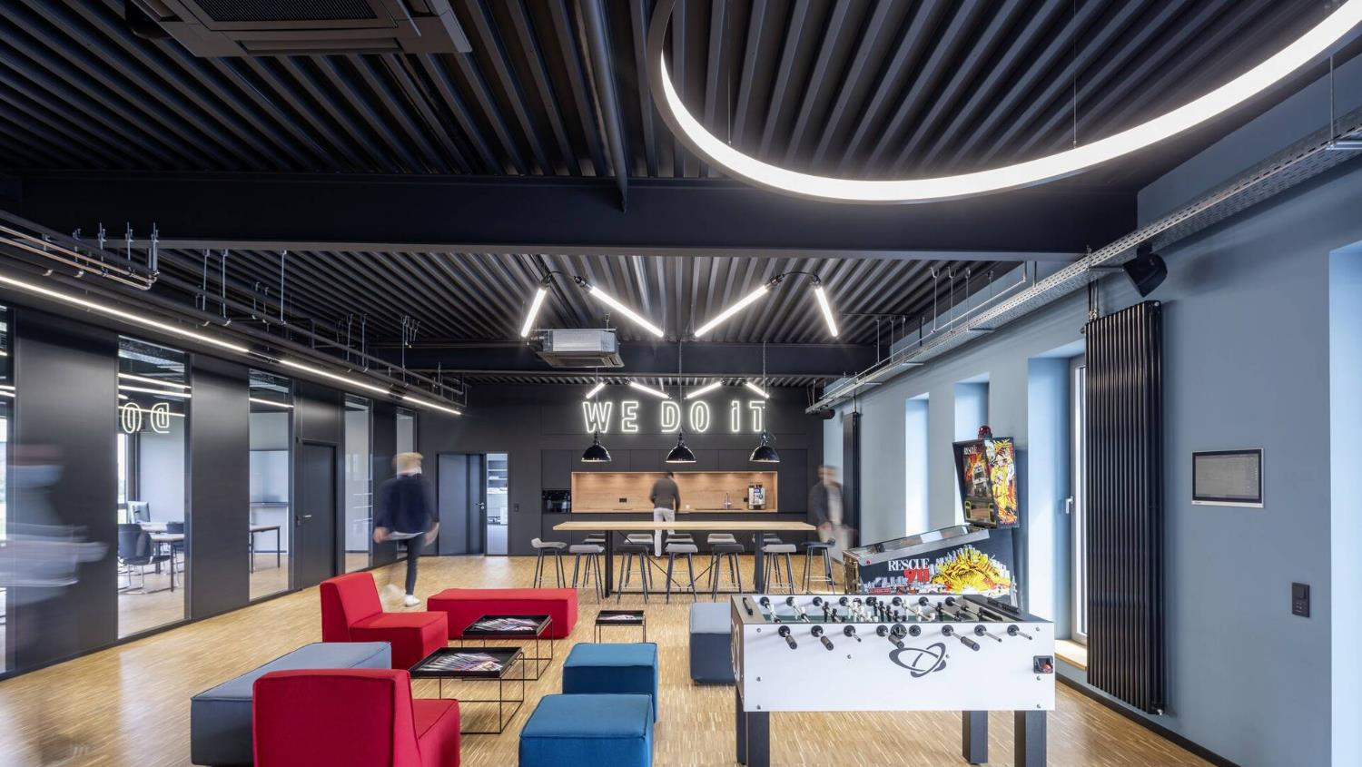
ELEKTRO BECKHOFF, VERL
A training centre with a future
Notes:
https://www.trilux.com/de/anwendungen/referenzen/detail/reference/ELEKTRO%20BECKHOFF%20GmbH/?cHash=8e14318a160b22790ff7b26c59442655
https://www.elektro.net/119557/neues-ausbildungszentrum-bei-elektro-beckhoff-eroeffnet/

Slide 37

Focus on the employee
At Elektro Beckhoff in Verl/Germany, the apprentice quota has been above average for years and the focus is on the quality of the training. This has now been improved by the new in-house training center in Verl.
Spacious practice and theory rooms, modern lab tables and energy boards, a casual lounge area - the 450 square metre training centre presents itself young and transparent.
With the support of TRILUX lighting solutions, an activating and motivating working atmosphere prevails for a future-oriented training centre.
Notes:
https://www.trilux.com/de/anwendungen/referenzen/detail/reference/ELEKTRO%20BECKHOFF%20GmbH/?cHash=8e14318a160b22790ff7b26c59442655
https://www.elektro.net/119557/neues-ausbildungszentrum-bei-elektro-beckhoff-eroeffnet/

Slide 38





Slide 39

JLL WATERSTREET, LONDON
More people, less desk

Slide 40

JLL IMPRESSES WITH
NEW WORK-OFFICE
The goal for the redesign of the 6,300 square metre office space was to create a collaborative, sustainable, inclusive, health-focused, tech-smart, energy-efficient and flexible workplace.
In contrast to classic offices, the focus in the new JLL Office is not on desk workstations, but on employees.
At the heart of the lighting concept is the extremely flexible Sonnos LED downlight family. Also in use: Canilo supended luminaires, the Finea light channel and E-Line Next. In addition, all luminaires were networked via a light management system.

Slide 41
sustainability
41
TRILUX SIMPLIFY YOUR LIGHT

Slide 42






OUR
SUSTAINABILITY VISION
"Responsible use of resources and creation of high-quality living and working spaces. Leading the way boldly and creatively as a pioneer in the industry ."

Slide 43




Our commitment - research projects
As part of our sustainability strategy, we are exploring new technologies and business models for the future.
Reusable and
reprogrammable parts for sustainable LED-based lighting systems
Sustainable Materials in Future Luminaire Designs - from Recycling back to Application
Interchangeability: The aim is to develop a modular architecture and an intelligent production scheme for LED luminaires
Circular economy: The aim is to make lighting fit for the circular economy

Slide 44




















Examples of holistic alignment
Material usage
Interchangeability
Circularity
Environmental data
Well-being
Tugra
Tugra
Spare parts
Pilot project in 2023
Environmental friendliness
Olisq
Cultega
Recyclability
EPEA Workshop
Employee well-being
40 % PPR
Notes:
Material use:
In-house production Regrind - evaluation whether we can call it a recyclate.
Tugra also optionally with Covestro
Interchangeability
in 67 % of indoor luminaires the lighting unit can be replaced by a qualified person
in 53 % of the indoor luminaires the lighting unit can be easily replaced
in 84 % of indoor luminaires the ballast can be replaced by a qualified person

Slide 45



German Sustainability Award 2023
The jury was convinced by the sustainable overall concept:
Our highly efficient continuous-line system makes lighting more climate and environmentally friendly
Overall, energy and CO2 savings of up to 85 percent are possible.

Slide 46


TRIPOLIS PARK
An environmentally conscious campus of 50,0000 m²

Slide 47

The next generation office
The aging TRIPOLIS PARK has been transformed into a state-of-the-art work environment. The new office campus sets standards in sustainability as well as inspiration and health.
TRILUX is responsible for the lighting solution and the associated smart control system. It is the largest construction project in the 111-year history of the company.
A total of 10,000 TRILUX luminaires are used in the interior areas alone. A special sensor is installed in 3,000 of them.
TRILUX HCL lighting solutions in combination with LiveLink significantly reduce energy consumption and at the same time increase the well-being of your employees.

Slide 48

rauch Möbelwerke, Freudenberg
Everything perfectly spruced up
V.Offices, Krakow
Poland's most sustainable office building

Slide 49

Workspaces of the future
    The newly constructed office building in Krakow offers 24,700 m² of leasable space built to the highest standards of ecology as well as ergonomics and well-being.
    With a BREEAM score of 98.87%, V.Offices is the most efficient office building in Poland and one of the most sustainable offices in the world. This outstanding score was also achieved through the use of state-of-the-art luminaires from TRILUX.
    With a total of 1,540 luminaires for indoor and outdoor areas including lighting management, TRILUX implemented the entire project as a complete supplier. Maximum efficiency, excellent visual comfort and minimal light pollution – all factors that go into the BREEAM scores.

Slide 50

Skanska, London
Recycle instead of buying new
Notes:
Cycle instead of buying new - TRILUX Simplify Your Light

Slide 51

Adios waste, hello closed loop project
    Skanska is a multinational construction and development company from Sweden with ambitious sustainability goals. The goal: to create a smart, sustainable and inspiring workplace that serves as an agile hub for collaboration and digital work.
    TRILUX is adapting the existing LED lighting at Skanska to the new location and new requirements as part of a closed loop project. By modernizing or modifying 650 metres of light channel, Skanska saves a total of 17 tons of CO2 – compared to a new purchase.
    To avoid waste and make the best use of available resources, we developed an intelligent take-back process for the TRILUX LC 60 light channel. The linear luminaires were taken back, disassembled and all recyclable materials were recycled.
51
TRILUX SIMPLIFY YOUR LIGHT

Slide 52

Up! BERLIN
Transformation from department store to workspace

Slide 53

Transformation from department store to workspace
An aging department store at Berlin's Ostbahnhof station has been transformed into a forward-thinking place for work and retail, designed by Jasper Architects.
The new glass building envelope was cut into a wedge shape in its cubature, thus providing daylight-flooded, high-quality office space inside even in the areas far from the façade.
A connecting element that runs through the entire building, blends in perfectly with the sophisticated architecture and provides perfect light everywhere: the modular E-Line Next continuous-line system in black.
27 SIMPLIFY YOUR LIGHT

Slide 54
individuality
54
TRILUX SIMPLIFY YOUR LIGHT

Slide 55

ZALANDO M_EINS, BERLIN
Modern and sustainable office architecture

Slide 56

A lIVing OFFICE
With A variety of functions
M_Eins is home to Zalando, Europe's leading online fashion platform, and is located in the middle of one of Berlin's largest inner-city development areas.
The building design was about making the design flexible to allow for efficient office concepts suitable for both open and closed office floors.
The lighting solution from TRILUX becomes part of an identity-creating spatial concept that zones the different areas – So-Tube LED was integrated here as a surface-mounted system into the purist architecture. The flexible possibility of arrangement was the key to success here.

Slide 57

SO-TUBE LED
Industrial Style meets New Work

Slide 58

UP FOR ANY JOB
The perfect lighting solution for industrial architectures that are to be used, for example, as office buildings with open space and co-working areas: With its modern industrial design, the So-Tube LED fits perfectly even in harsh environments – and creates a uniquely attractive atmosphere in the office with high-quality light.
Whether used as a functional individual luminaire, practical continuous line or eye-catching artistic lighting installation: multiple mounting options, standard through-wiring and flexible connectors make So-Tube LED a versatile all-rounder for a wide range of applications.

Slide 59

dfb aCademY, Frankfurt
Modern and sustainable office architecture

Slide 60

FULL Power ART!
TRILUX Artisan Workshop has created a unique work of art for the Academy of the German Football Association in Frankfurt am Main: an eight-metre high light sculpture reminiscent of a bundle of luminous reeds.
The luminaire construction itself proved to be challenging. The luminaire bodies are made of satin-finished plastic of the very highest quality, with seamless and form-fitting transitions to the support system. Matching innovative lighting technology provides excellent light – a total of five diffusers inside the translucent tubular bulbs guarantee attractive and homogeneous illumination.

Slide 61
innovation
61
TRILUX SIMPLIFY YOUR LIGHT

Slide 62

BICULT LED
A light revolution at the desk

Slide 63

Light as individual as never before
The changing world of work demands not only flexible and homely office equipment – but also modern lighting concepts that combine excellent light with flexibility and individual adjustment options.
TRILUX Bicult LED revolutionizes office lighting. It is the first desktop luminaire to combine a direct and indirect light output. While the upward glare-free indirect lighting illuminates the entire office, the direct component creates perfect light on the desk.
Users can adjust their personal light individually on the luminaire or via app. This enables standard-compliant light with unprecedented flexibility.

Slide 64

Apps Associates GmbH, DORTMUND
Smart lighting for agile work

Slide 65

NEW WORK INFRASTRUCTURE FROM THE SOCKET
The software company Apps Associates was looking for a smart lighting solution for its new offices at Dortmund‘s lake Phoenix.
The lighting had to perfectly match the company's agile way of working and optimally support the New Work structures with open office landscapes and changing workplaces. The only shortcoming of the new location: the lack of power supply in the ceiling panels.
Ideal conditions for the Bicult LED desktop luminaire, which was of course used as a networked "Smart Connect" variant. Particularly attractive: Lighting with the Bicult LED means that no free-standing luminaires have to be used, so that the visual axis in the room remains free.

Slide 66

LIGHTGRID
Desk and ceiling lighting in dialogue

Slide 67

Highest visual comfort through automatic synchronization
The innovative Lightgrid control system coordinates desk and ceiling lighting. This reduces costs and enables, among other things, the Human Centric Lighting curves of the various luminaires to be perfectly coordinated.
This Bluetooth-based control system makes it possible for the desktop and ceiling luminaires to communicate with each other – even if the desktop luminaire is controlled by DALI and the ceiling lighting by KNX.
Clever: Not only all desktop luminaires, such as the Bicult LED, can be controlled with Lightgrid, but also all "mobile" TRILUX luminaires, for example also the Luceos Slim LED free-standing luminaire.

Slide 68
smartness
68
TRILUX SIMPLIFY YOUR LIGHT

Slide 69

trilux light campus amersfoort
Intelligent control for optimal lighting conditions

Slide 70

ONE SITE SETS STANDARDS
    To show our customers how quickly and easily Location Based Services can be implemented, we have implemented the full program in our TRILUX Light Campus in Amersfoort.
    In addition to Indoor Navigation, also Proximity Marketing, Asset Tracking and data visualization via Heat Mapping were implemented in Amersfoort.
    The implementation of the beacon technology – including planning – took just 2 weeks. For this purpose, a total of 50 beacons and 5 beacon controllers were integrated into the lighting – and the "World of TRILUX App" was expanded to include the corresponding functions.
70
TRILUX SIMPLIFY YOUR LIGHT

Slide 71

zeHnder Center of Climate, lahr
Lighting and sun shading make common cause

Slide 72

A real innovation for more efficiency and well-being
    In the almost 5,000 m² new building, competence and passion for a healthy indoor climate can be experienced. The three-story building was designed as a space for innovative ideas and a place of learning, as well as for encounters and exchanges between employees, customers and visitors.
    One component of the holistic building concept is the Wellumic lighting management system from TRILUX and Warema.
    This solution enables the coordination of the two trades lighting and sun protection as an attuned light management system.
    For this purpose, sensors measure the lighting conditions indoors and outdoors – and automatically adjust the exterior blinds and lighting optimally.
72
TRILUX SIMPLIFY YOUR LIGHT

Slide 73

vodafone, kerpen
Technology and IT site for around 460 employees

Slide 74

Energy savings thanks to light management BY trilux
    In Kerpen, the working world at Vodafone is being reinvented. The 'Future Ready' concept includes new collaboration areas, work cafés and practical think tank spaces – in addition to classic workplaces in open-plan offices, these are some of the highlights of the new concept, which makes the Kerpen site shine in a new light.
    The solution from TRILUX: intelligent lighting systems. Controlled by sensors, they minimise their energy consumption, report maintenance requirements and react to their environment and the users.
    The networking of TRILUX luminaires via IoT ensures greater transparency, energy efficiency and sustainability. By converting lighting to LED in combination with smart control, companies can save up to 85% energy.
74
TRILUX SIMPLIFY YOUR LIGHT

Slide 75
other topics and tools
75
TRILUX SIMPLIFY YOUR LIGHT

Slide 76

trilux Artisan Workshop
    When it comes to special requests in terms of lighting, we are the right contact:
    Technically and creatively unique solutions for ambitious and demanding architectural projects
    Individual customised lighting solutions according to customers' requirements
    Easy exchange from the beginning & throughout the project
    Unique pieces, from quantity of one
76
TRILUX SIMPLIFY YOUR LIGHT

Slide 77

LiveLink
TRILUX LiGht management
From individual room solutions to lighting control in large-scale projects. From upgrading existing lighting systems to new installations:
LiveLink – the light management system from TRILUX – offers comprehensive solutions for intelligent and resource-saving light management in the office.
    For every project size
    For interior and exterior areas
    Different technologies (DALI or radio)
    With cloud networking
    Connection to building control system
LEARN MORE

Slide 78

LIGHT AS A SERVICE
    Planning, implementation and operation of lighting installation are often associated with high effort and investment.
    With Light as a Service, TRILUX offers a clever all-round carefree package. TRILUX plans, installs and operates the lighting installation, the customer only pays a fixed monthly rate, which he can deduct from taxes as operating costs.
    Best of all, thanks to the high energy efficiency compared to the existing solution, the customer generally saves money from day one with Light as a Service.
LEARN MORE
78
TRILUX SIMPLIFY YOUR LIGHT

Slide 79

TRILUX ONE
ONE LOGIN. MANY Benefits.
    In addition to the personal business relationship, we at TRILUX rely on digital possibilities to make processes even more efficient and easier for you in the future.
    We have expanded the TRILUX portal and now offer you additional practical functions and services under TRILUX ONE:
    Work on projects together
    Access relevant documents faster
    View orders, check status, track delivery dates
    and much more...
REGISTER now
79
TRILUX SIMPLIFY YOUR LIGHT

Slide 80

TRILUX LIGHT SNACKS
SMALL bites, BIG BENEFITs
    We make light simple for you: Satisfy your hunger for knowledge with the TRILUX Light Snacks. Let us inform you regularly in a short and compact form about everything important from the world of light:
    Get to know our product innovations and services
    Get inspired by trends in the lighting market
    Look forward to current event information
    Benefit from the know-how of our TRILUX experts
REGISTER now
80
TRILUX SIMPLIFY YOUR LIGHT

Slide 81

THE TRILUX REFURBISHMENT Tool
    Lamp bans, exorbitant energy costs and ambitious sustainability goals – currently, refurbishing inefficient conventional lighting solutions with LED luminaires is one of the most urgent and commercially viable tasks in the market.
    The TRILUX smart online tool helps customers find the perfect 1:1 refurbishment solution for their requirements.
    After just a few steps, they will find out which solutions they can use to convert their existing lighting – and how high their individual savings potential is.
TO THE Refurbishment TOOL
81
TRILUX SIMPLIFY YOUR LIGHT

Slide 82

82
TRILUX SIMPLIFY YOUR LIGHT

Slide 83

LIGHT around THE BUILDING
    Between interior and exterior space, an expanded field opens up for lighting design around the building: from the facade to entrances, accesses, paths and facilities to parking lots.
    TRILUX lighting for outdoor areas lifts buildings out of their urban context, making them attractive and distinctive. It supports users in orientation and creates a safe environment with quality of stay – and all this as economically as efficiently.
learn more
83
TRILUX SIMPLIFY YOUR LIGHT

Slide 84

YOUR TRILUX CONTACT
OMAR RABAH APPLICATION MANAGER OFFICE
TRILUX Vertrieb GmbH Heidestr. 4 - D-59759 Arnsberg Mobile: +49 151 171 45 851 omar.rabah@trilux.com

Slide 85
trilux product solutions office
85
TRILUX SIMPLIFY YOUR LIGHT

Slide 86


www.trilux.com/finea-led
www.trilux.com/finea-led

Slide 87


www.trilux.com/sonnos-led
Notes:
Variety of variants | Product quality through lighting technology and product quality | Modern design | From one source

Slide 88


www.trilux.com/lunexo-led

Slide 89





www.trilux.com/lateralo-plus-led

Slide 90


www.trilux.com/solvan-flow-led

Slide 91


https://www.trilux.com/de/produkte/luceos-slim-standleuchte/
Notes:
Variety of variants | Product quality through lighting technology and product quality | Modern design | From one source

Slide 92


www.trilux.com/bicult-led

Slide 93



https://www.trilux.com/de/produkte/cultega-led/
www.trilux.com/cultega-led
Notes:
Variety of variants | Product quality through lighting technology and product quality | Modern design | From one source

Slide 94

www.trilux.com/olisq-led
Notes:
Variety of variants | Product quality through lighting technology and product quality | Modern design | From one source

Slide 95


www.trilux.com/polaron-iq-led

Slide 96

www.trilux.com/arimo-fit-led

Slide 97

www.trilux.com/creavo-led

Slide 98


www.trilux.com/e-line-next

Slide 99


www.oktalite.com/invola

Slide 100

www.oktalite.com/canilo-plus

Slide 101

www.oktalite.com/bveo

Slide 102

www.oktalite.com/lightpanel

Slide 103

LET'S START TOGETHER WITH UNIQUE PROJECTS!
103
TRILUX SIMPLIFY YOUR LIGHT

Slide 104
thank you very much!

