Slide 1
CULTEGA

Slide 2
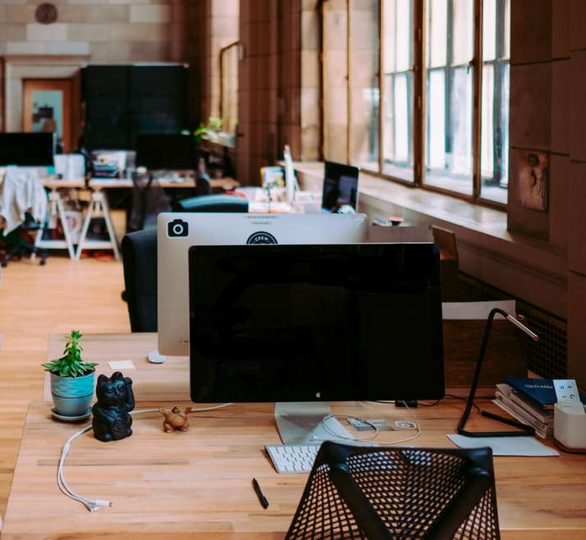
Individual light for well-being, health and sustainability in the workplace
High quality of light to enhance the office workplace and differentiate it from the competition
Flexible lighting solution for new-work concepts with open-space areas and changing workplaces
Heterogeneous lighting needs in the team

Slide 3
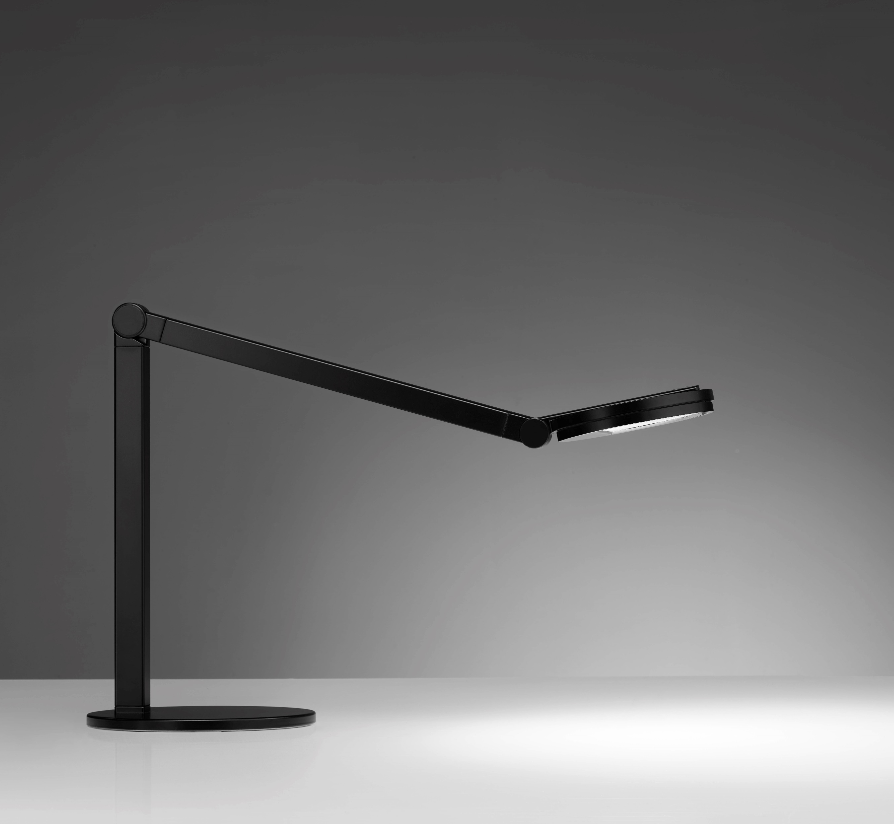
Table lamp with flexible adjustment options for light intensity and light colour
Excellent light quality: outstanding colour rendering, with HCL at the touch of a button, available everywhere
Save frequently used light scenes via app and call them up mobile at all workstations
Individual and tailor-made light at every desk

Slide 4
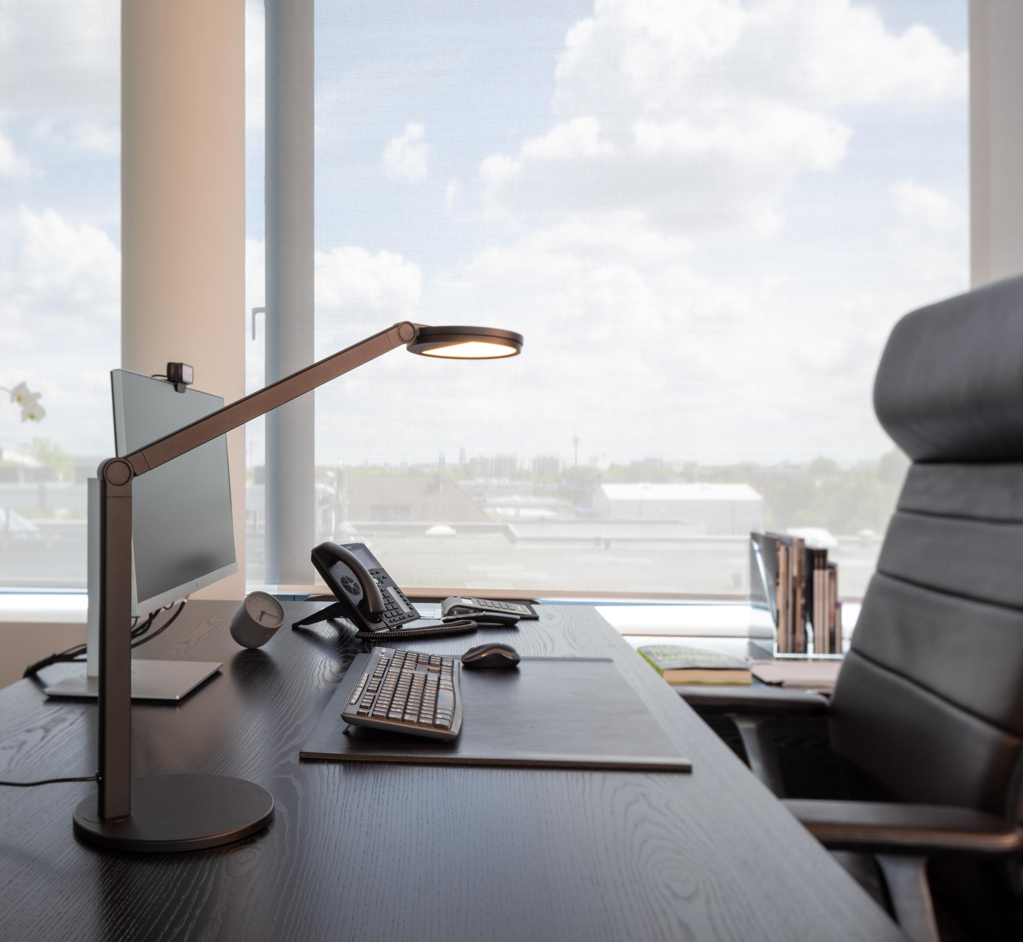
Individual and group offices - quality on the table
The excellent light quality and exclusive design create optimal visual conditions and an attractive atmosphere in the office. Thanks to individual adjustment options, everyone gets the light they want.

Slide 5

Open space and coworking spaces
Harmony instead of cabbage and turnips: As a networked solution, the Cultega LED ensures uniform lighting quality and mood in the room. Ideal for changing workplaces: Individual lighting scenes can be saved via app, taken along and called up on the move.

Slide 6

Mobile working - like the light, like the mood
Professional light, even in the home office: with its high-quality light, the Cultega LED quickly and easily ensures optimum visual conditions at the desk at home.

Slide 7

If the use of space has not been finally clarified, the Cultega LED desk luminaire offers flexible design options for room and lighting planning or arrangement of workstations. The luminaire is similarly versatile in terms of lighting technology, luminaire colour and mounting type. Special designs can also be implemented quickly and easily.

Slide 8
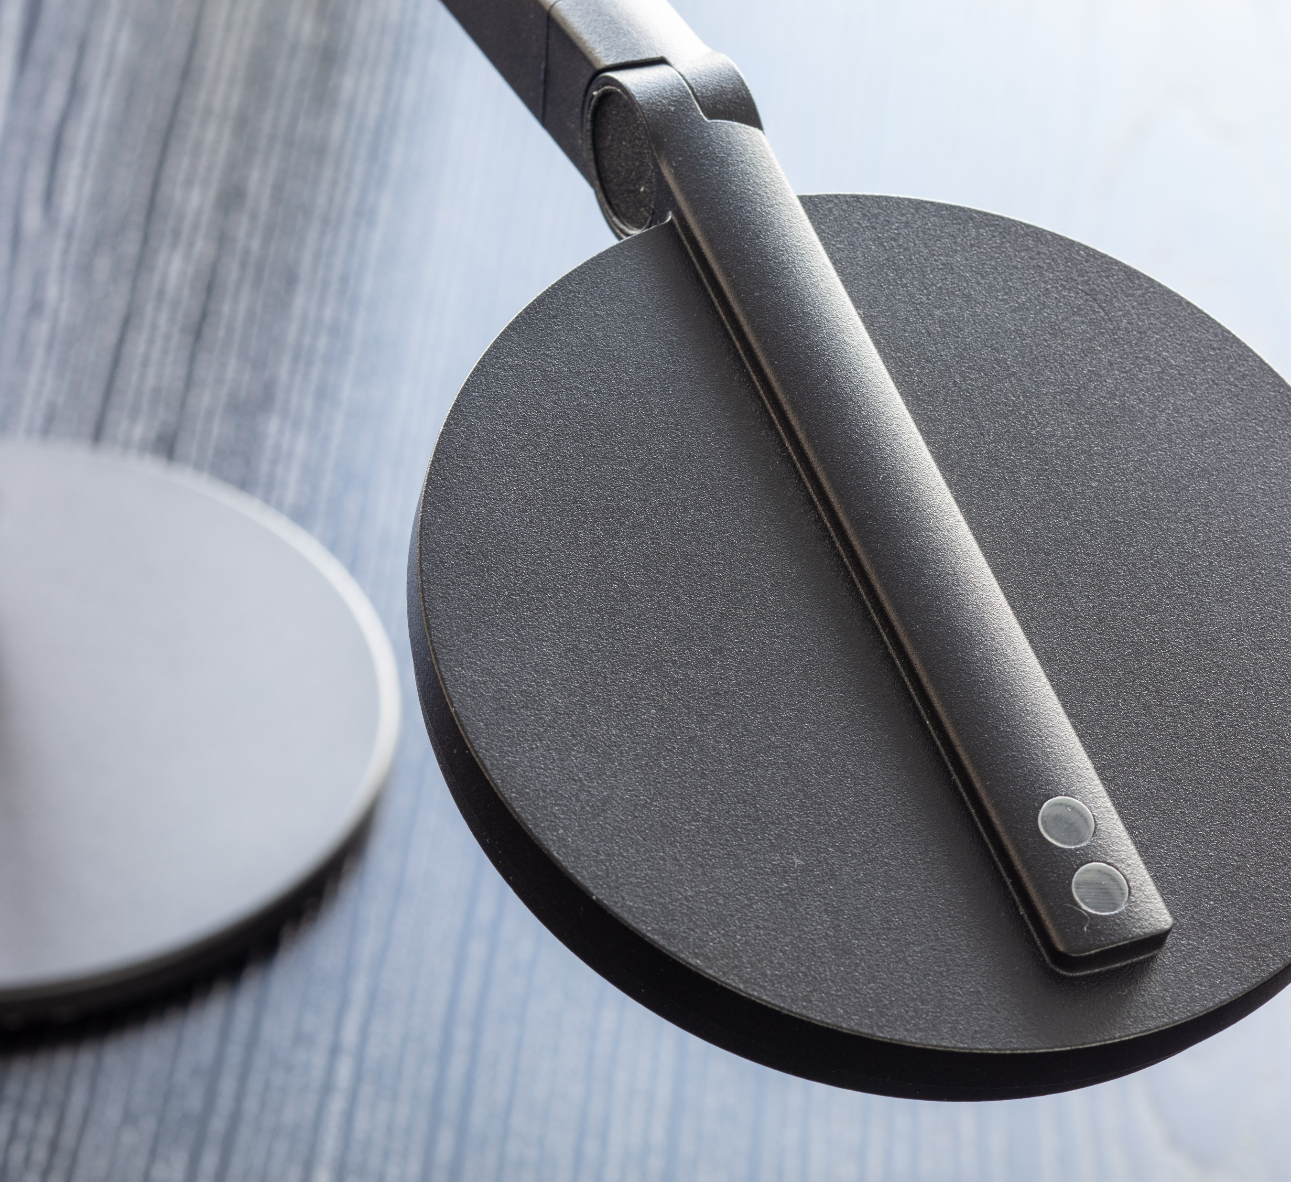
Lighting quality - show your colours
The high colour rendering of CRI>90 ensures excellent, natural lighting conditions on the desk
Individual light - intensity and light colour
The Cultega LED is dimmable. With the Active variants, the light colour can also be flexibly adjusted .

Slide 9
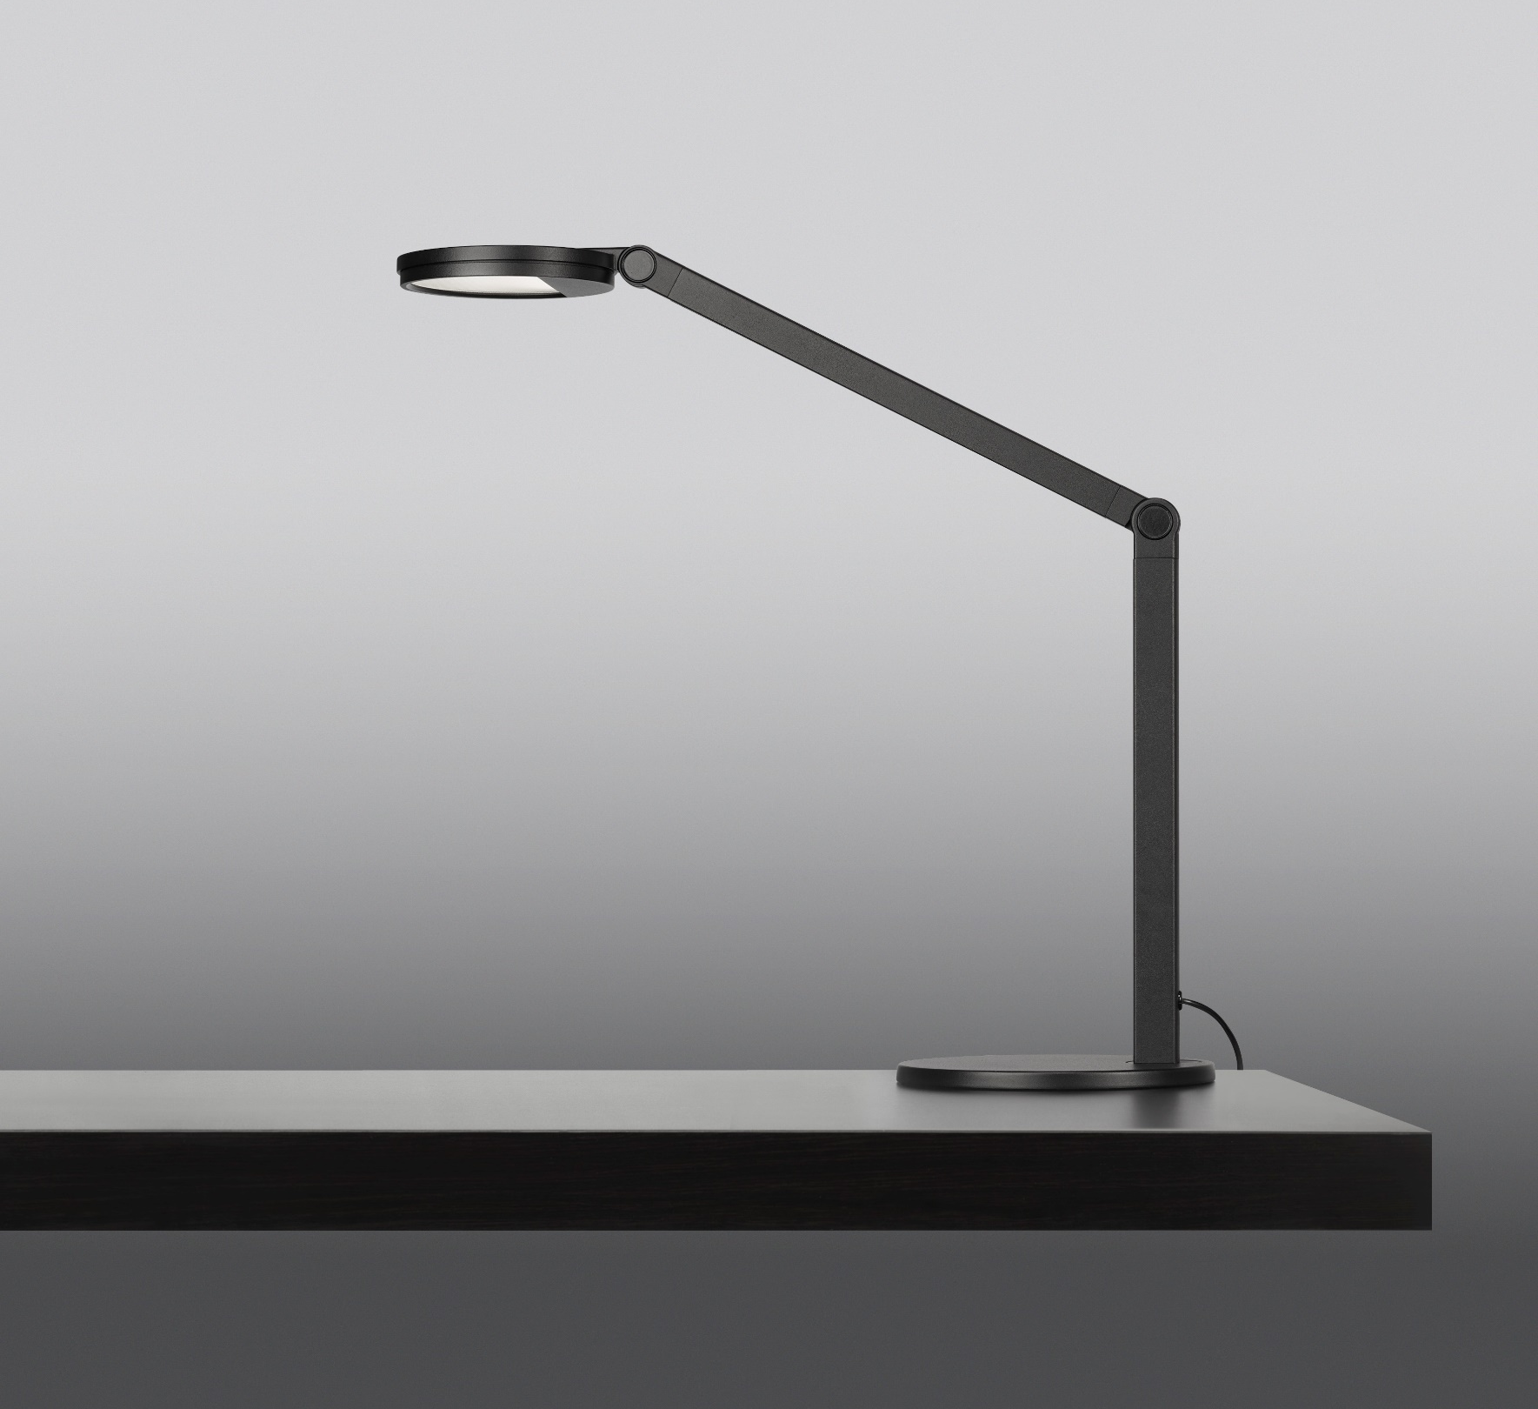
Three performance levels - precisely planned
With three different performance levels - Comfort, Comfort+ and Smart Connect - the scope of services can be adapted to suit your needs
Quality and flexibility, made in Germany
Meets the highest quality standards: the Cultega LED was developed and manufactured in Germany
Thanks to on-site production, special requests - for example in terms of colours or assembly methods - can be implemented quickly and easily.

Slide 10


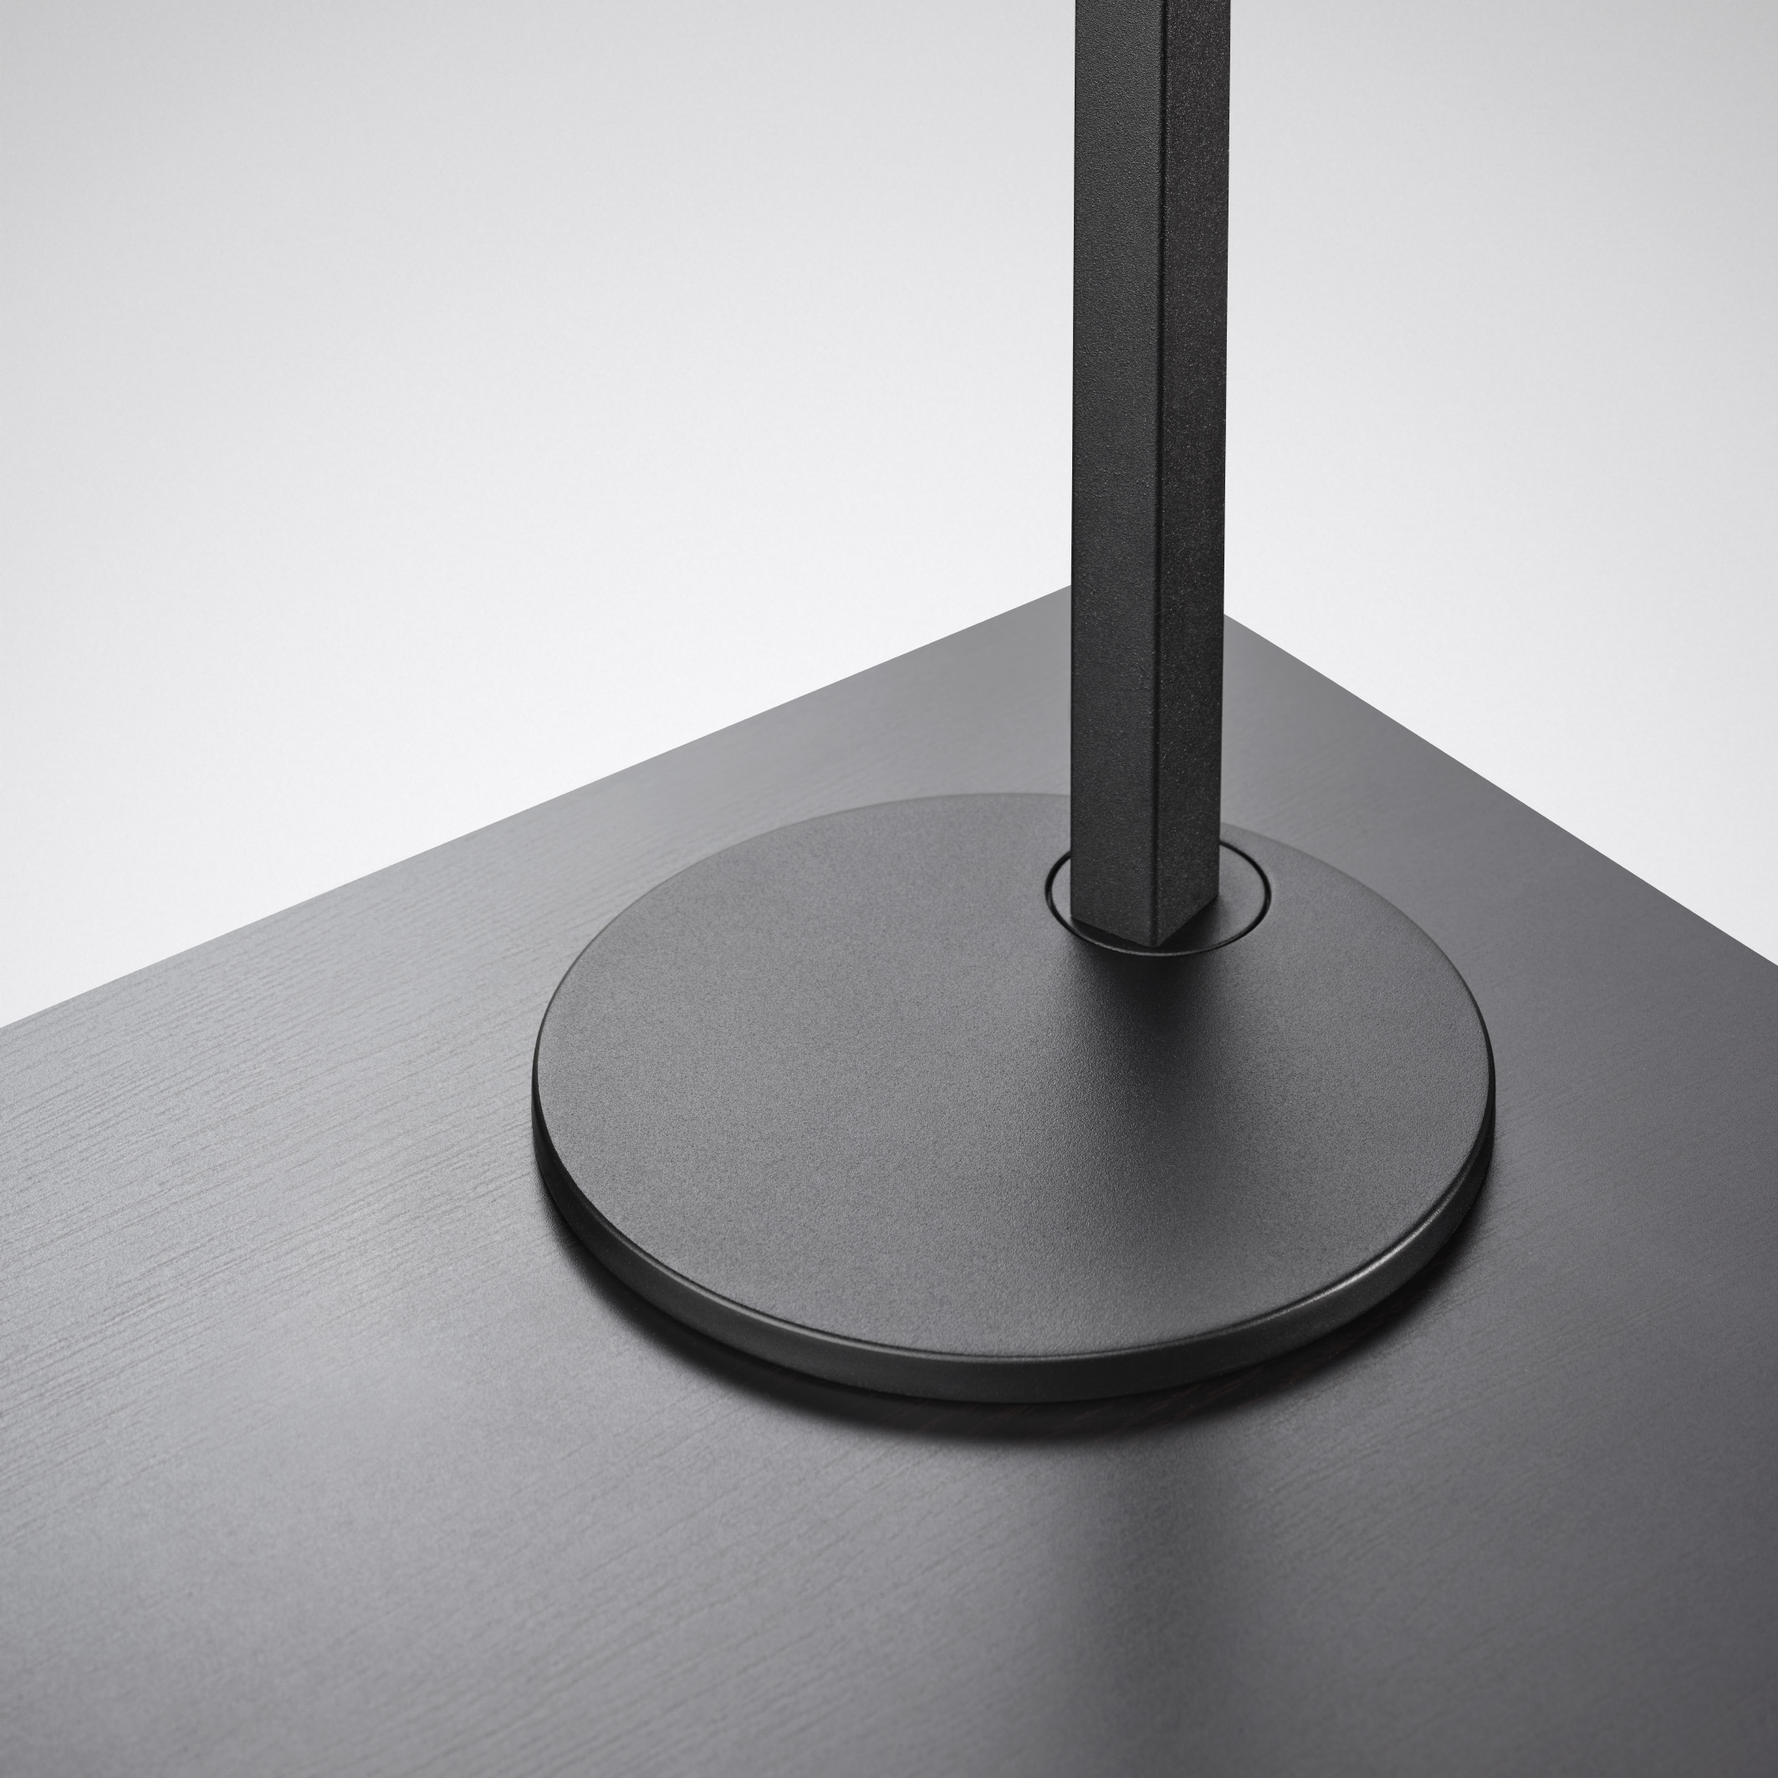
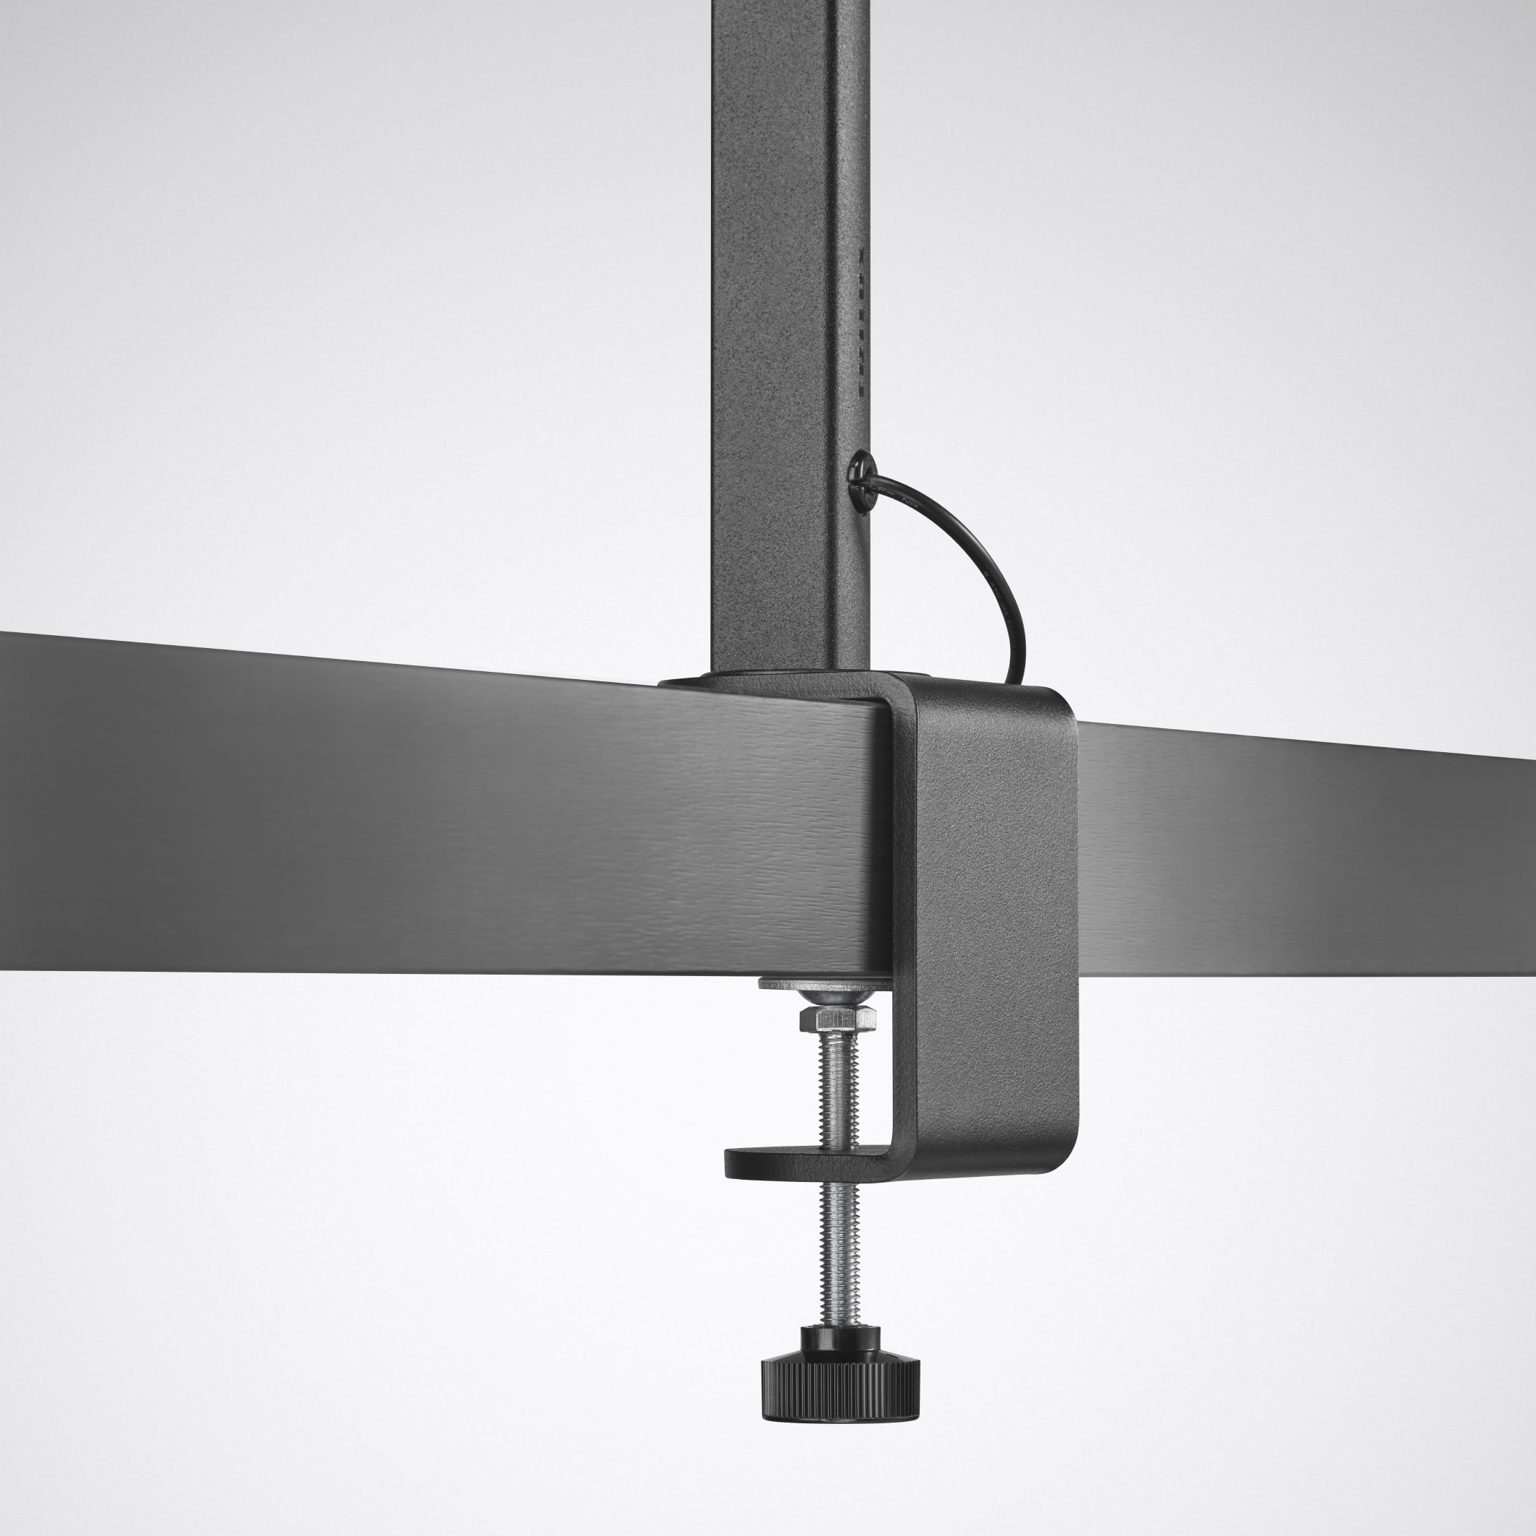
VARIANTS
Cultega - Portfolio
 | COMFORT | COMFORT + | SMART CONNECT
Light colours | 3.000K, 4.000K | ACT 2.700 - 6.000K | ACT 2.700 - 6.000K
Control | 2 buttons: ON/OFF & DIM | 2 push buttons: ON/OFF/DIM & light colour/HCL curve | 2 push buttons: ON/OFF/DIM & light colour/HCL curve
Other | - | Incl. status LED for automatic HCL curve | Incl. status LED for automatic HCL curve
Networking | - | - | Networking with ceiling lights
App control | - | - | Yes - LiveLink Workplace App
All versions are available with table base or clamp.

Slide 11
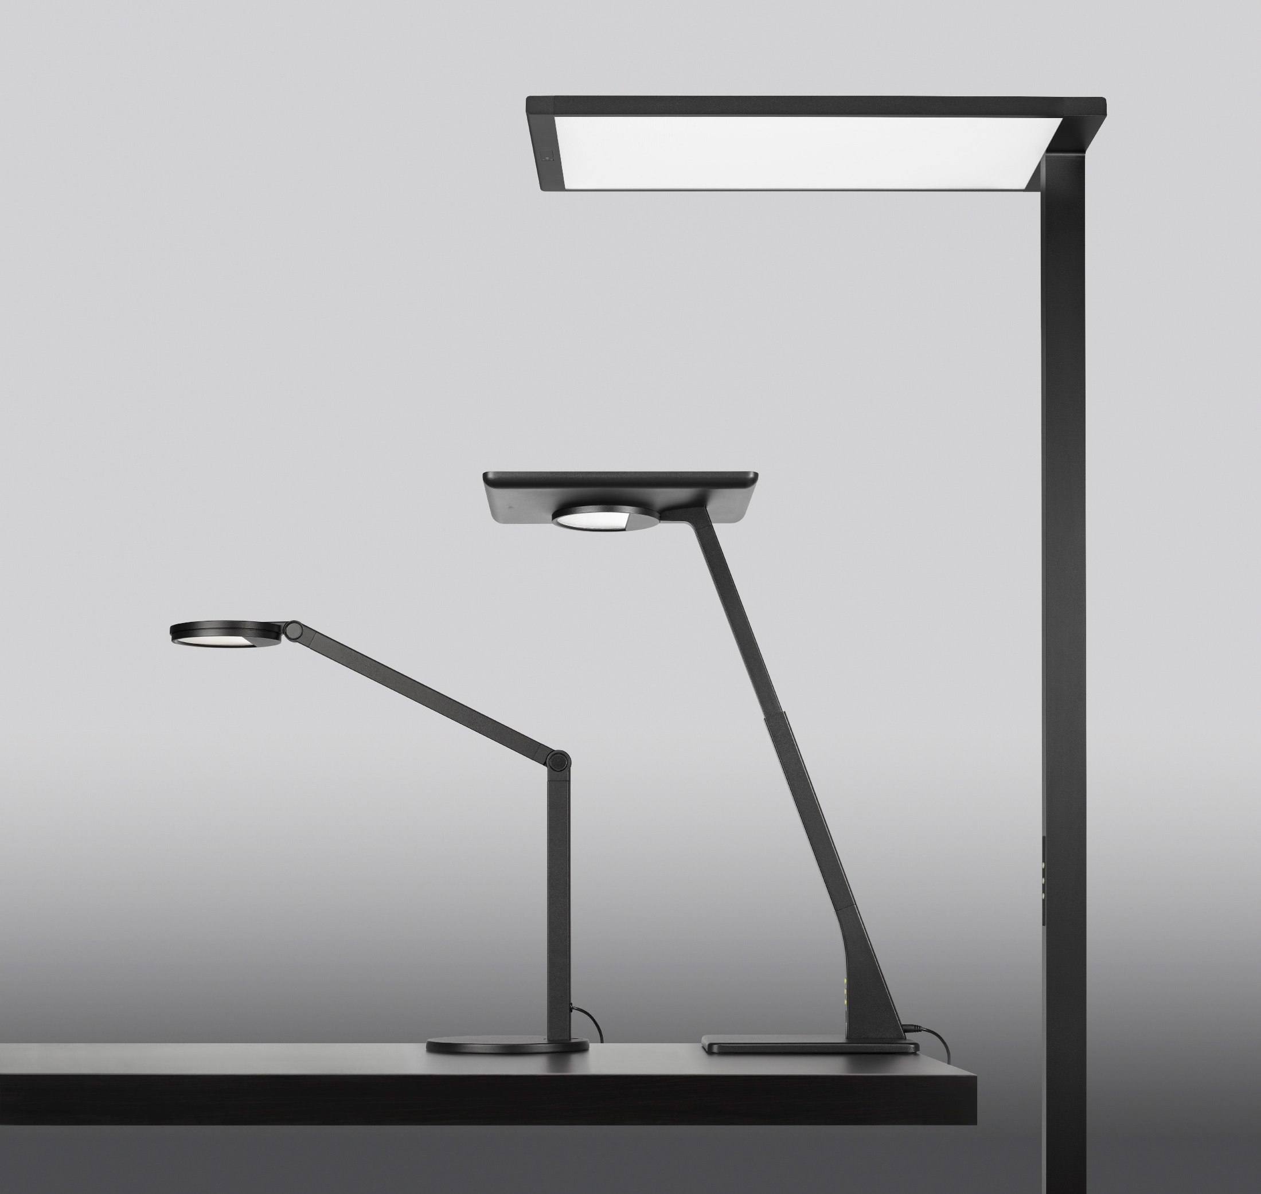
Minimalist design, maximum effect
Thanks to its reduced design with a stringent colour and form language and design elements typical of the family, the Cultega LED perfectly matches all other mobile TRILUX luminaires, such as the Bicult LED desk luminaire and the Luceos Slim free-standing luminaire. The result: an excellent design on the desk - and a holistic, cross-family design language that enhances the room.

Slide 12
Simply plug it in and you're done. As a desk luminaire, the Cultega LED functions according to the plug-and-play principle. With the Active version, the HCL curves are also already stored in the luminaire and ready for immediate use. Just as simple: positioning on the desk via base plate or desk clamp.

Slide 13
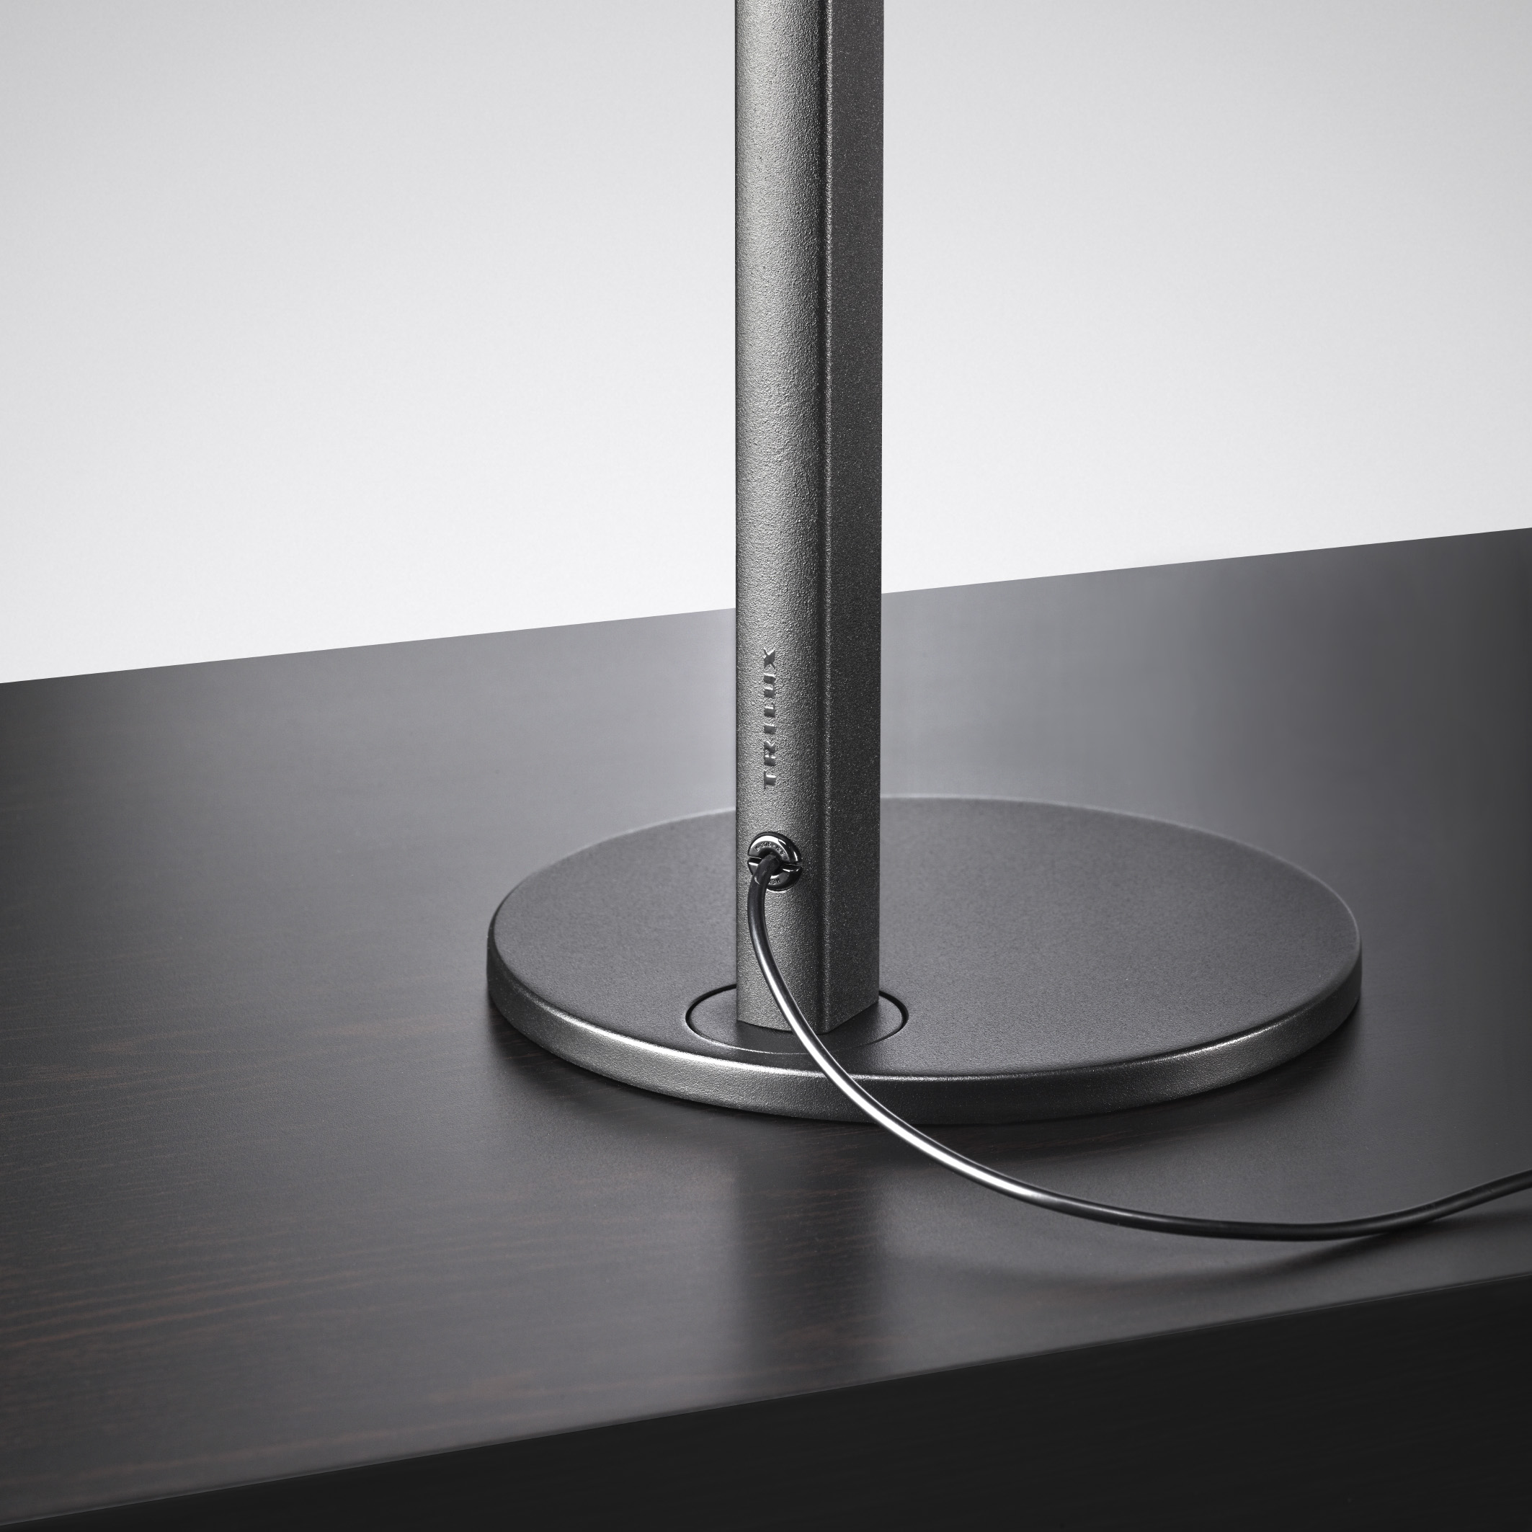
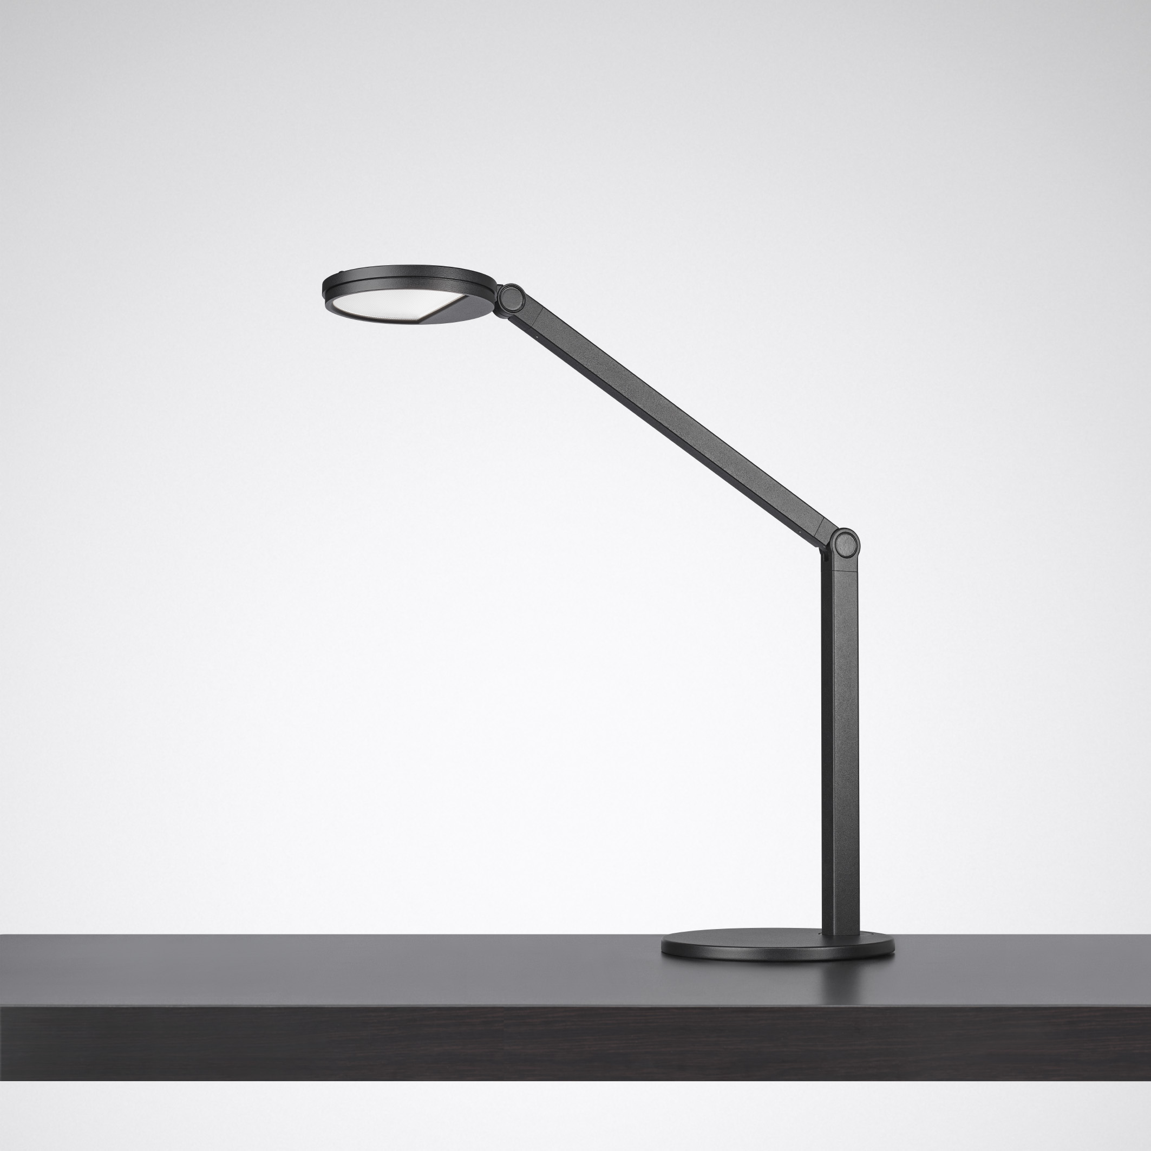
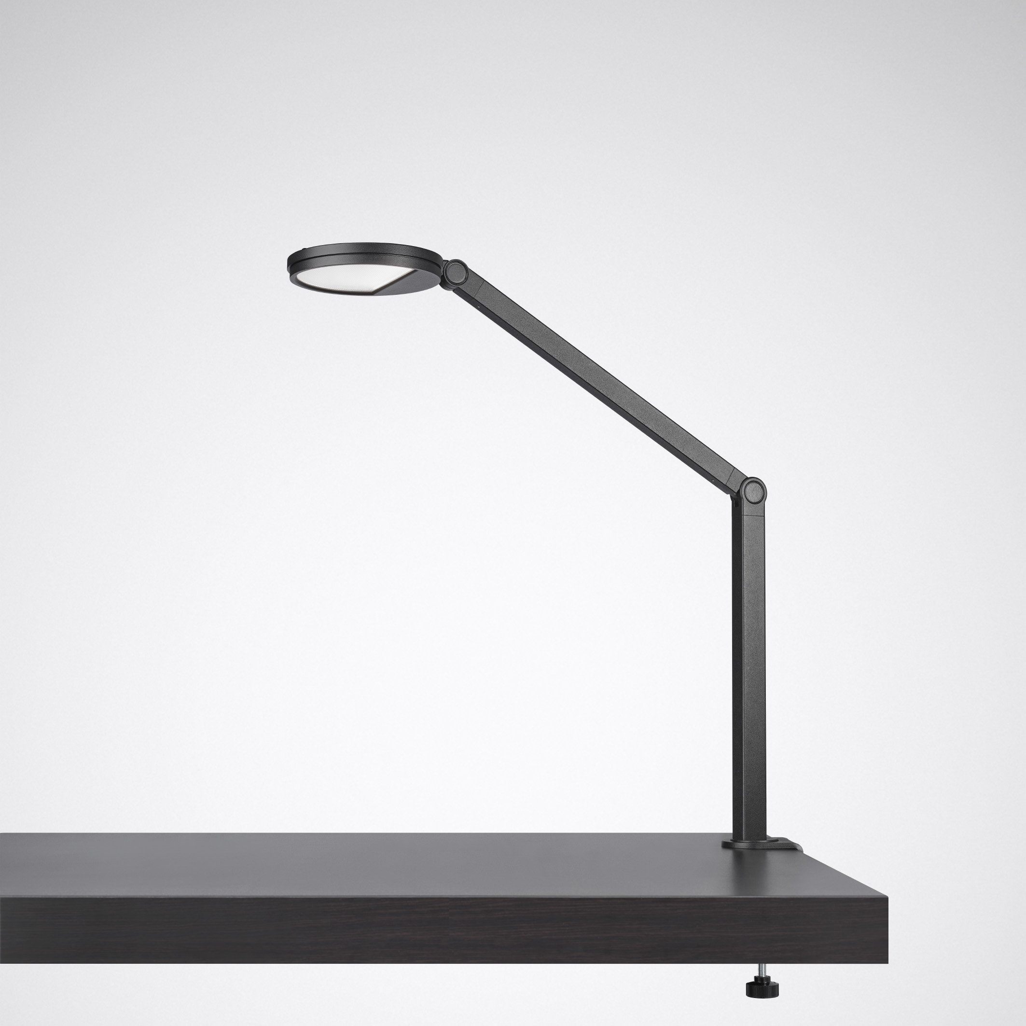
Mounting type - base plate or table clamp
Either classic with base plate - or with table clamp if there is little space on the desk. Can also be replaced at a later date.

Slide 14
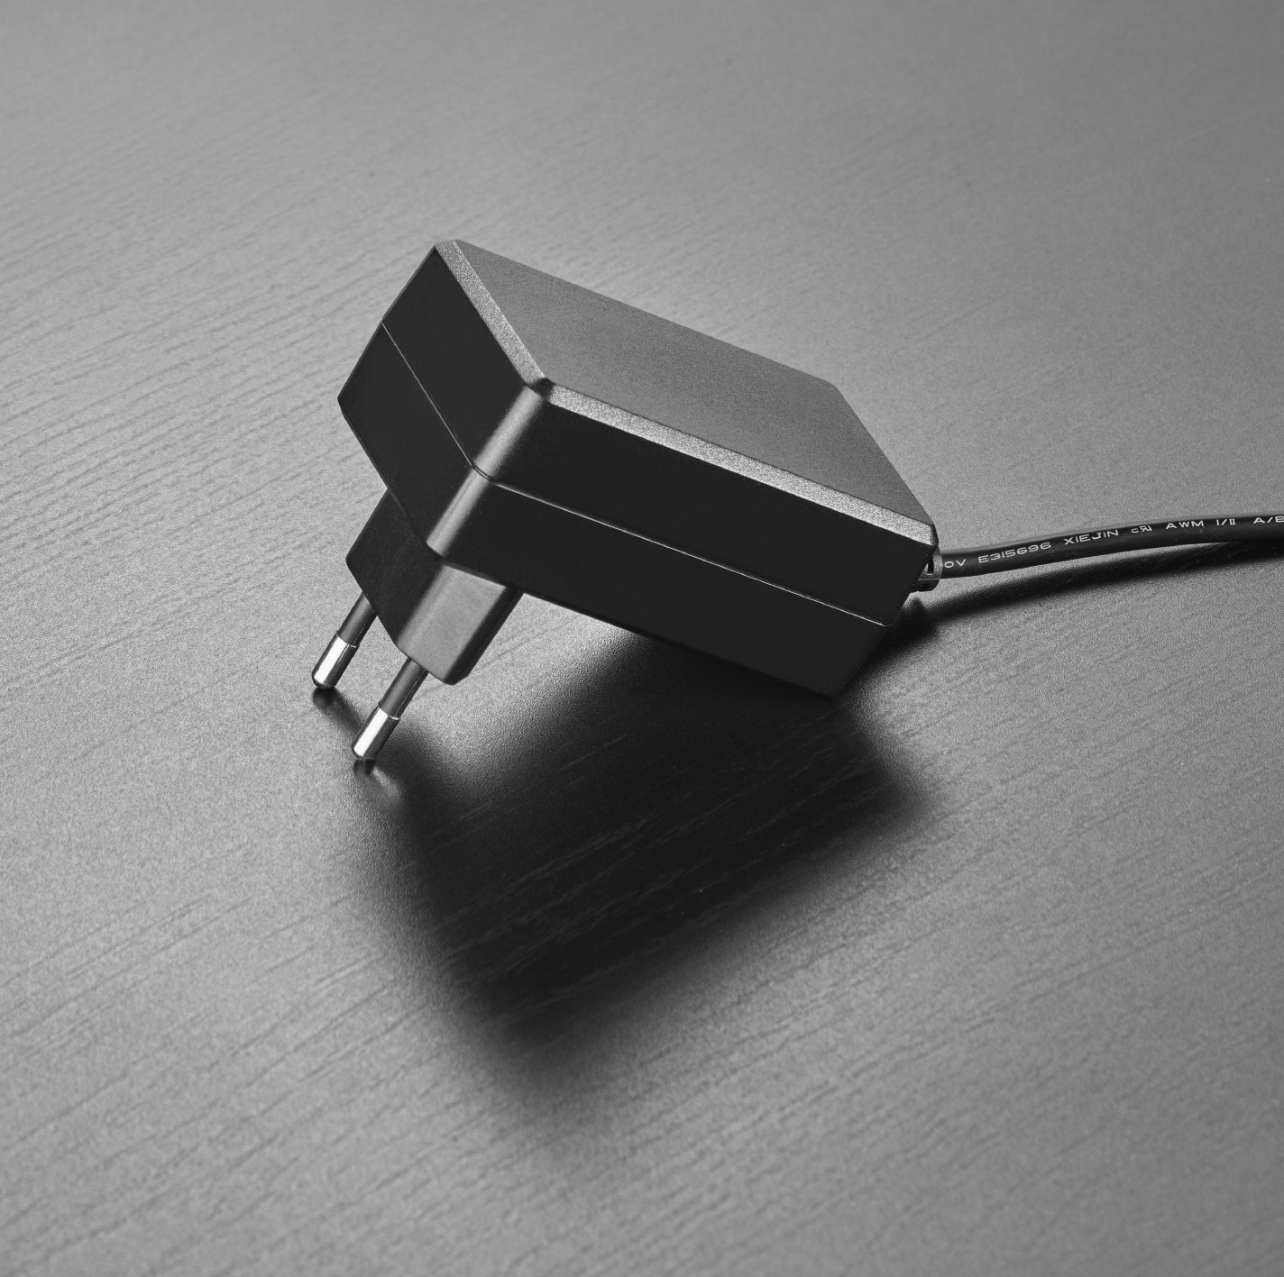
VARIANTS
Cultega - Portfolio
The scope of delivery of the luminaires TKs includes everything that is required for the operation of the luminaire:
  Luminaire
  Table base or table clamp
  Power supply unit
In addition, the power supply, table base and table clamp are available as separate spare parts.

Slide 15
The attractive design, the high-quality light (CRI>90) and the high adaptability make the Cultega LED a smart partner on the desk. Three joints enable precise alignment of the luminaire head. Light colour and intensity can be flexibly adjusted to individual needs and work tasks. Practical: frequently used light scenes can be saved and recalled via app - even at another workstation. Optionally also available as HCL variant to support the biorhythm.

Slide 16
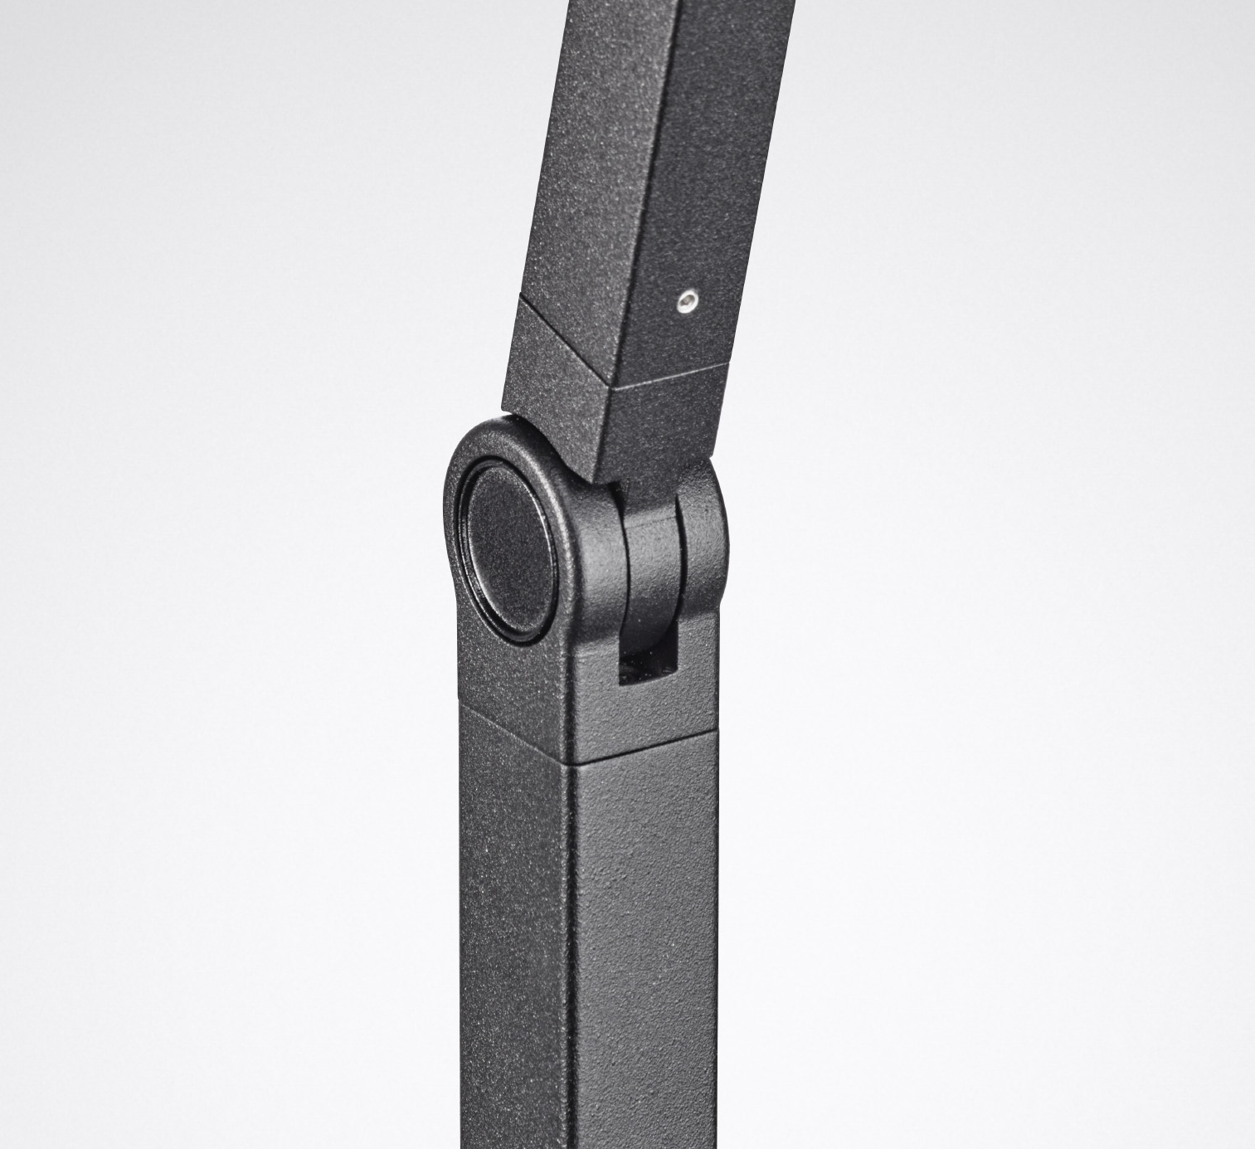
Extremely flexible - light where it is needed
Has the knack: Any area on the desk can be specifically illuminated via three high-quality joints
A desk lamp that is simply fun
Convinces not only by the quality of light: High-quality materials, excellent workmanship and haptics make the luminaire something special

Slide 17


LUCEOS SLIM
BICULT
CULTGEA

